Slide 1
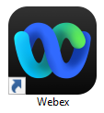
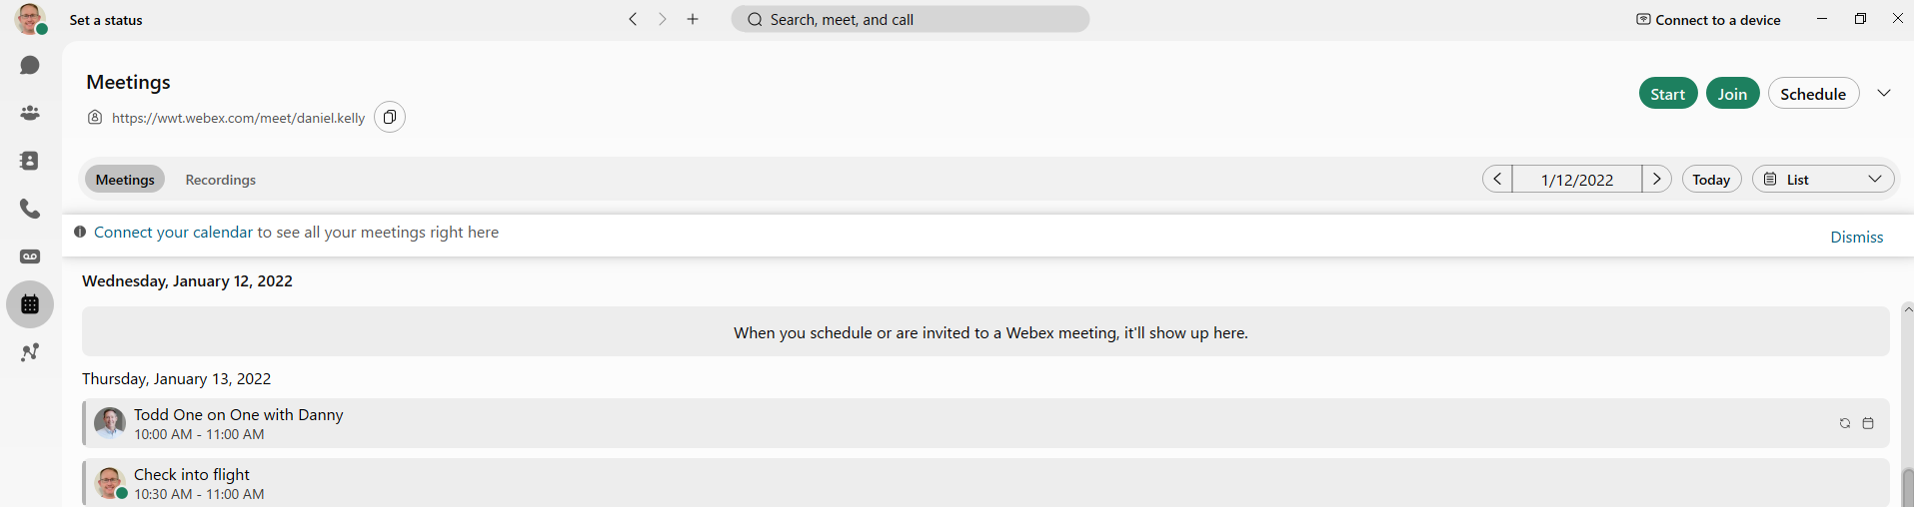
Webex – Meetings
Quick Reference Guide with Detailed Steps for Navigating Webex Meetings
1
Access Meetings
Open up Webex by clicking on the Webex shortcut.
On the left-hand side you will see a panel of icons, select the calendar icon to access a list of your upcoming meetings and to schedule meetings.
2
View Meetings
When the calendar icon is selected, you will see upcoming meetings scheduled on your Outlook calendar. Scroll up to view past scheduled meetings. You can also go to this tab to listen to any previous recordings.
Select a meeting to view meeting details, the meeting agenda, and the attendee list.
3
Meeting Capabilities
You can use these features from your toolbar while you are in a meeting.
Mute / Unmute your audio
Start / Stop your video
Share your screen or application
Record the meeting
Create Breakout Session assignments and start Breakout Sessions
Send reactions or raise your hand
Leave meeting
4
Join Meetings
Webex offers several ways to join a meeting. If you do not see these, select the dropdown for them to appear.
From the Meetings tab, select the Green button when a meeting is ready to start.
From the Meetings tab, select Join a meeting to search for a name to join their Personal Room, or enter a meeting number, video address, or meeting link.
Join by entering the video address found in your meeting invite.

Slide 2
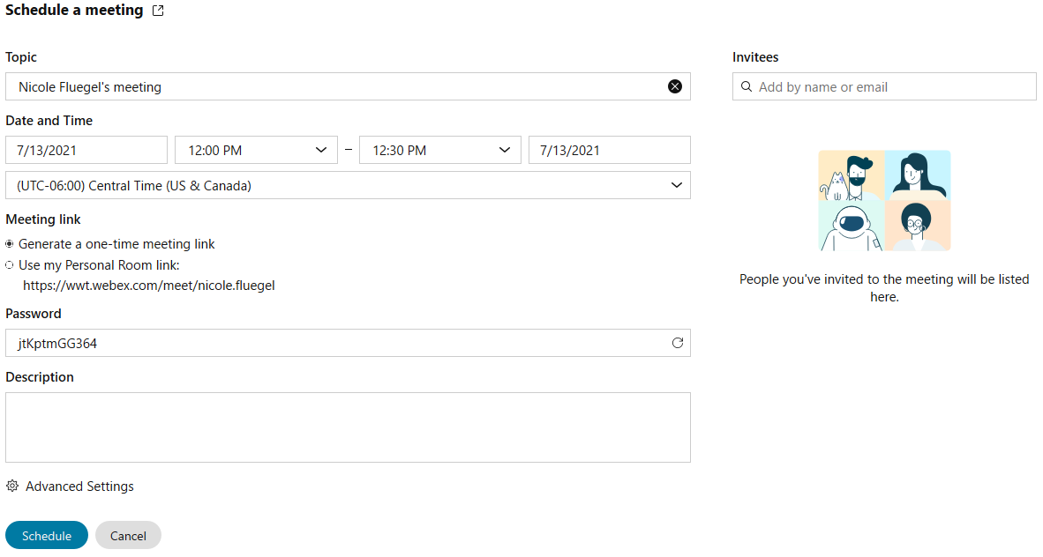
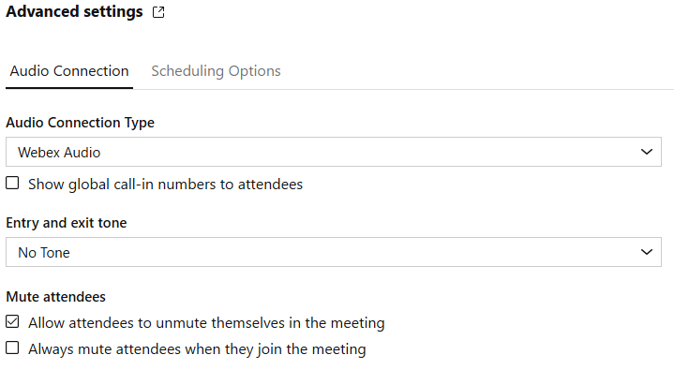
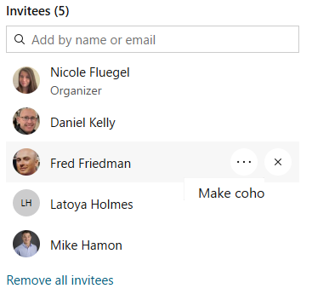
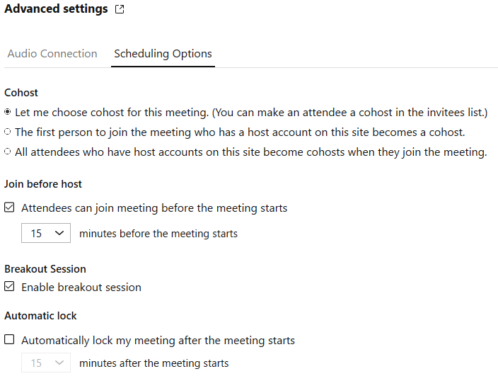
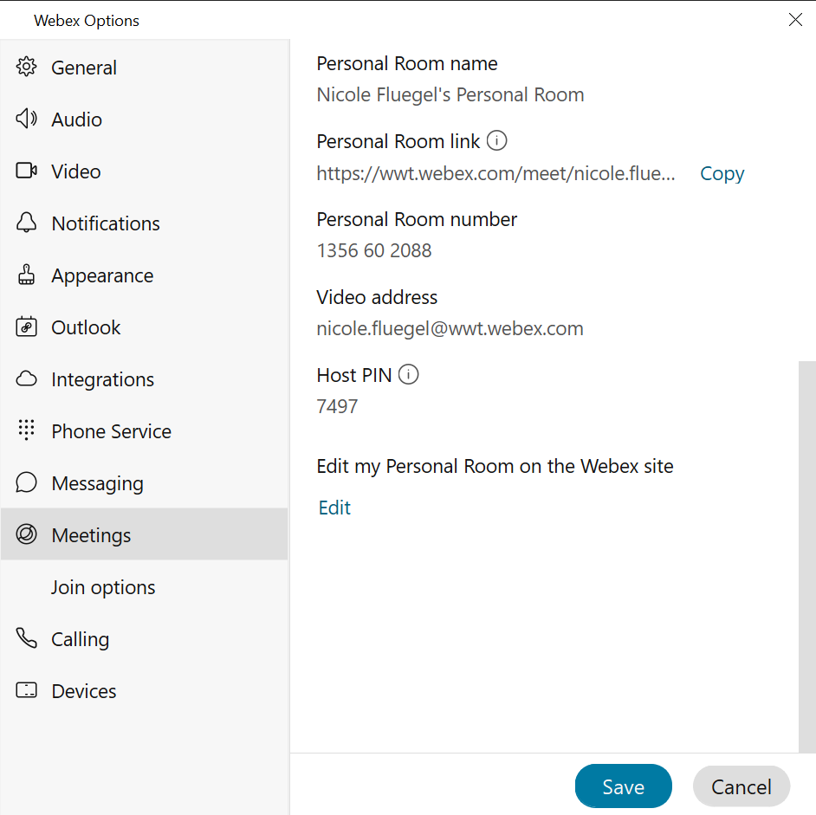
Webex – Meetings
Quick Reference Guide with Detailed Steps for Navigating Webex Meetings
5
Schedule a Meeting
Select Schedule a meeting to schedule meetings with internal or external participants from the Meeting tab.
Customize your meeting with a Title, Date, and Time.
Generate a one-time meeting link or use your Personal Room.
Using your Personal Room does not require a Password.
6
Invite Participants
7
Advanced Settings
Enter a person’s name or email under Invitees to invite them to the meeting.
Select to choose Audio Connection and Scheduling Option settings.
For One-Time Meeting Links only, hover over an internal invitee to select … and make them a co-host.
Select mute settings for attendees.
Select when attendees can start joining the meeting.
Tip: Allow attendees to join 15 minutes prior to the start.
Make Co-host
External invitees can be assigned as a co-host inside the meeting.
8
Change Personal Room Information
Edit you Personal Room information easily and quickly.
Select your profile picture in the Webex app.
Select Settings and then select Meetings.
Click Edit under Edit my Personal Room on the Webex site.
A webpage will open to your Webex site.
Choose your preferences for your Personal Room.
Click Save after all preferences are edited.

