Slide 1
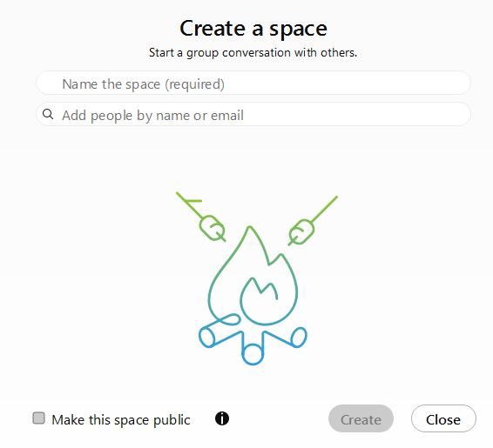
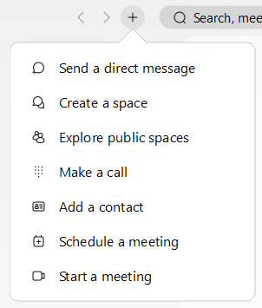
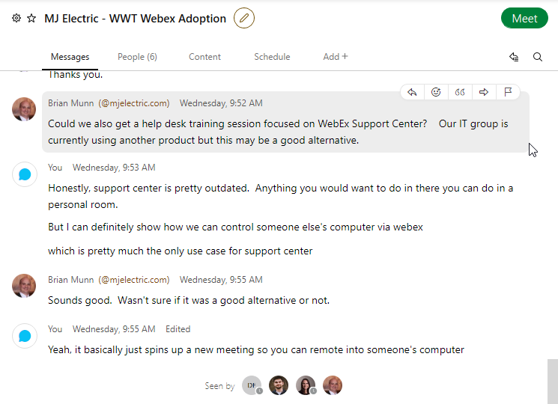
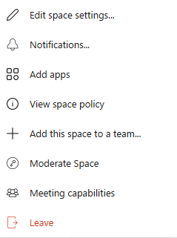
Webex – Spaces
Quick Reference Guide with Detailed Steps for Communicating in Webex
1
Creating a Space
Name your Space, then add your people by looking up their name or email.
Then select Create.
Select the + next to the Search bar.
Select the Create a Space option.
2
Navigating a Space
Edit the space name, add a space profile picture or background.
View threads you are apart of or search the entire Space.
Hover over a message within a Space to flag it for follow up, start a thread, add reaction, quote message, or forward a message.
Identify participants of the Space that have viewed the most recent content.
3
Messaging in a Space
When typing a message,
a BLUE line will appear when all members of the Space are within your organization.
Capture your screen to share with the Space by clicking the screen icon.
Insert your Personal Room URL to start an impromptu meeting.
YELLOW Group Icon, you can view a list participants from outside your organization.
Attach files, pictures, etc. by clicking the file icon.
@Mention someone in the Space to grab their attention via the @ icon.

Slide 2
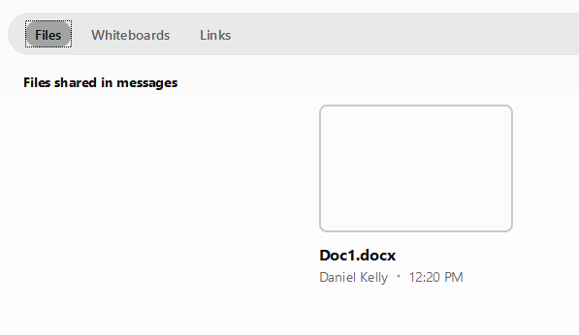
Webex – Spaces
Quick Reference Guide with Detailed Steps for Communicating in Webex
4
Chat Tabs
Messages- View all the current messages
Schedule- Schedule a meeting and invite everyone in the chat.
People- Add or remove people from a Space.
Content- View files, whiteboard, or links shared in the chat.

