Slide 1
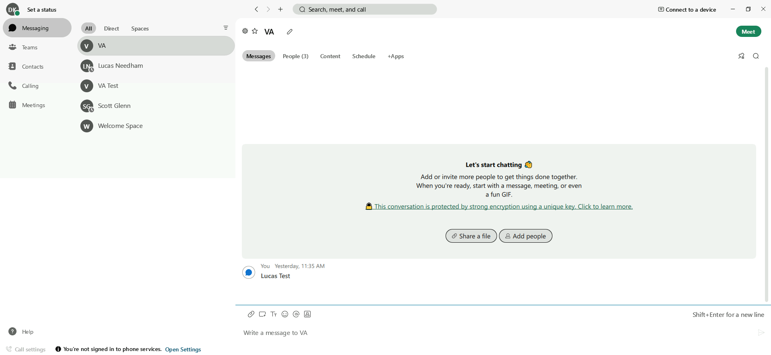
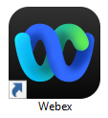
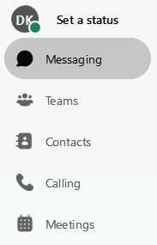
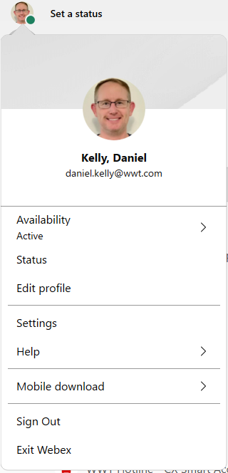
Webex – Overview
Quick Reference Guide with Detailed Steps for Navigating Webex
1
Webex
Cisco® Webex is an easy-to-use collaboration solution that keeps people and teamwork connected anytime, anywhere. Webex brings together messaging, file sharing, white boarding, video meetings, calling, and other tools you use to streamline teamwork and produce results faster.
Webex Navigation
2
Search Bar - Filter your messages based on selected search criteria. Available options include filtering by specific Notification, Unread, People, Favorites, @Mentions, Threads or Flags (those you’ve flagged for follow up).
Use the bar on the left-hand side to navigate throughout Webex.
Chat – Communicate with people individually or as a group within Spaces.
Teams – Create Teams to manage groups and projects. Use Spaces within the Teams for project specific communication.
Contacts – Organize frequently used contacts for quick access. You can also create custom contacts.
Meetings – See and join upcoming meetings. Can also jump directly into your personal room or schedule a future meeting.
3
Status, Profile, Settings, and more…
Select your profile picture in the top left corner to access addition options.
Availability – Availability will sync with Outlook and display if you are in a meeting. You can manually set to Do Not Disturb.
Set a Status – Select or create a custom status to let people know what you are doing.
Edit Profile – Change your profile picture or display name.
Settings – Adjust default Audio / Video selections, Color Theme & Notifications.

Slide 2
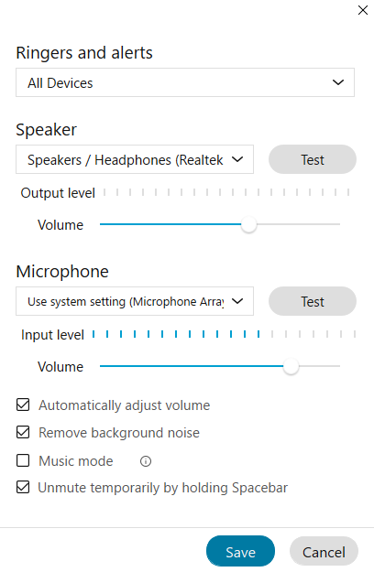
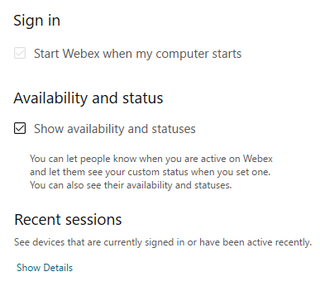
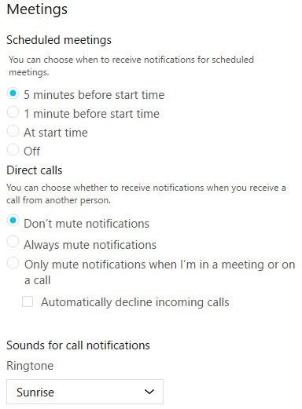
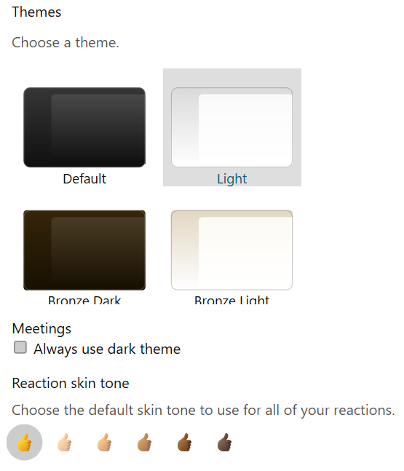
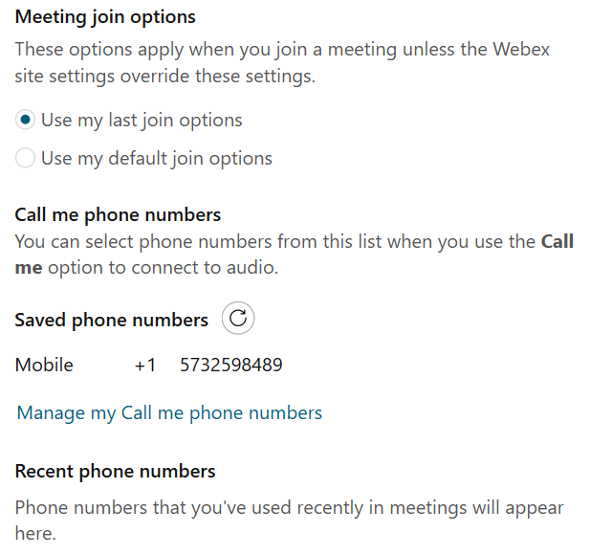
Webex – Overview
Quick Reference Guide with Detailed Steps for Navigating Webex
4
Settings
Find additional options after selecting your profile image > Settings. Select the desired tab to adjust settings.

