Slide 1

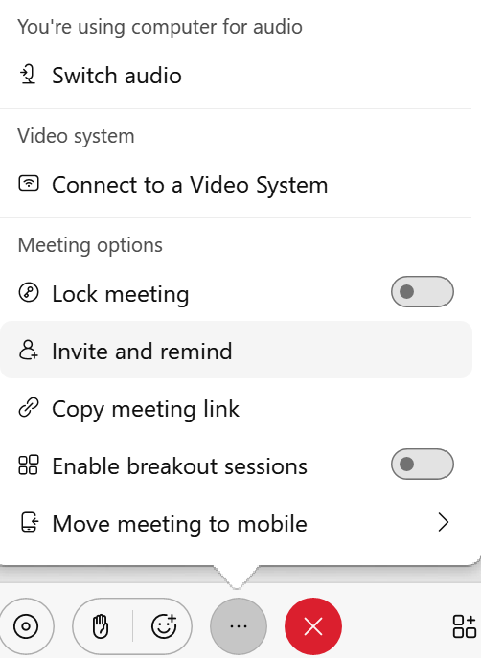
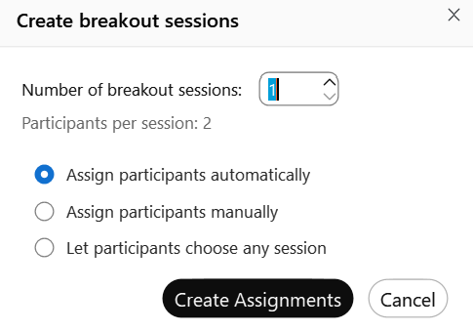
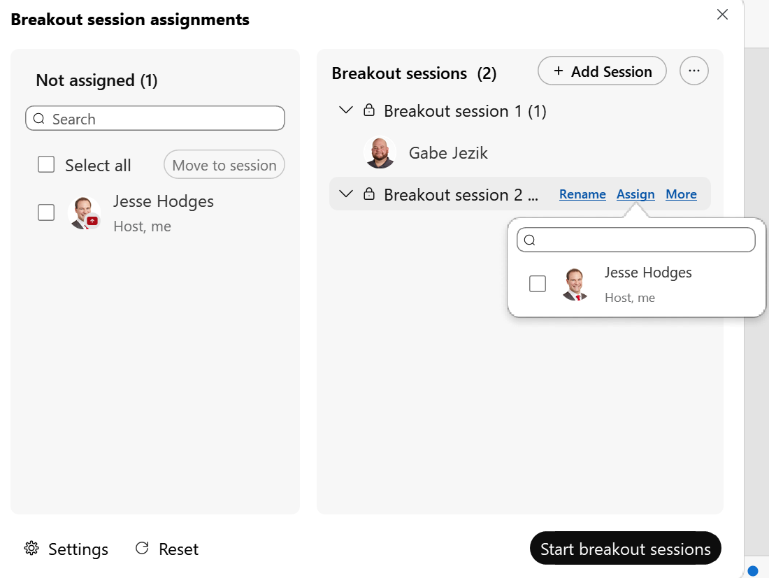
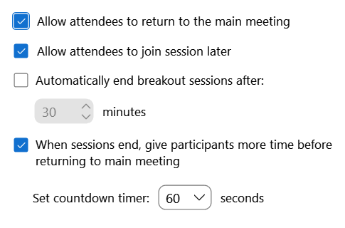
Webex – Breakout Sessions
Quick Reference Guide with Detailed Steps
for Using Breakout Sessions
1
Enable Breakout Session
Access Breakout Sessions by selecting the … on the lower bar. Select the slider to enable Breakout Sessions.
2
Breakout Session Assignments
When selecting a Breakout Session button for the first time you will be prompted to choose how many sessions you want to create and if you want automatic assignments. Choose Create Assignments to open the Breakout session assignments window.
    Uncheck if you want to force participants to stay in their session.
    Uncheck to force participants into the session.
    When ready, choose Start breakout sessions.
    If you chose to automatically create assignments, the host will not be giving a session.

Slide 2
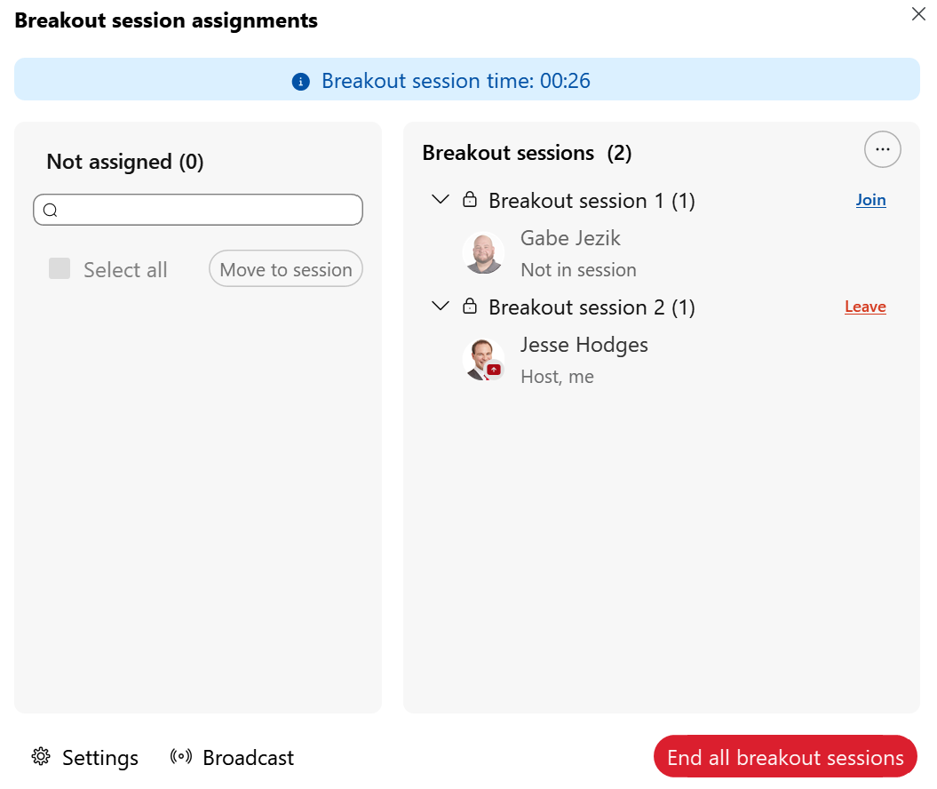
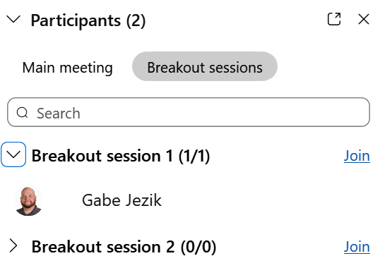
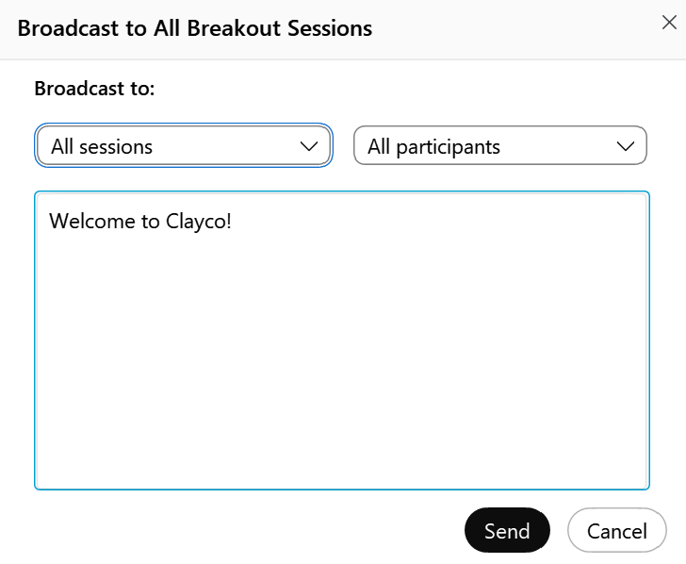
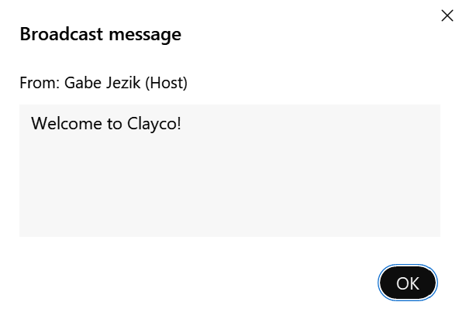

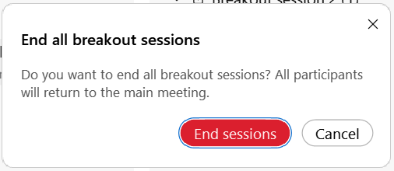
Webex – Breakout Sessions
Quick Reference Guide with Detailed Steps
for Using Breakout Sessions
3
Managing Breakout Sessions
The host and cohosts continue to manage the Breakout Sessions while they are in progress. The sessions can be viewed in both the session assignment window or the Breakout sessions tab within the Participants panel
4
Broadcast
From the Participant panel, choose Broadcast to send a message. The Broadcast can be sent by session or participant type.
5
End Session
The host/cohost can recall participants back to the main meeting and keep the sessions open or they can end the breakout sessions all together.

