Slide 1
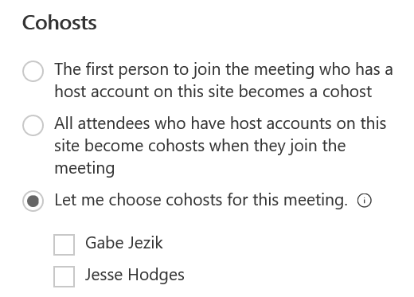
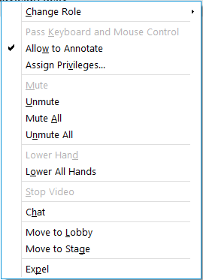
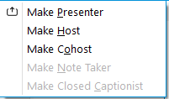
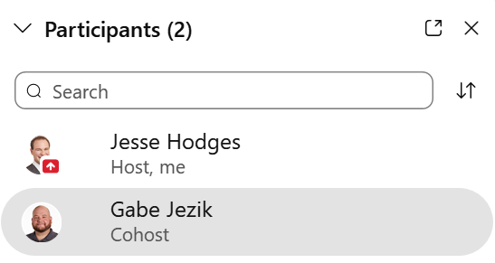
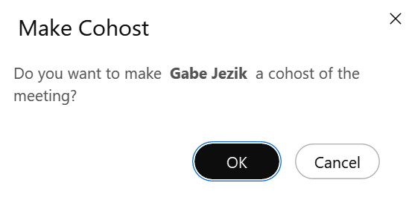
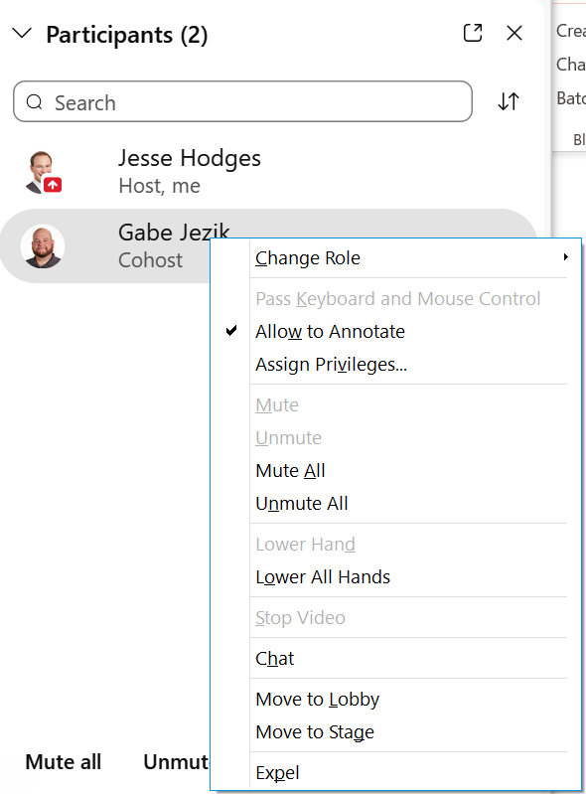
Webex – Hosting a Meeting
Quick Reference Guide with Detailed Steps for Hosting a Webex Meeting
1
Add Alternate / Cohosts While Scheduling a Meeting
Open the meeting invite and click Webex Preferences in the productivity tools banner.
Scroll down to the Cohost section to select which option works best. Cohost must be attendees on the meetings.
2
Assign Cohost During the Webex
You can also assign one or more cohosts by right clicking on participants.
Cohost privileges include:
Mute/Unmute Audio, Stop Video
Move/Admit from lobby, Expel
Lock/Unlock and End Meetings
Manage breakout session assignments
Control the stage layout of cameras and what’s being presented
3
Control Audio During a Meeting
The host has complete control of the audio experience from within Webex.
Webex identifies call noise and indicates the participant speaking in the full screen. When hovering over their name, click the microphone icon to mute.
To mute all participants, right click any name in the participants list and then select Mute All. Click Unmute to unmute all participants
With the participant list open, click the microphone icon next to the participant’s name.

Slide 2
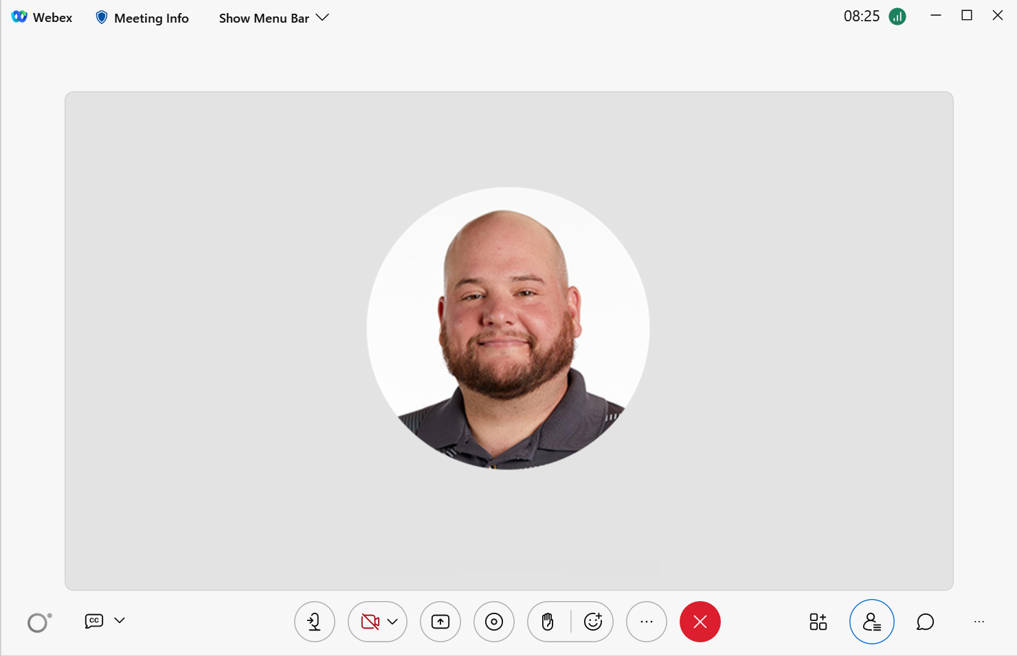
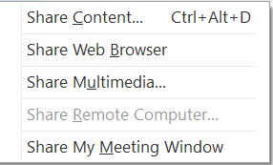
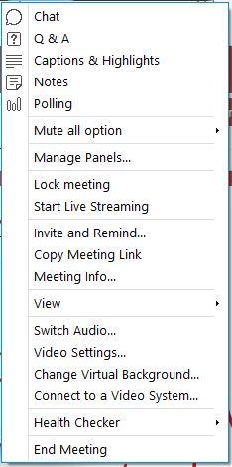
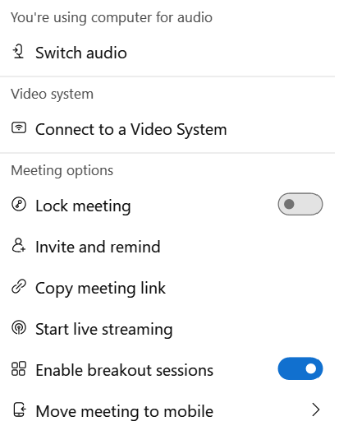
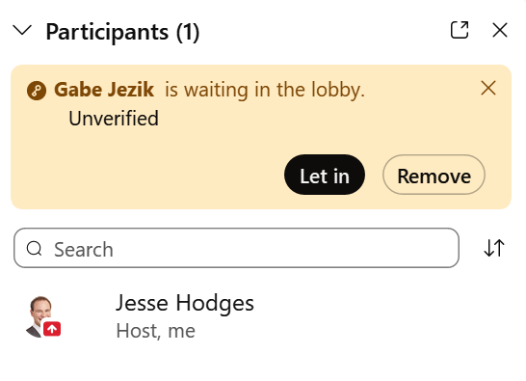
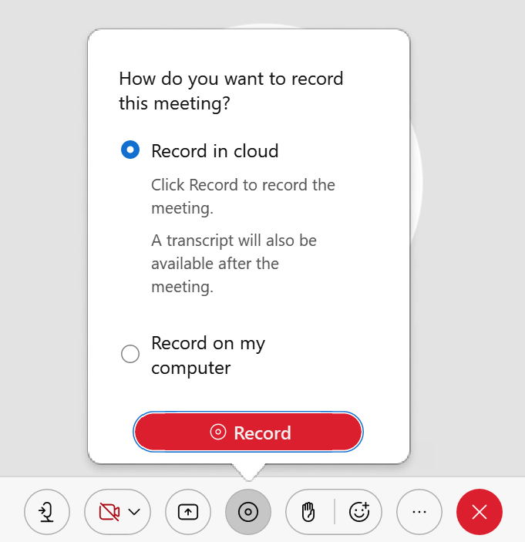
Webex – Hosting a Meeting
Quick Reference Guide with Detailed Steps for Hosting a Webex Meeting
4
Share Content
There are several ways to share content with participants within a Webex meeting. The methods are as follows:
Click the Share icon in the tool bar. Select what you would like to share from the options provided (e.g., desktop, a specific file, or a single application). **Sharing an application or specific file will avoid unwanted pop-ups being shared with the viewers.
From the tabbed menu across the top of the Webex meeting screen, click the Share Tab. Select what you would like to share form the options provided.
When you are sharing your screen, there is an orange drop down bar you that is accessed by moving your cursor to the top. Use these options to pull up the chat or participants panels.
Click to open a picture in picture view to verify what your participants are seeing.
5
Managing your Personal Meeting Room (PMR)
Take control of who comes and goes by locking your PMR.
Lock your PMR for privacy by clicking the ellipsis (…) then Lock Meeting.
When someone is in your Personal Room Lobby, you will be notified at the top of the Participants panel.
You can choose to let the person in or remove them from your lobby.
Remove participants from your meeting by right-clicking their name in the participants list and clicking Move to Lobby or Expel.
6
Recording
If you choose Record in cloud you will receive an email when your recording is ready.
Both hosts and cohost can manage the recording but the .mp4 will be saved on the host’s account or computer.
Record your meetings to re-play in the future.
Click the record button in the toolbar and then click record.

