Slide 1
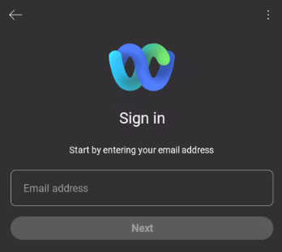
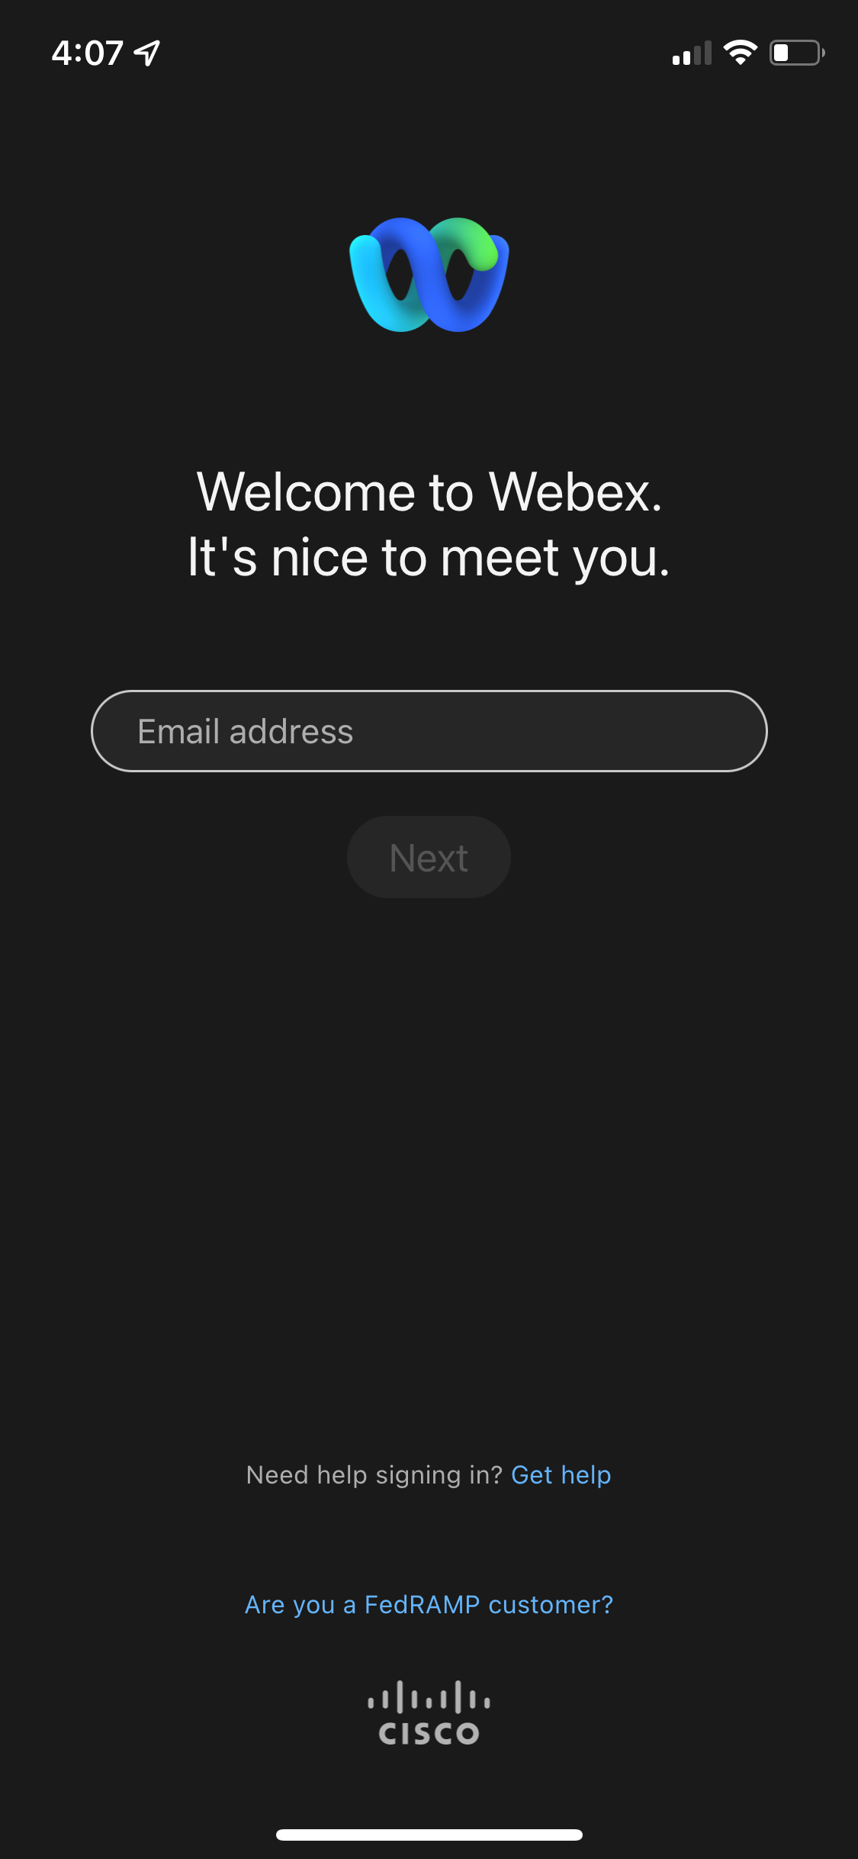
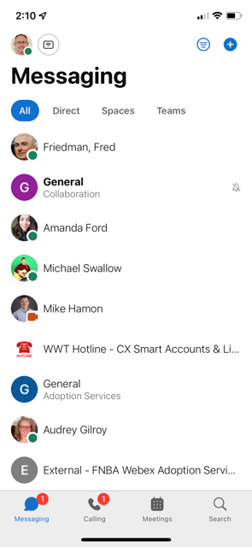
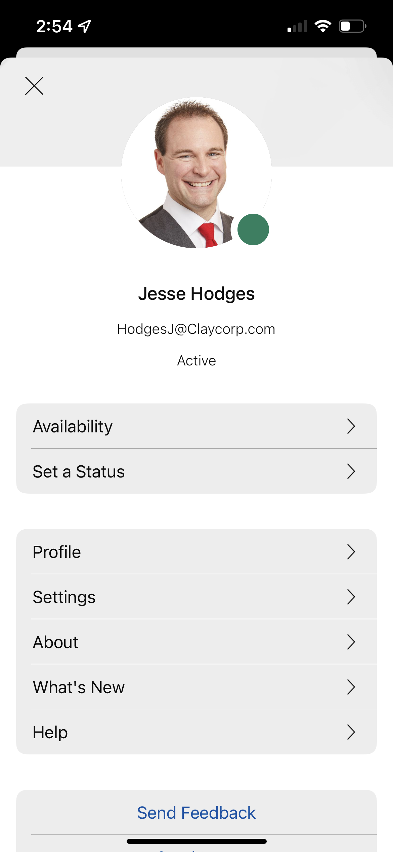
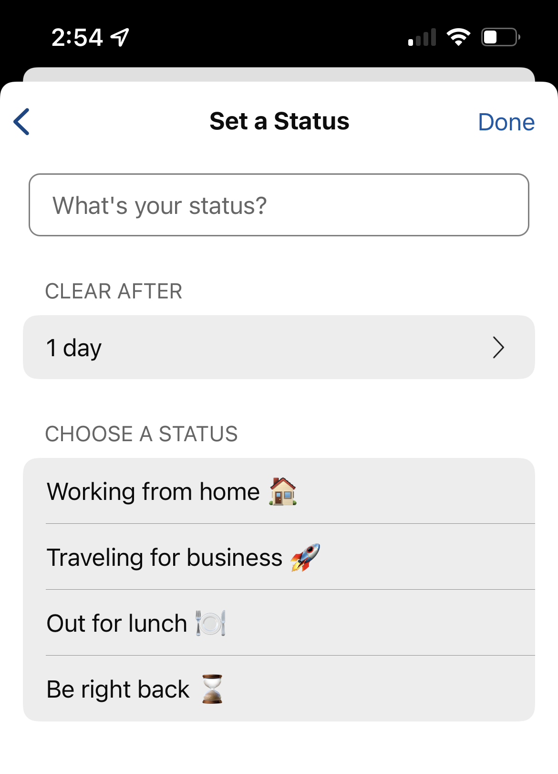
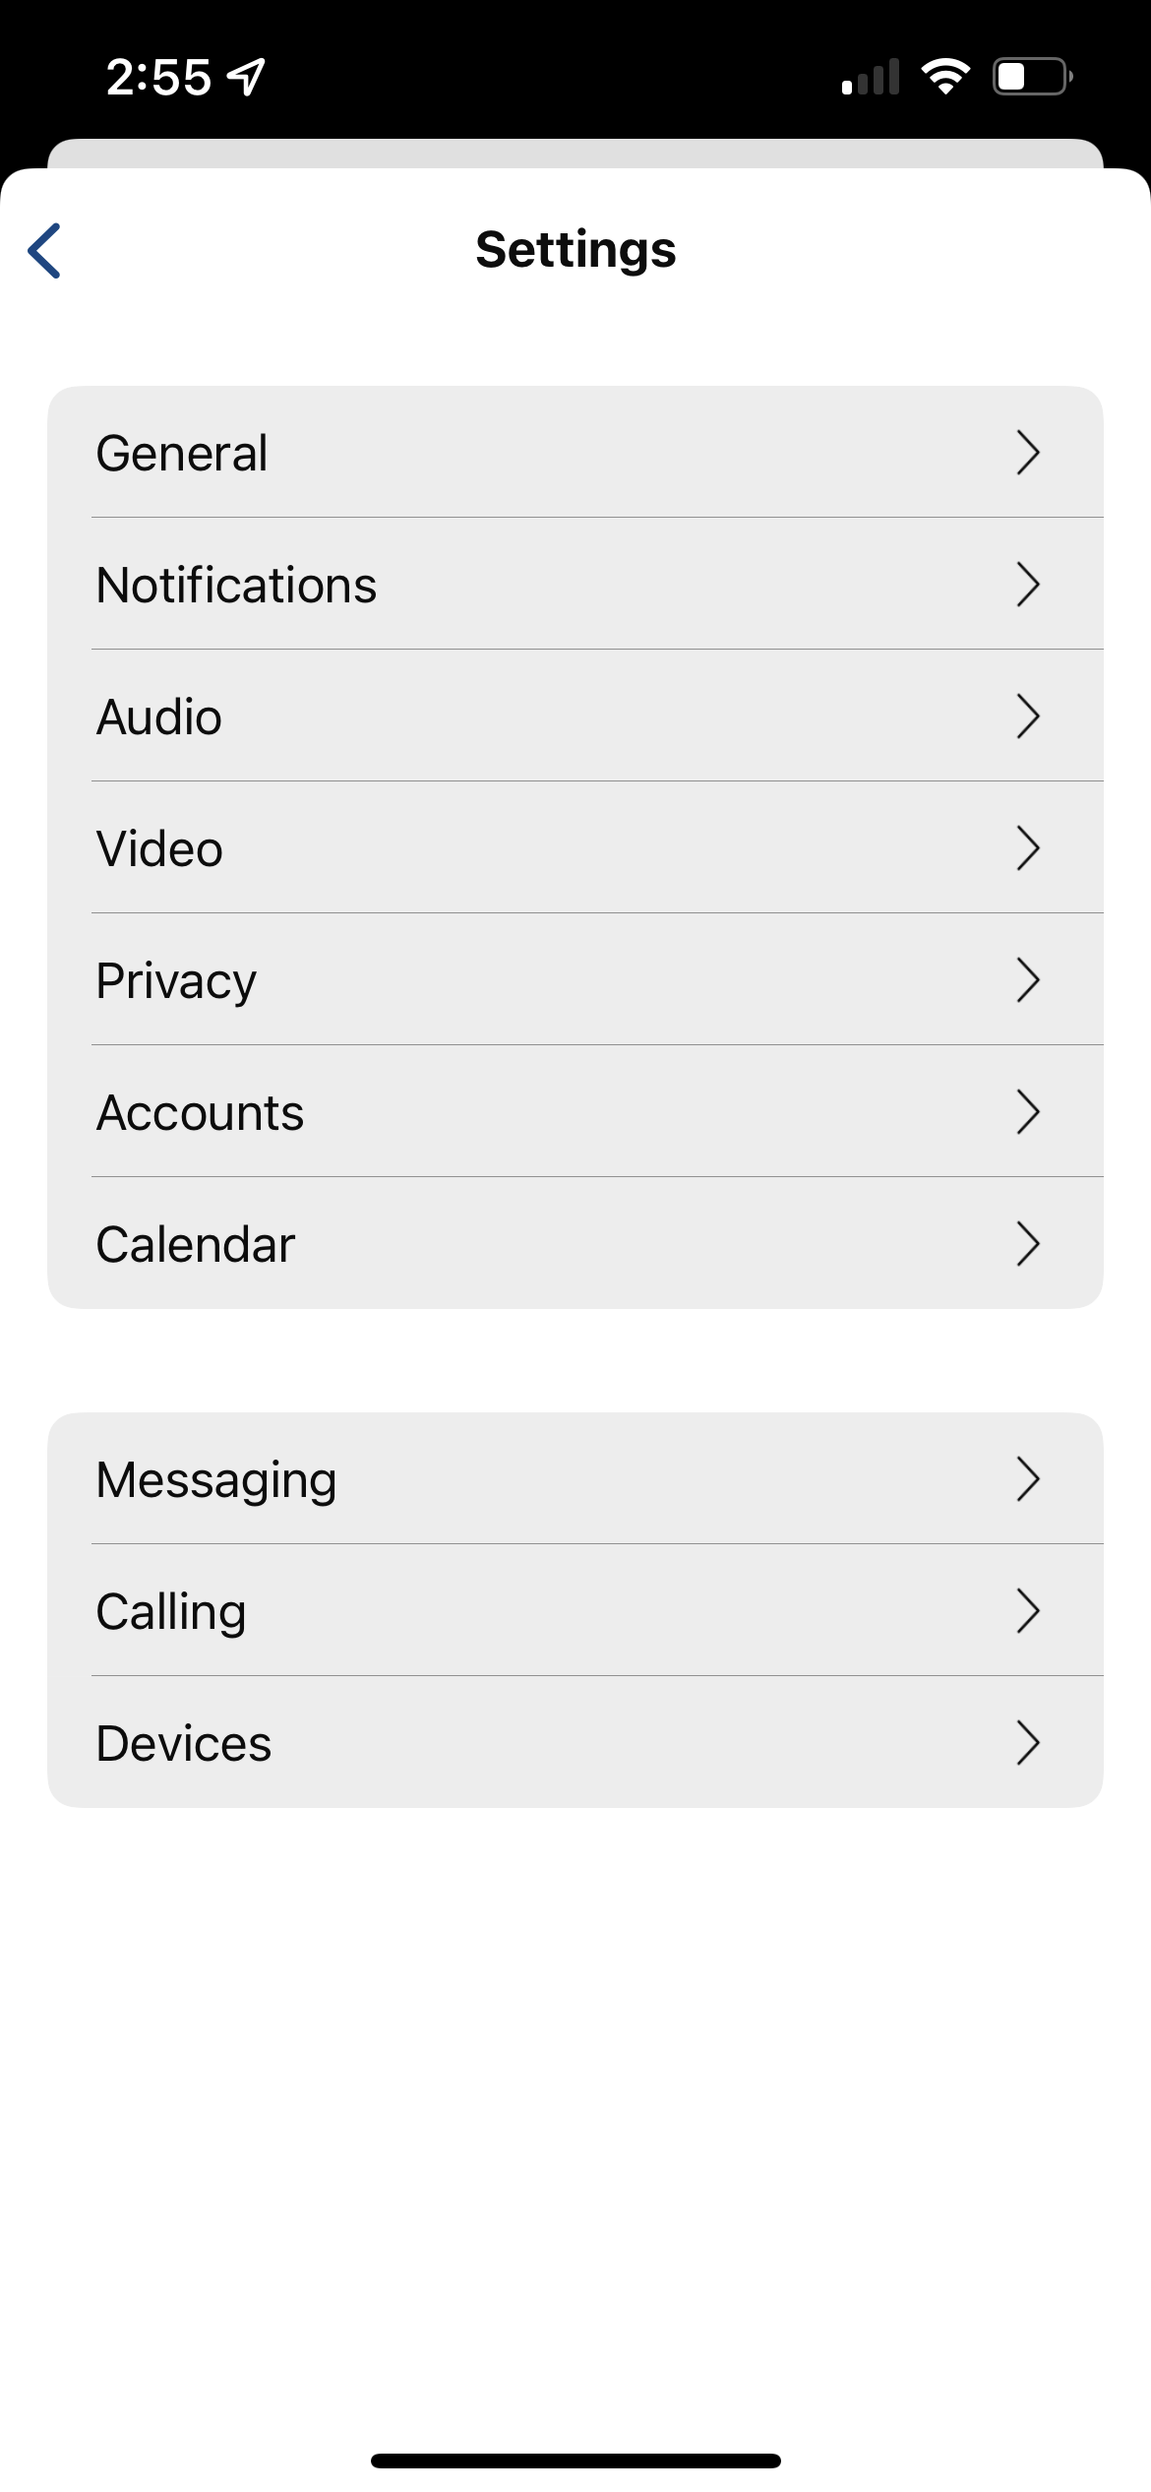
Webex – Mobile App
Quick Reference Guide with Detailed Steps for Using the Webex Mobile App
1
Download and Sign-in to Cisco Webex
Download the Webex Mobile app by searching in the Android Play Store or iOS App Store.
Android
iOS
Use your e-mail address
2
Settings and Tab Navigation
Select your profile picture to bring up additional settings. Navigate through the Webex App functions at the bottom of the screen.
Choose your collaboration tool at the bottom navigation bar.

Slide 2
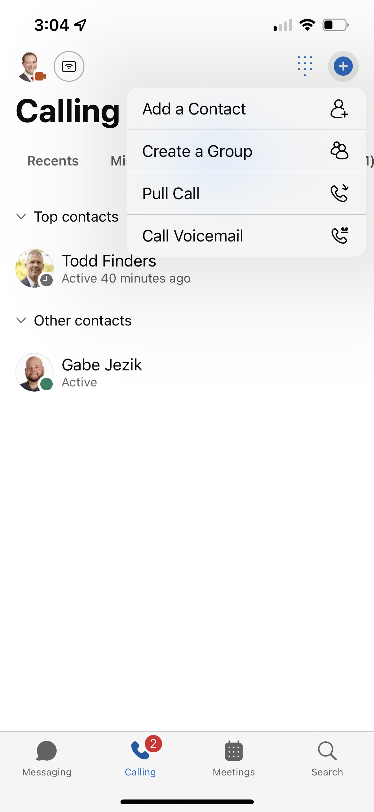
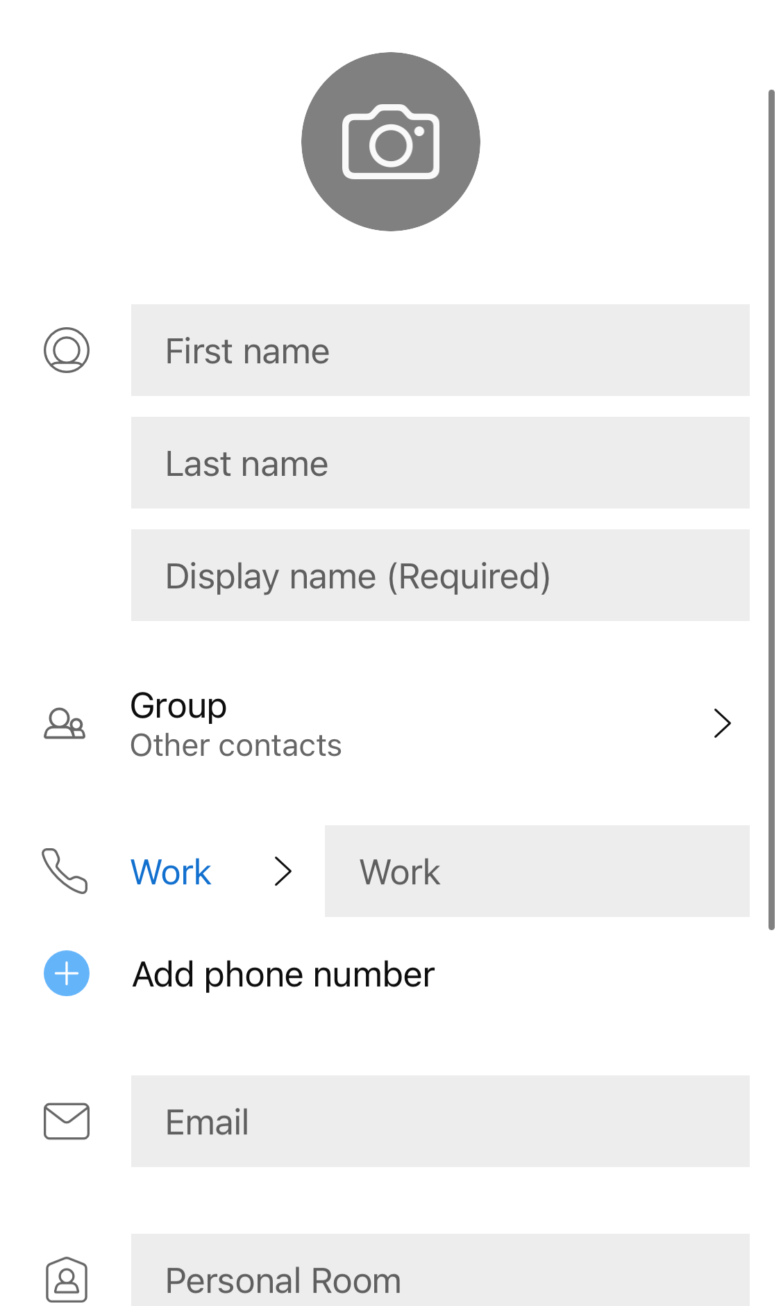
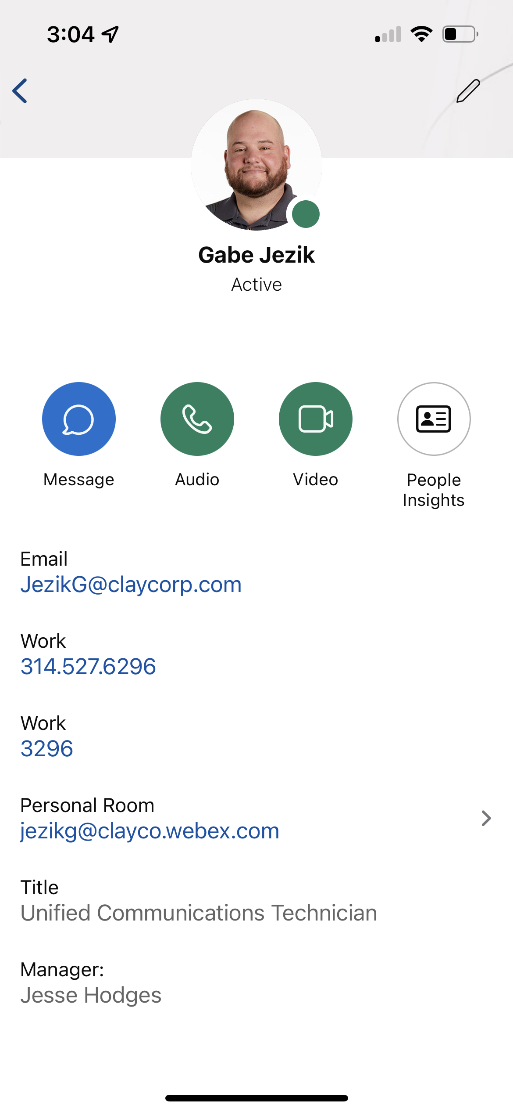
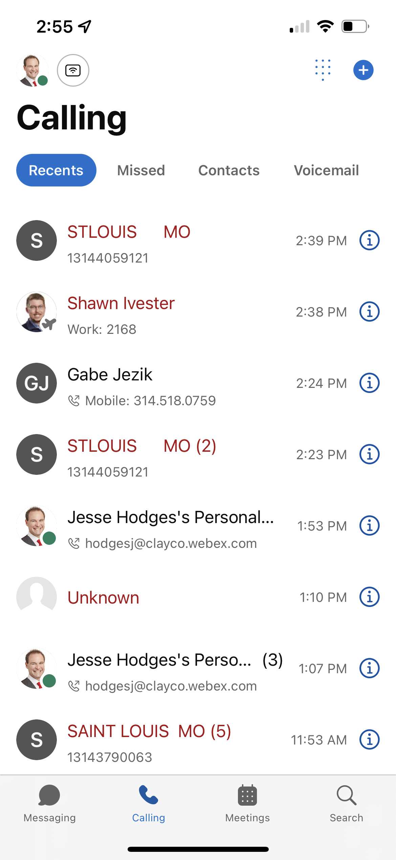
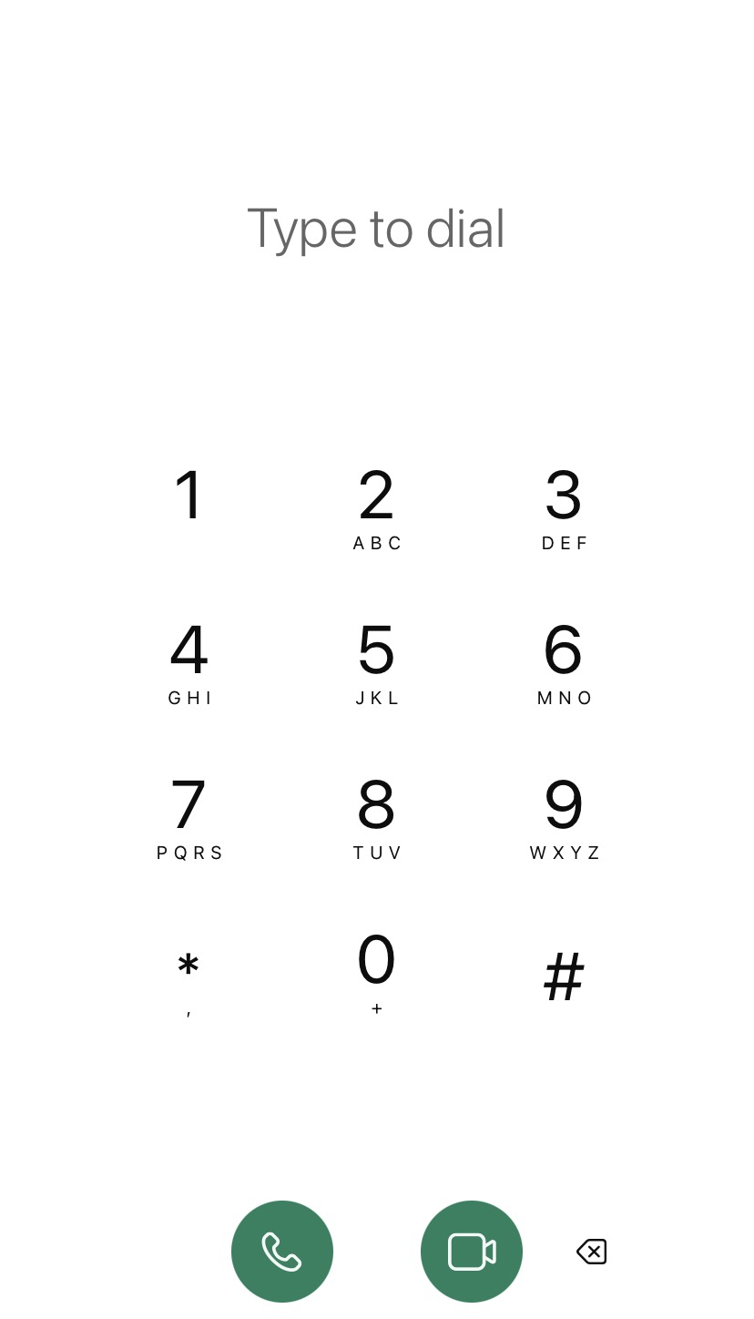
Webex – Mobile App
Quick Reference Guide with Detailed Steps for Using the Webex Mobile App
3
Contacts
Organize frequent contacts into groups or create a new custom contact. These are different than your contacts on your phone.
View information and contact them directly with a message or call.
4
Calling and Voicemail
View recent meetings or Webex Calls (not standard telephone calls), use the dial pad to enter and navigate through the voicemail system.

Slide 3
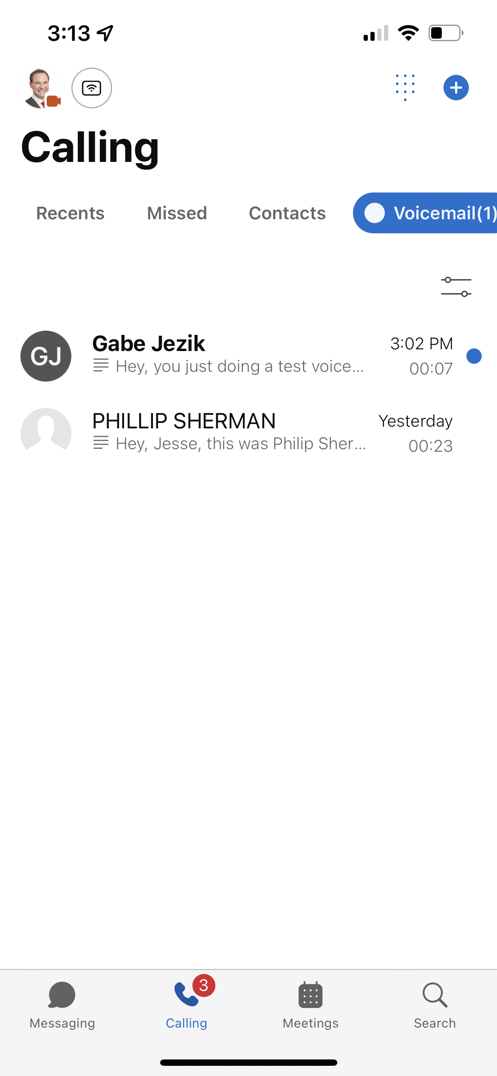
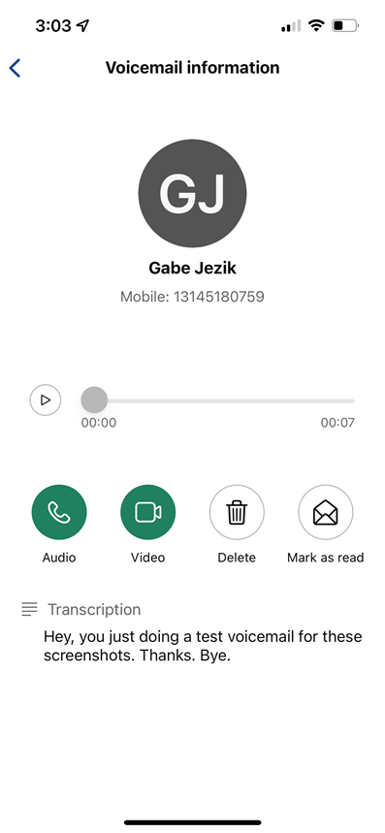
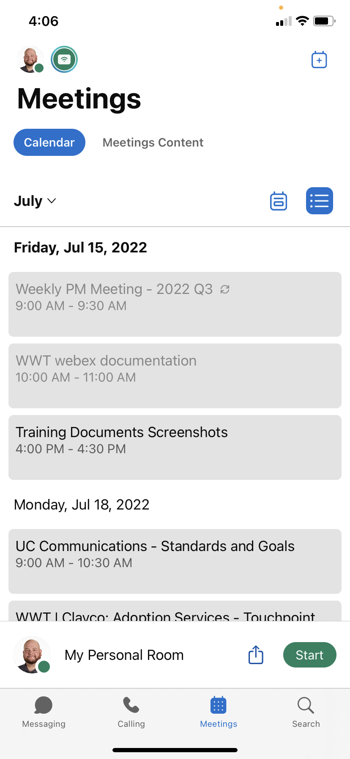
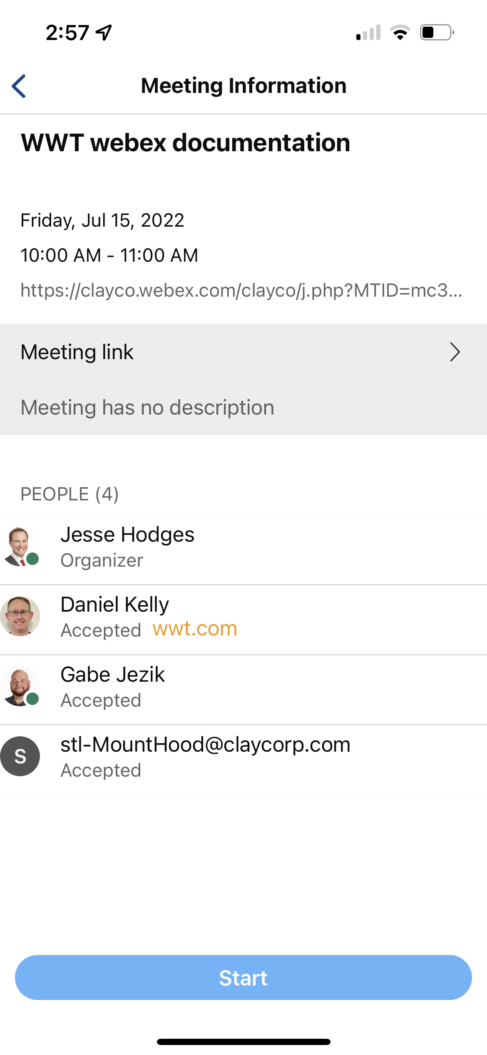
Webex – Mobile App
Quick Reference Guide with Detailed Steps for Using the Webex Mobile App
5
Calling and Voicemail continued…
Within Calling, you can select the tab to listen to Voicemail.
Play to listen
Call back or manage the voicemail
6
Meetings
View upcoming meetings and join when applicable or jump directly into your personal room.
Click to join meeting
Click to join meeting

