Slide 1
Join a Microsoft Teams meeting from a Webex Endpoint
When you schedule a Microsoft Teams meetings and include Cisco devices, a Join Button appears on the devices.
Right before the meeting begins, on your device or Touch controller displays, Tap the Join Button to enter the meeting.
Need additional help? TIP: Expect 40 seconds or more of a delay…..

Slide 2
Contact Enterprise Video Teleconferencing Network or CCS Video if you have any issues or need further guidance using the Webex Video Devices.
Scan the QR code to view videos and how-to guides
Need additional help? Scan the QR code and check out the VA IT Modernization Community Page for tutorials, quick reference documents and FAQs

Slide 3
You can make a Phone call with a Webex Endpoint
Tap the Call icon on the Touch Controller’s home screen
Add 9 in front of the number (no 1 for long distance is needed) eg 98885641894
Tap Call
NEW IMAGE
No phone required!
Need additional help? Scan the QR code and check out the VA IT Modernization Community Page for tutorials, quick reference documents and FAQs

Slide 4
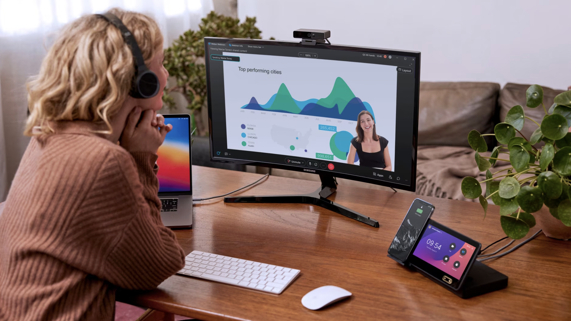
Webex Webinars
Up to 1,000 participants (request SNOW ticket for webinars over 1,000 participants).
Create a series of webinars
Upload content before a webinar for attendees to browse
Speaker and host bios pre-webinar
Landing pages and registrations for events
Lobby Music
Breakouts
Need additional help? Scan the QR code and check out the VA IT Modernization Community Page for tutorials, quick reference documents and FAQs

Slide 5
Cinematic Mode with Webex Endpoints
See who you’re talking to
See the reactions of everyone in the meeting
Understand the situational context of participants
Feel like part of the discussion
Need additional help? Scan the QR code and check out the VA IT Modernization Community Page for tutorials, quick reference documents and FAQs

Slide 6
Room OS is coming to this endpoint *date
See the [Video team sharepoint for detailed info]

Slide 7
Room OS will alter the touch pad controls
Aimed at having a more “App-like” feel
Specific examples:
Video call icons, phone call icons, etc
Expanded features in Webex Meetings
Allows MS Teams integration

Slide 8
Be Aware, Webex and Teams have some bugs
Calls take around a minute to connect
Enhanced features are not supported
Feature
Feature
Feature
Video Endpoints have to be added as attendees in the MS Teams in the meeting invite (similar to other participants) – however, they can’t be added on the fly (via add participant in the meeting, for example)

Slide 9
For best results
The best quality experience is to use Webex Meetings for calls using Video Endpoints

Slide 10
2 ways to Join Webex Meetings
Schedule the endpoint in the Webex Meeting
Add the system using system name in Outlook
Dial 9500 from any endpoint
At the prompt, enter the meeting number of any running Webex Meeting

