Slide 1
Strategic Framework Agreement Kickoff
Jim Shupe, Cisco CX Leader
Donna Herr, WWT CX Leader
September 2024

Slide 2
01
Team Overview
Agenda
02
Cisco Services Review
03
WWT Services Review
04
Next Steps

Slide 3
Team Overview

Slide 4
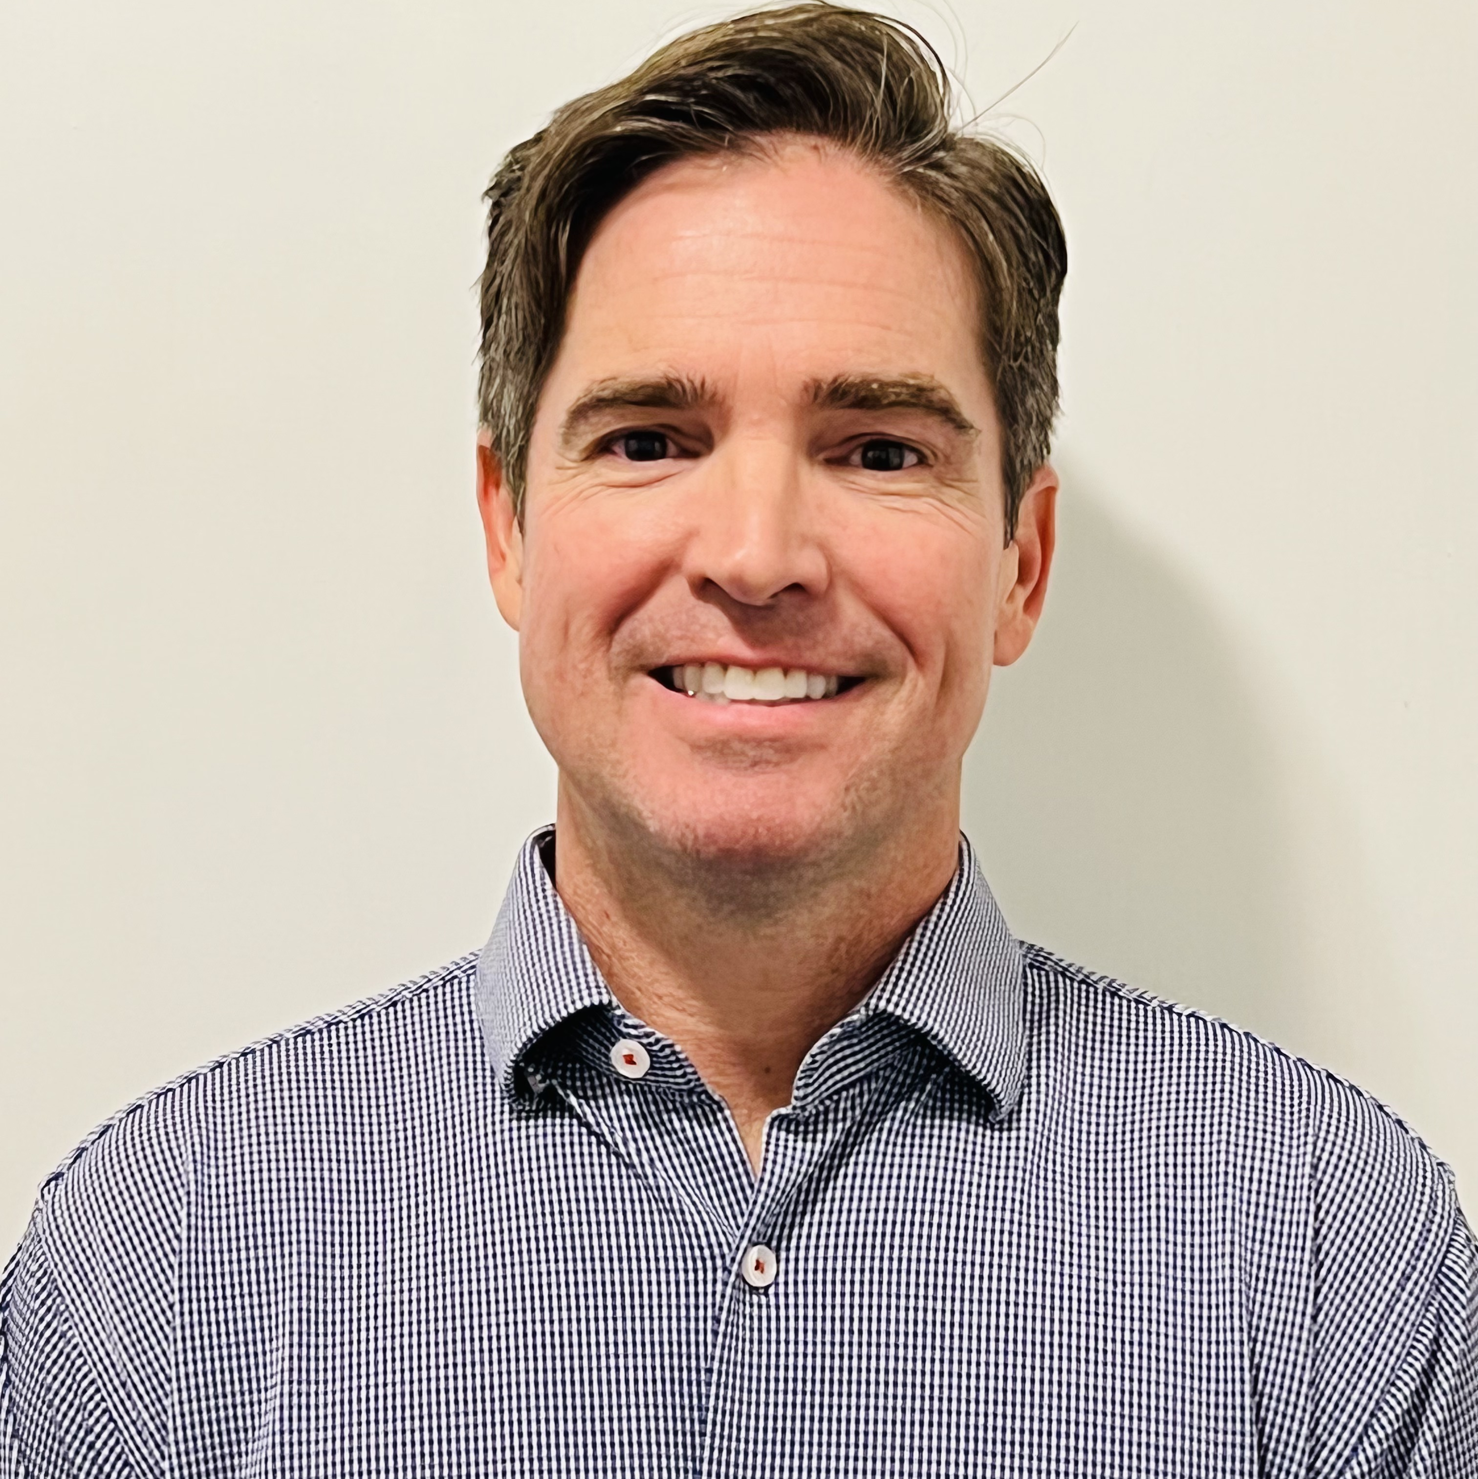
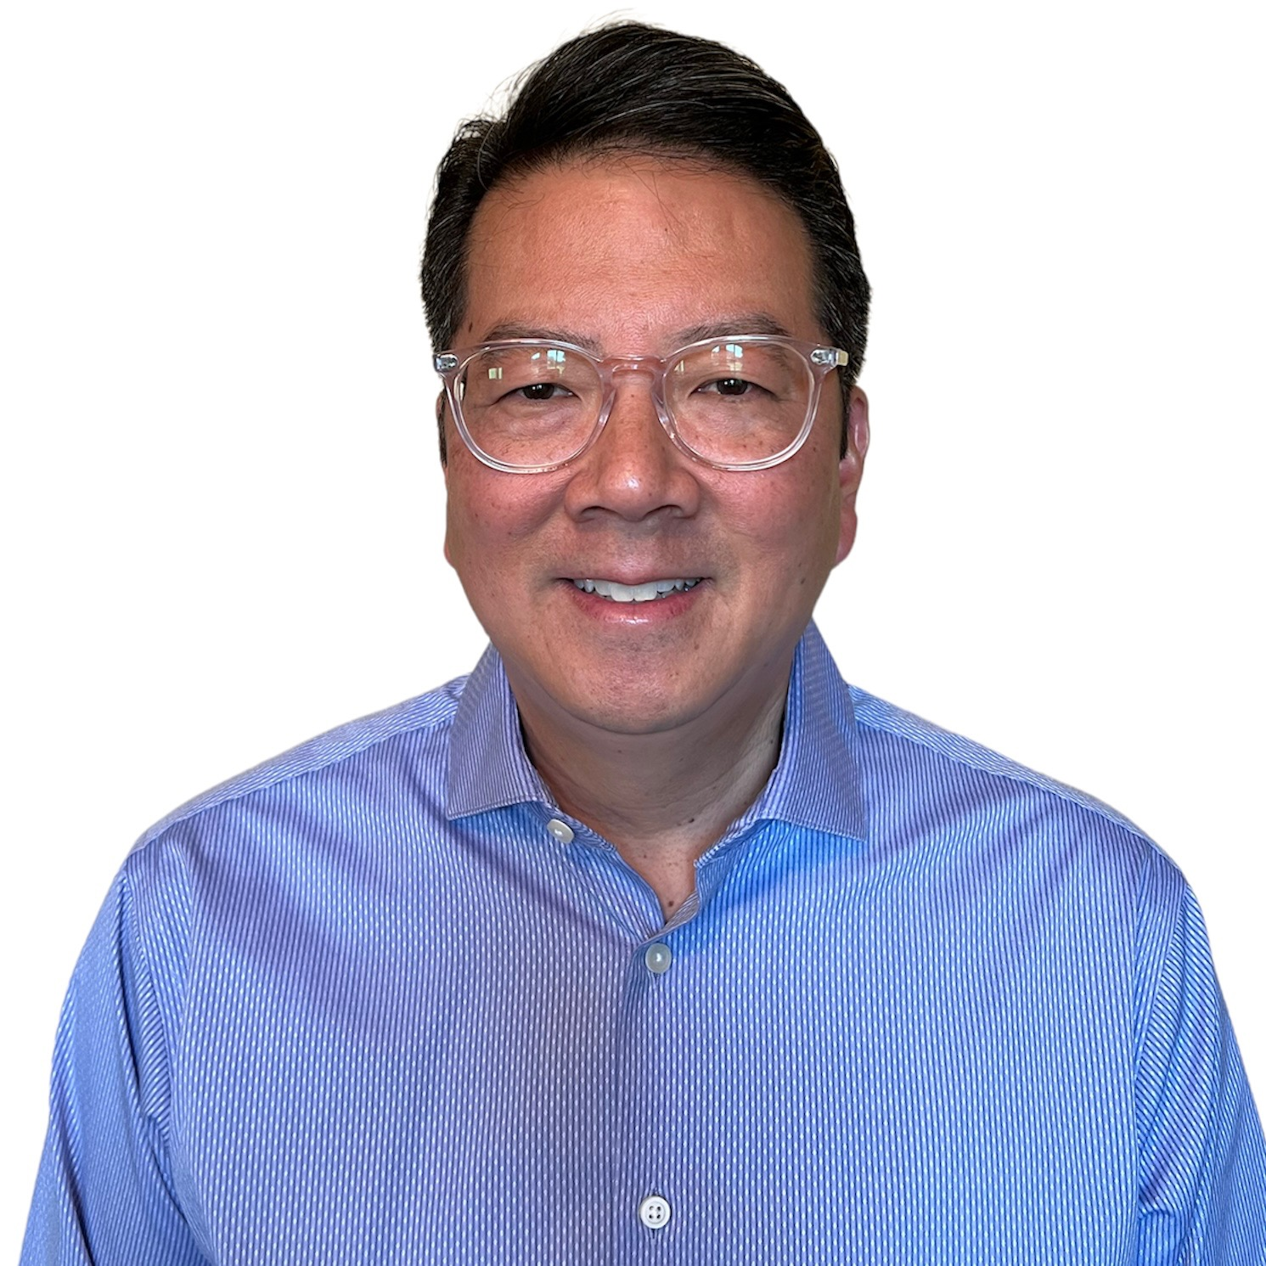
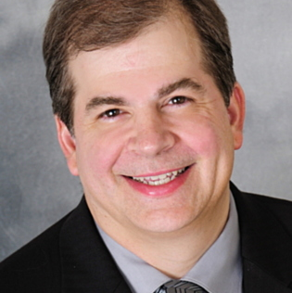
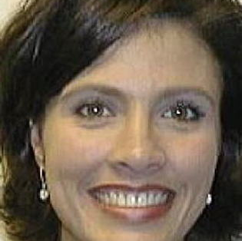
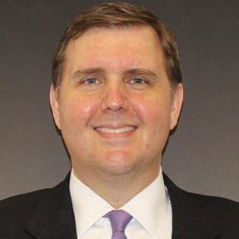
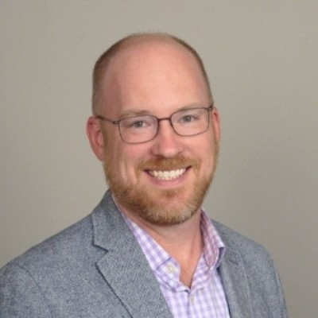
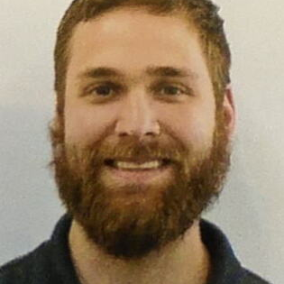
Cisco Account Leadership Team
Bart Sepko
Client Director
Sales
Architecture & Engineering
Stephen Cheng
Global Account Manager
Orders & Logisitics
Customer Experience
Keith Weaver
Principal Architect
Tim Lovelace
Global Account Manager
Christy Blackard
Order & Logistics Manager
Jim Shupe
Customer Success Director
Nick Zerwig
Solutions Engineer
Leaders for:
Solution Resource Enablement
CCW/ePRO Quotes
Global Strategy Alignment
Leader for:
Order Processing
Schedule/Stewardship Reporting Billing
Leader for:
Advanced Services/Delivery
Adoption/Optimization
TAC
Leaders for:
Business Solutions Architecture
Technical Innovation
Global Standardization

Slide 5
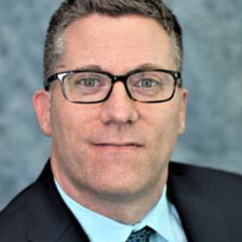
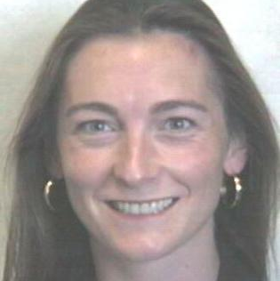
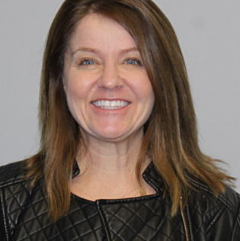
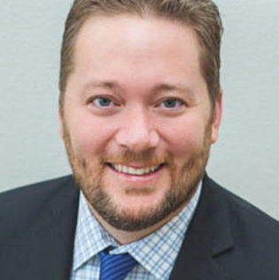
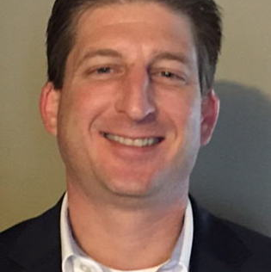
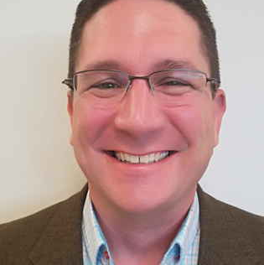
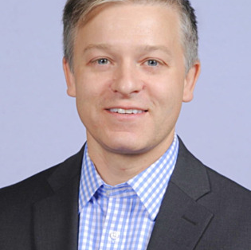
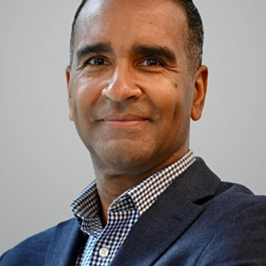
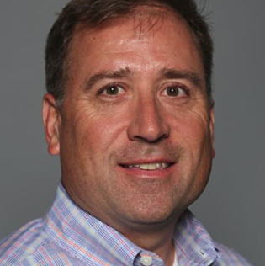
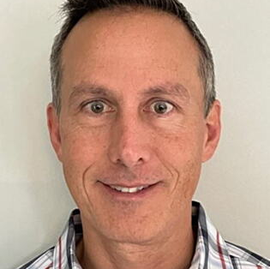
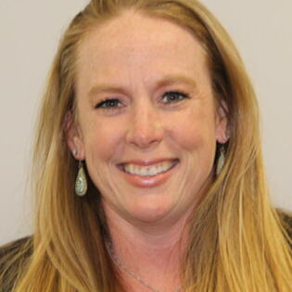
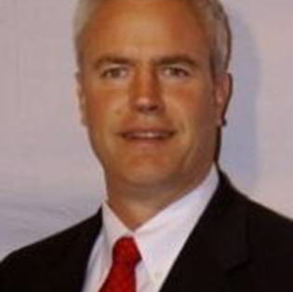
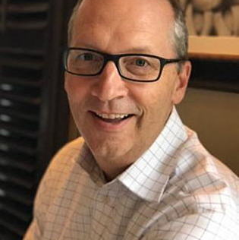
Cisco Sales Team
Stephen Cheng
Global Account Manager
Field & Campus Lead
Tim Lovelace
Global Account Manager
DC & Collaboration Lead
Product & Service Specialists
Frank Kauffman
Services Sales
Genevieve Collignon
EMEAR
Global Account Manager
Ben Lee
SFA Specialist
Lori Nourse
Renewals Manager Lead
SFA Specialist
Steven Zemaitis
Contact Center Specialist
Aaron Van Beusekom
Cybersecurity Specialist
Seth McCauley
Renewals Manager
John Seaton
Collaboration Specialist
Chris Galo
IoT Specialist
Joe Mazzola
Thousand Eyes Specialist
Reggie McFadden
Operations Analyst
Install Base/Coverage
Becca Vaughn
SDWAN Specialist
Mark Thurman
Enterprise Networking
Jon Huhn
Meraki Specialist

Slide 6
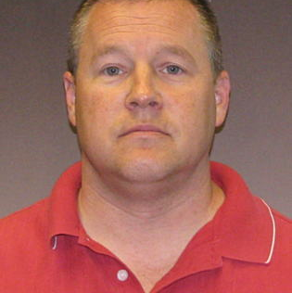
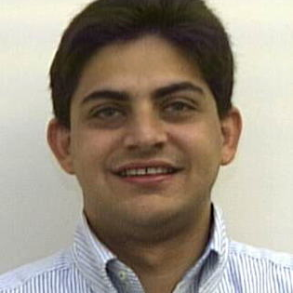
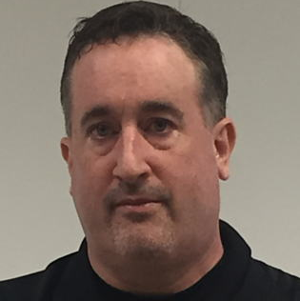
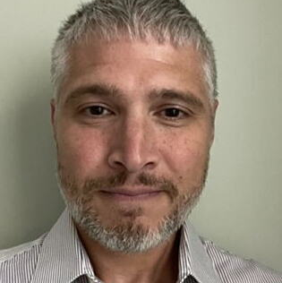
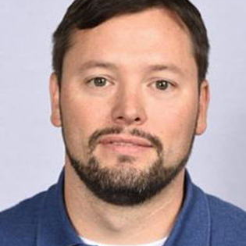
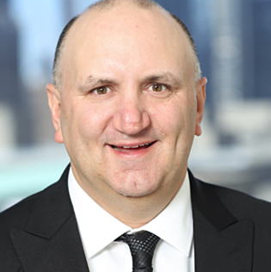
Cisco Architecture & Engineering
Keith Weaver
Principal Architect
Nick Zerwig
Solutions Engineer
Solutions Architects
Al Wilson
Collaboration
Technical Solutions Architect
Cesar Obediente
Distinguished Solutions
Architect
John Thompson
Contact Center
Technical Solutions Architect
Paul Conti
Thousand Eyes
Technical Solutions Architect
Alphonsine Anderson
Enterprise Networking
Technical Solutions Architect
Joel Metzger
Meraki
Technical Solutions Architect
Vinny Smith
SDWAN
Technical Solutions Architect

Slide 7
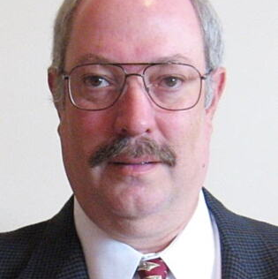
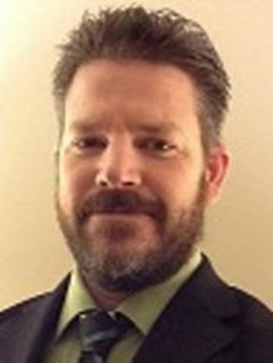
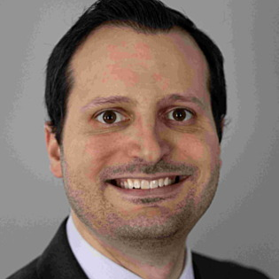
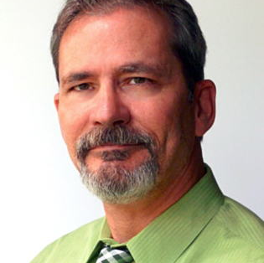
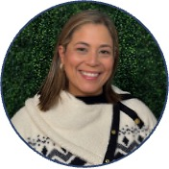
Cisco Customer Experience
Jim Shupe
Customer Experience (CX) Director
Michael Fries
Solution Integration Architect
CX Architecture & Engineering
Reactive Support Services
Project Management Office
Customer Success
Steve Powell
Services Manager
Mike Dabbo
High Touch
Operations Manager
Daniel May
Program Manager
Maria Belleth
Success Programs Manager
Cesar Campos
High Touch Engineer
Architecture Consulting
Testing Support
Solutions Validation Services (SVS)
Projects Execution
Optimization Recommendations
Scheduled Change Support
Knowledge Transfer
Project Management
Executive Communications
Contract Management
Financials / Invoicing
Solution Adoption Support
Accelerators
Ask the Expert Sessions
Proactive Case Management
Technical Recovery Leadership
RMA Facilitation
Outstanding RMA Reporting

Slide 8
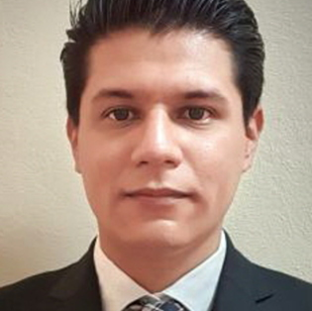
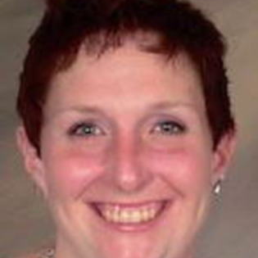
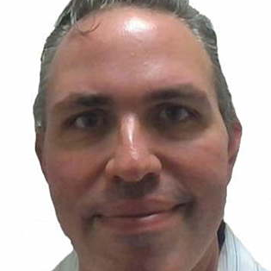
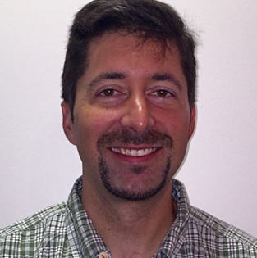
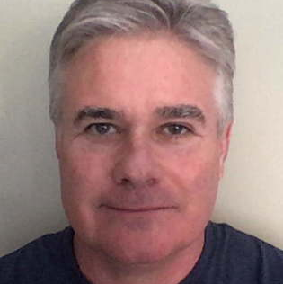
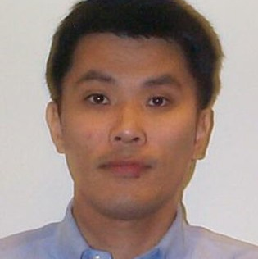
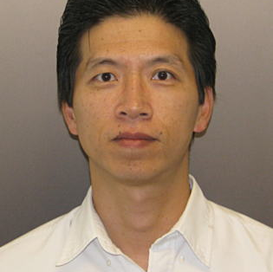
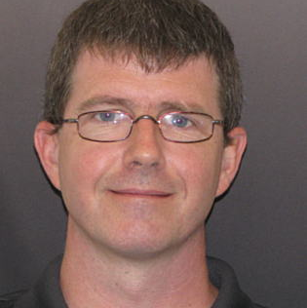
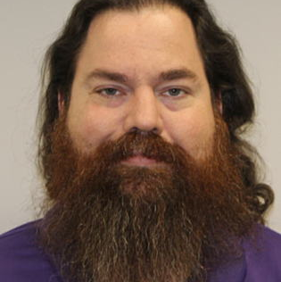
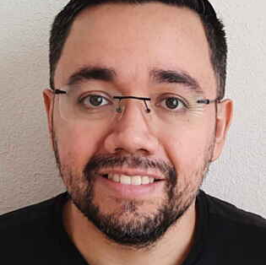
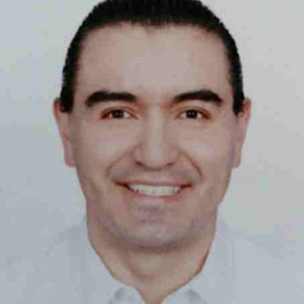
Cisco Delivery Architecture & Engineering
Steve Powell
Services Manager
Daniel May
Portfolio Manager
Cesar Rosales Gallegos
Project Manager
Allison Morian
Program Manager
Stephanie Peters
Project Manager
Architecture & Engineering
Roman Hendrick
Technical Leader
Mike Moskal
CX Architect
SDWAN, SAN
Darrell Burnett
CX Architect
ACI, Data Center
Richard Szeto
CX Architect
Contact Center
Xiaoning Zhang
CX Architect
ISE
Jason Smith
CX Architect
Software Strategy Lead
Robert Phillips
Technical Leader: Collaboration
Carlos Aldaz
Consulting Engineer:
ISE
Blake Braught
Consulting Engineer:
Route/Switch, ACI
Raul Valdez Maltos
Consulting Engineer:
Route/Switch, SDWAN
Yoshio Homma Gonzalez
Consulting Engineer: Collaboration
Greg McClellan
Technical Leader: SAN

Slide 9
WWT TEAM

Slide 10
WWT Team – Domestic
Client Executive
Lead Engineer
Brian Hoover
Max Blake
AVP
CTO
RM – TN
RM – TN
Customer Experience
Contract Specialist
Andrew Palumbo
Mike Taylor
Brian Jesse
Warren Nyffeler
Donna Herr
Isaiah Vasquez
Business Advisors
Strategy – Finance – Reporting
Business Manager
Business Manager
Engineering Resources
Principal CSE
Engineer Manager
Data Center
Reporting Execution
Financial Analyst
Tony Bright
Shawn Waldrup
Max Blake
Jarrod Deschaine
Scott Herbig
Donna Herr
Sean Liston
Matt Long
Sales Operations
Operations Lead
Senior ISR
Supply Chain PMO
Principal Architect
Cloud
Services RM
Principal Architect
KEY:
Pat Moriarty
Brendan Loughman
Siobahn Jones
Bob Watson
Jack French
Dave Sellers
Sean Walters
FedEx Dedicated
FedEx Shared
Advisors & Specialists
Services
AI
ATC – Lab Center
Security
Services
Strategic Staffing
Raj Ganesan
Jon Duren
Jeff Fonke
Aaron Freidenberg
Rachelle Lybarger
Robert Geis
Danielle Paulson
Jeff Swords
Keith Jacob

Slide 11
WWT Team – Global
Client Executive
Lead Engineer
Global Director
Brian Hoover
Max Blake
Global Engineering
Chris Canale
Eric Helfer
Client Management
Consulting Systems Engineers
Business Development & Specialists
Client Manager
(UK)
Client Manager
(SG)
Client Manager
(Brazil)
CSE – Network & Security (UK)
CSE – Data Center
(UK)
Client Manager,
MFG Industry
Industry Advisor
MFG
Client Manager, Security
Daniela Martinez
Jason Lim
Carlo Zimmer
Marco Attene
Rakesh Patel
David Robinson, UK
Bret Van Resburg, UK
Chris Nicholson, UK
Inside Sales
ISR
(UK)
ISR
(SG)
ISR
(Brazil)
CSE – Network & Security (SG)
CSE – Data Center
(SG)
BDM
(UK)
BDM
(SG)
Alden Charles
Sonia Teo
Karen Isayama
Jing Rong
Gopi Gonuguntla
JT Thomas
Joseph Ling

Slide 12
Cisco Services Review

Slide 13
Services Framework
FedEx Services | Original 5Y Contract & 1 Year Option | 5Y Renewal
TAC Support (24x7x365) + Advanced Replacement (8x5 NBD / 24x7), Software Support & Upgrades, Online Portal Access | 24x7 with Onsite (Transport & Retail), and 8x5xNBD | 8x7xNCD OS (Transport), 8x5 NBD OS (Retail), and 8x5 NBD
TAC Support (24x7x365) Legacy Data Centers | Full Term | 1Y of Coverage – DC Exit
High Touch Technical Support (24x7x365) & Network Level Incident Mgmt Support | All Technologies | All Technologies
High Touch Ops Manager (HTOM) Service Monitoring and Reporting | Primarily US Hours | 24x5 Follow the Sun
High Touch Engineer (H.T.E) Senior-Level Technical Expert | Primarily US Hours | 24x5 Follow the Sun
Asset Management & Software Consumption Reporting | Hardware AM – Cisco Consumption Report - NTT | Hardware & Software AM & Consumption / ROI Reporting
Business Critical Service (BCS) / Lifecycle Services (LCS) Operational enhancement recommendations / best practices Change Window Support Compliance and Configuration Management Insights Software risk analysis and recommendations for new version deployment Device health checks / log and fault analytics Network infrastructure security and alerts (PSIRT) and Risk Mitigation Review customer created Method of Procedure (MOP) Field Notice reviews Lifecycle Management (End of Life/End of Support) Solution Validation Services (1 Test Track) | ✓ | ✓
AST Subject Matter Expert (SME) 4,000 annual PDI project hours |  | ✓
Learning | Outside SFA | 30 All Access Seats
AppD Expert as a Service | Outside SFA | ✓*
AppD Expert Care | Outside SFA | ✓*
*valid for 18 months

Slide 14
FedEx Covered Inventory Summary
Notes
Data summarized using March, 2024 NetDB/Shipping data
Includes Legacy Data Center (3.4K quantity)
NetDB data Summarized at Major Level, Shipping Data includes Major/Minor
Excludes assets that are/will be LDoS on August 1, 2024
Estimated Coverable HW only
Excludes assets at CIL, Tuggle Road/2950 Airways
Source | Major | Minor | Total
US NetDB, ACAT Shipping/Active | 42,202 | 3,579 | 45,791
Expected Inventory Reductions/Changes
Device Type/Location | Quantity | Change | Timing
Legacy Data Centers – WTC, EDC-W | 3,400 | DC Exit | By July 2025
Field Office Locations | Estimated 5,000 | Closures | 6% EoY1 6% EoY2 6% EoY3 1% EoY4 1% EoY5
Field Redundant Router / Switch | 650 | Redundancy Decom | 50% Y1 50% Y2
Field Offices Catalyst Platforms | 3,700 | Transitioning to Meraki | Over 5Y term
New Service Level Guidance:
Moved from 24x7x4 Onsite to 8X7 NCD Onsite: Transportation Field
Moved from 24x7x4 Onsite to 8X5XNBD Onsite: Retail Field Office
8X5XNBD (Parts Only): All Other Inventory

Slide 15
LCS and Project Hours
 | Lifecycle Services (LCS) | Project Hours
Plan | Multi-Generational Architecture Planning Consult on FedEx’s Solution Requirements Document Consult on FedEx’s Solution Design Document Guidance on Features, Syntax, Leading Practices | Create Detailed Architecture Documents Create Solutions Requirement Document Create Solution Design Document
Build | Solution Validation Testing: Single Track Review FedEx’s High-Level and Low-Level Design Documents Advise on Implementation Plans and Templates Scheduled Change Support (Optimize Existing Deployment) Software Upgrade Feature Optimization | Create High-Level and Low-Level Design Documents Create Implementation Plans and Templates Scheduled Change Support: New Hardware, Feature Implement Change: New Hardware, Software, or Feature Network Ready for Use Testing Labor (Test Equipment Excluded)
Run | Day-2 Performance Optimization Software Strategy Proactive Software Review and Recommendation End of Life / New Feature Planning Security Vulnerability Assessments and Recommendations Scheduled Change Support (Restore from Incident) TAC Case Management Critical Incident Support Hardware and Software Contracts Management Learning Advisor Training Through CLC Program Knowledge Transfer Sessions (60-90 Minutes on New Tech) | Automation: e.g. Scripts, Catalyst Center Programming Knowledge Transfer Sessions: Up to 8 Hours on FedEx Standards

Slide 16
Utilizing Project Hours
Engagement Process
Any effort outside the scope of LCS will leverage Project Hours.
The Cisco team will determine an estimated Level of Effort for the proposed scope of work and present to the FedEx team for acceptance.
Once accepted, those hours will be taken out of the allocation of Project Hours (4000).
Please Note
There are 4,000 Project Hours allocated per year of the SFA agreement. Any hours not consumed by the end of the year (July 31st) will expire.
Project Hours are to be consumed within their allocated project year (August 1st – July 31st of any calendar year).

Slide 17
Cisco Lifecycle Services - Structure
Human Intelligence + Digital Insights = Proactive, Predictive and Preemptive Outcomes
Lifecycle Services
Consulting
Digital Insights
Project Management
Technical Expertise to
Drive Outcomes
KPIs to Measure Outcomes
PM functions
Highlights:
Value focused on Outcome
Digital Insights & KPIs
Scaled with Outcome Consulting
Notes:
Base package mandatory – operational data that is required to deliver value of optional packages (for additional delivery bandwidth)
Expert Engagements and/or EaaS and/or Scrum – any/all can be added on top of the Base
Value messaging is around the add-ons, not the base
Can simplify offer by 75%. Cross-architecture and Flat price allows sales to give the ‘list price’ immediately.
Delivery has a consistent cost budget to deliver against – rubik cube no longer necessary to understand

Slide 18
WWT SERVICES REVIEW

Slide 19
Cisco SFA Management & Adoption
Delivering Software Lifecycle Outcomes We take a lifecycle approach to software and maintenance alignment, management and value extraction
Advisory (Software, Services, etc.)
Field Sales (CM/BD)
Leasing & Legal
OEM Sales
Customer Success
OEM CX
Solutions & Services
Pre-Signature
Onboarding
Smart Account Support
EA Readiness & Utilization
Consumption Monitoring
Renewal
Validate IB & SFA scope
Examine cost & payment terms
Evaluate cost analysis & ROI
Secure legal docs
Define timelines & needs
Develop digital community
Coordinate Onboarding Kick-Off
Create success plan
Facilitate SFA license generation
Review account structure
Educate license admins
Provision SFA licenses
Support end-user inquiries
Review priorities & deliverables
Explore digital labs & technical capabilities
Examine adoption & deployment
Prepare for True Forward activities
Inspect consumption alerts
Monitor technology adoption
Review SFA orders
Evaluate SFA model & adoption
Develop Value Analysis

Slide 20
WWT Partner of Record Value Adds
transformational programs for UB
Initial Benefits
WWT is providing:
Consolidation of Partners
Per FedEx’s international goals, WWT assists with lowering partner usage to two per region with the primary partner being WWT.
Improved Process Documentation and Execution
WWT continues to work with FedEx to understand their processes and provide optimization opportunities utilizing our experience working with our large customer base.
Procurement Simplification
Through the purchase of the SFA and consolidation of partners, the FedEx procurement team reduced the number of purchase orders that need to be created in addition to having a consistent process regardless of location or partner.
Addition of Global Business Review into Monthly Operation and Quarterly Business Reviews
Visibility and review of FedEx’s IT global business purchasing through WWT and measurement of key KPIs.
Just-In-Time Delivery
WWT manages ordering in a timely manner by understanding project timeline needs thereby eliminating the need for bulk orders and excess inventory sitting in warehouses.
Partnership
Since becoming partners in 1994, WWT has grown to be Cisco’s largest global and strategic partner. WWT has been recognized for our depth of expertise and delivery excellence service across Cisco’s extensive product portfolio, geographic regions and market segments. In addition to being a Cisco Gold Certified Partner, WWT has also achieved certification in many key areas.

Slide 21
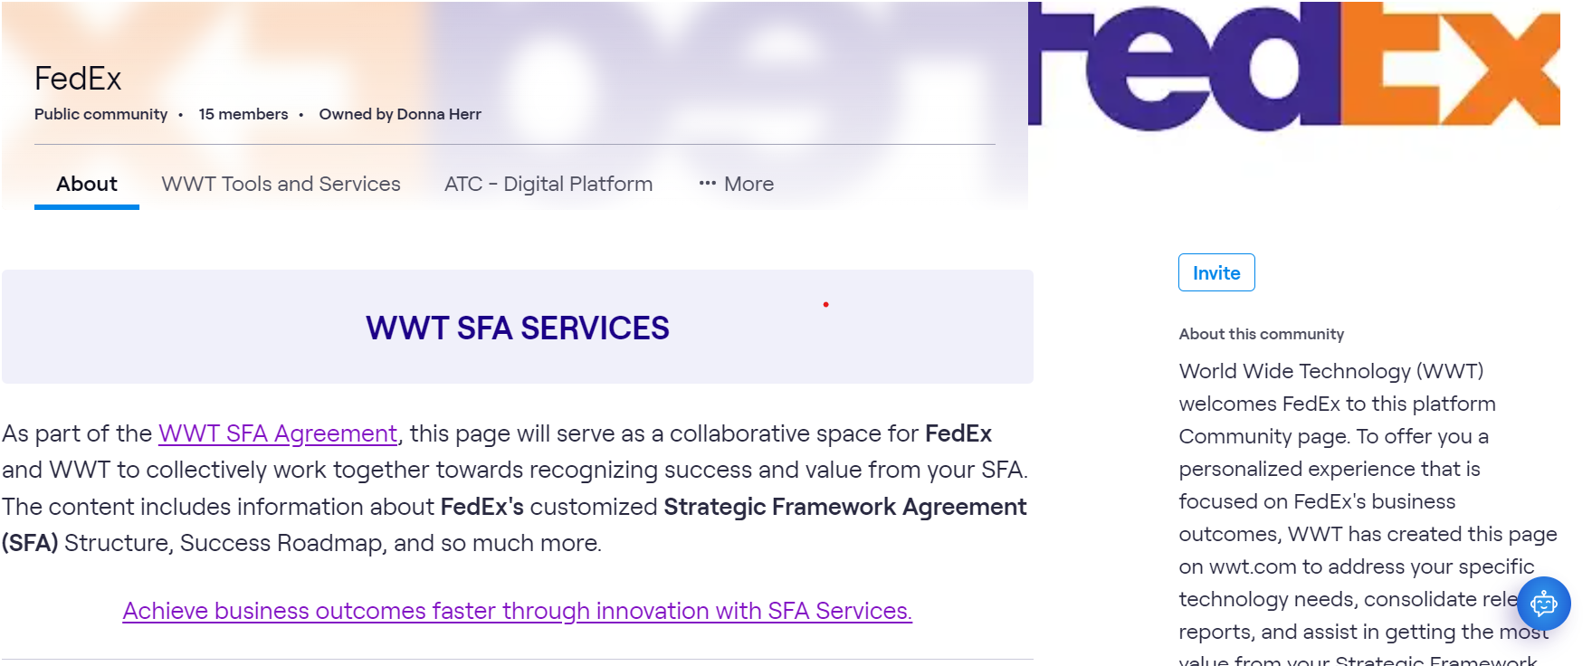
Single one-stop-shop for all SFA information and utilization needs
“Living” content that can be easily updated to meet the needs of the customer
Consolidated view of all events – both WWT and Cisco, allowing customers to engage with technology experts as well as expand training skills
Time sensitive announcements that are pushed to Community members
One click engagement with Team Experts

Slide 22
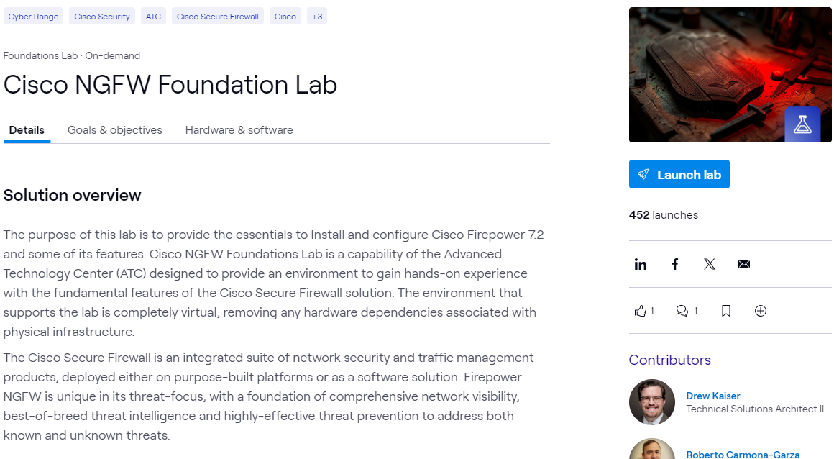
Health Check
Proactive, recurring touchpoints
designed to ensure our customers understand the inventory they own, rate of consumption,
and how WWT assists with adoption of technology
LOW UTILIZATION OF LICENSING
APPLY A WORKSHOP TO CREATE STRATEGY
Notes:
WWT offers a systematic approach to QSRs through internal tools, such as Event Planner.
We're utilizing this backdrop that introduces the customer into our digital platform.
Scheduled on the Digital Platform.
Inside a QSR, we're using insights from Cisco and from our Platform utilization. Allows us to paint a picture of where the customer sits in terms of their licensing utilization.
QSR: hosted in Event Planner.
Low utilization: we can see over and/or underutilization. we can see and evaluate use cases, in this scenario low utilization and plateau of use. We can then position a workshop to understand strategy and shift in consumption and user adoption.

Slide 24
SPA Return on Investment
Asset Management Deliverables (Monthly)
SFA ROI - Cumulative
$448M
$362M
$350M
$300M
$274M
$250M
$200M SFA…
$200M
$200M
$186M
$160M
$150M
$120M
$100M
$88M
$48M
$80M
$50M
$40M
$M
Yr 1
Yr 2
Yr 3
Yr 4
Yr 5
Non-SFA Cost
Cumulative SFA Payments
Breakeven
Projection (Based on Yr 1 continuation)
WPA ROI | Yr 1 | Yr 2 | Yr 3 | Yr 4 | Yr 5
Breakeven | $240M | $240M | $240M | $240M | $240M
Cumulative SFA Payments | $40M | $80M | $120M | $160M | $200M
Addl HW Cost (Pre-SFA) | $41M | $23M | $41M | $41M | $41M
Software Licenses | $25M | $63M | $25M | $25M | $25M
New Maint. Attach | $3M | $6M | $3M | $3M | $3M
Services (Maint./BCS/SVS) | $18M | $14M | $18M | $18M | $18M
Cumulative Savings | $48M | $106M | $154M | $202M | $248M
* If trend continues, breakeven would occur during Year 3 and would continue with total expected savings of $248M over the 5 years

Slide 25
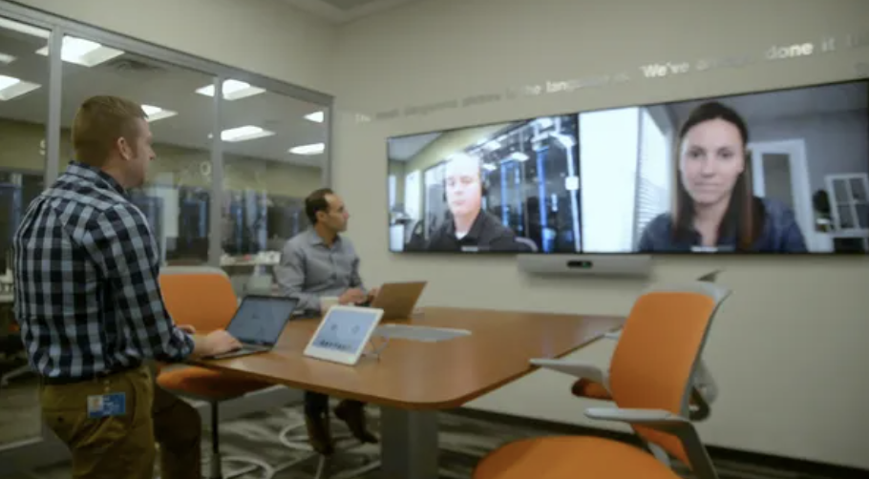
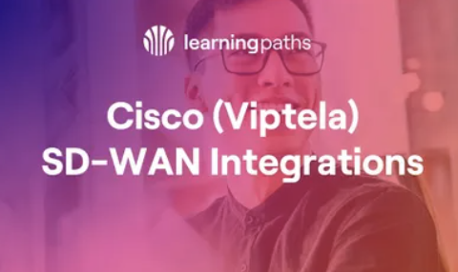
SFA Customer Adoption Resources
WORKSHOPS
LEARNING PATHS
PRE-BUILT TRAININGS
WWT Adoption Workshops
WWT ATC Trainings
SFA
Included
SFA
Included
SFA
Included
Using the ATC as a backdrop, WWT Workshops give your organization the opportunity to better understand the considerations for building or deploying architectures based on experience and best practices.
Our learning paths are carefully designed to guide architects and engineers through the latest technologies. By grouping relevant content based on experience level, the paths provide a customized training journey.
WWT’s Trainings can deliver messaging to admins, engineers, architects, or end users. These on-demand courses will walk users through a variety of new technology to ensure your organization is aware of the latest in Cisco technology.

Slide 26
WWT Asset Management & Supply Chain Program
transformational programs for UB
Program Summary
Business Goals
WWT will provide a Cisco-based Supply Chain & Asset Management solution aimed to deliver outcome-based objectives for the FedEx business:
WWT will work with FedEx to outline project priorities, requirements & forecasting
WWT will provide staging, configuration, integration, kitting & testing services
WWT will perform Asset tagging services which will enhance data quality
WWT will provide just-in-time delivery to FedEx project sites
WWT will leverage Global Supply Chain capabilities to support projects around the world
WWT will perform joint planning and governance sessions with FedEx to ensure quality
WWT will provide oversight and governance, and FedEx will not lose access to Cisco resources
WWT will coordinate, validate & procure Cisco-approved infrastructure (Phased approach)
FedEx: Accelerate time to market and significantly improve four key metrics:
Reduce time from request to delivery
Reduce overall integration costs
Achieve best in class pricing
Consolidate global sourcing
WWT: Provide a programmatic Supply Chain & Asset management service as alternative channel to existing process. Support critical projects by leveraging WWT’s Integration Centers, supply chain & asset management expertise with a focus of building an efficient, streamlined process.
Notes:
- Questions around - WWT will provide oversight and governance, and FedEx will not lose access to Cisco resources

Slide 27
WWT Partner of Record Value Adds
transformational programs for UB
Future Benefits
Experience
WWT can offer:
Self Service Online Ordering Tool – WWT offers a secure tool where FedEx can:
Create a FedEx custom catalog – locked down catalog to drive compliance with FedEx approved standards
Request quotes for individual parts or configured items
Digitally transfer quotes and POs between FedEx’s procurement system and WWT
Modernized Request and Approval Processes
WWT can create and automate operational process flows for various requests using FedEx’s Community Page. We have the experience creating different options and designing what is the best and most streamlined to assist FedEx.
Since becoming partners in 1994, WWT has grown to be
WWT recognized long ago the importance of investing in the resources and capabilities necessary to deliver end-to-end solutions that help customers solve challenges throughout the lifecycle of their technology investments. Our commitment to invest in lifecycle solutions includes creating a mature, accredited software and lifecycle practice, which has achieved Advanced CX Specialization status and been recognized as Cisco’s Customer Experience Partner of the Year

Slide 28
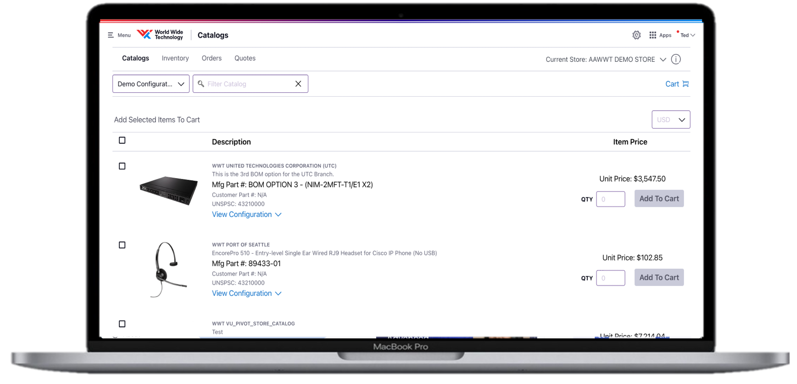
Catalogs
Shop from a customized catalog.
Provides product relevancy and buying standardization for the customer
24/7 access to shop and procure configured bills of material or stand-alone parts
Customer’s procurement system can be integrated with WWT’s product catalog via CXML or OCI
International pricing allows WWT to sell product in the customer’s desired local currency and buy product from vendors/OEMs in USD currency
Intelligent cart integration and checkout steps provide for a simple and prompt buying process
Eliminates dependency on WWT’s Inside Sales Representative to place an order

Slide 29
Opportunity to Delivery
WWT Team Alias: FedEx@wwt.com
QUOTING PHASE
FEDEX EMAIL FEDEX@WWT.COM
CSE BOM VALIDATION
ISR REQUESTS
& RECIEVES PRICING
QUOTE SENT TO FEDEX
FEDEX CREATES OCF REQUEST
PO APPROVAL WORKFLOW
PURCHASING & LOGISTICS
PURCHASING & LOGISTICS
ORDER SENT TO BUYER
EQUIPMENT DELIVERED TO INTEGRATION CENTER
INTEGRATION SERVICES
DELIVERY COORDINATED BY ORDER MANAGER
PRODUCT DELIVERED TO FEDEX FACILITY
CUSTOMER INVOICES INC. TAX AND IOR/CUSTOMS

Slide 30
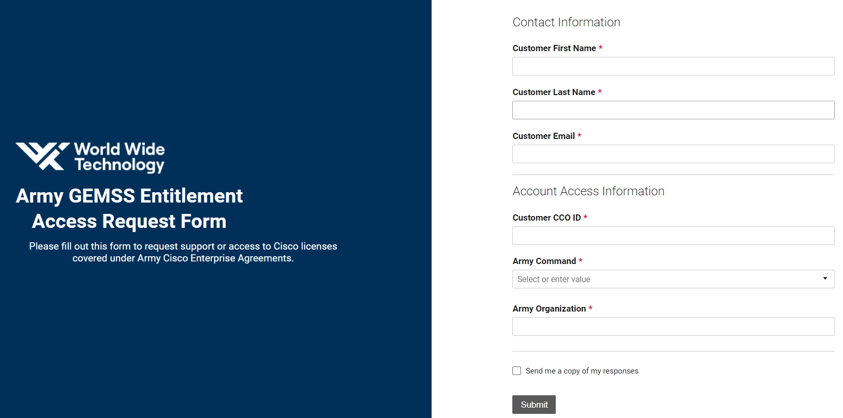
Notes:
11:00 – grab a plate (assuming food is ready and set up – Max is checking)
11:15 – Topic 1 – Introductions – Foundation Setting
11:30 – Topic 2 – Part 1: Operational Excellence – SFA Management Process
12:15 – break
12:25 – Topic 3 – Part 2: Operational Excellence – SFA Management Process
1:00 – Topic 4 – Global Sourcing & Supply Chain
1:20 – Q&A

Slide 31
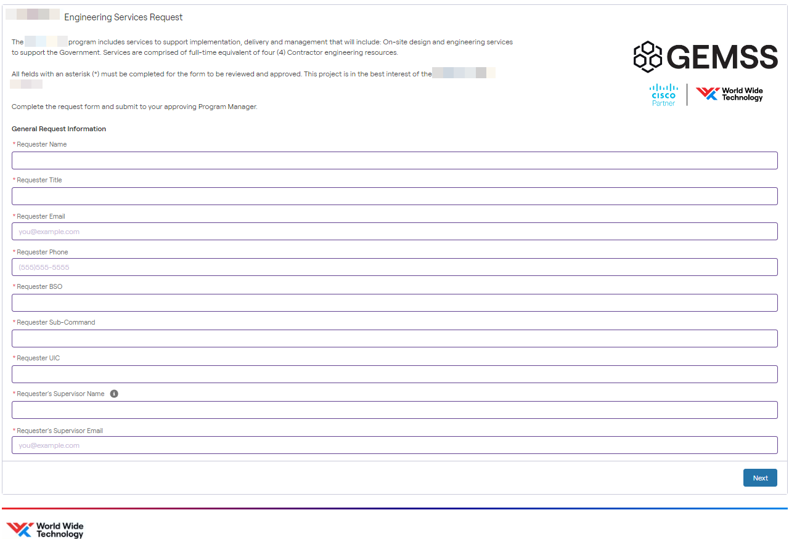

Slide 32
Contract Specialist Service + Partnership
Isaiah Vasquez- Dedicated WWT Service Contract Specialists working with the Cisco Asset Manager and HTOMs
Following booking of renewal, Isaiah is conducting an initial Installed base (IB) reconciliation to align to agreed upon baseline and ensure all assets converted and entitled correctly with accurate naming convention and location
Need standards for coverage by site and product family to validate proper coverage
Cisco Asset Manager to produce baseline IB value (calculated off of annual service list price) with validation from Isaiah
Effectively manage contracts by maintaining consistent contract numbers, monitoring and applying standards for coverage, updating install site addresses, discover and validate decommissions to offset growth value of IB
Communicate with appropriate FedEx POCs to ensure maintenance contract based on actual installed base and provide visibility into growth throughout year leading up to annual review and renewal date
Utilize ship reports, NetDB and Cisco collector report as FedEx source of truth for IB
Establish FedEx contact to provide NetDB file monthly
Work with Cisco Asset Management to ensure accuracy of devices added to contract throughout contract term and review growth calculation and detail
Perform and review with FedEx updates and corrections monthly for accurate reporting
Visibility into current and upcoming End of Sale and End of Support devices
Maintain country specific contracts and install sites where required by FedEx
Can also report by business unit/owner, technology, or other FedEx requirement (FedEx to provide preferences)
Track Asset decommission against growth for accurate install base value calculation to ensure annual IB reduction goals
Monitor and report on cost savings for maintenance to capture financial value of SFA

Slide 33
Next Steps
Cisco Tech Summit – October 2024
Leveraging Year 1 Project Hours
Monthly Operational Reviews – starting October 2024
Quarterly Business Reviews – December 2024

Slide 35
Backup Slides

Slide 36
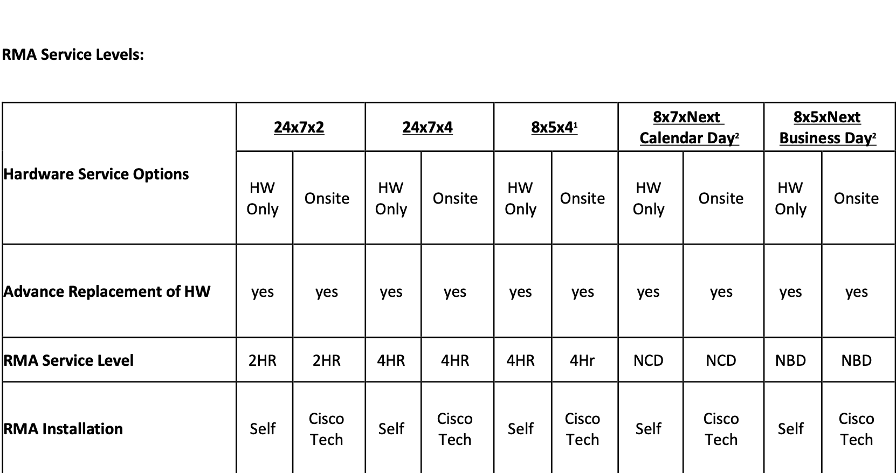
RMA Service Levels
New Service Level Guidance*:
Transportation Field: Moved from 24x7x4 Onsite to 8X7 NCD Onsite
Retail Field Office: Moved from 24x7x4 Onsite to 8X5XNBD Onsite
All Other Inventory: 8X5XNBD (Parts Only)
*Meetings have started with FedEx Operations to ensure the operations teams understand the service level reduction and new local time processing requirements for RMA and Onsite FE requests to meet NCD or NBD turnaround

Slide 37
FedEx Priority Overview
Business Priorities
Priority Project
Growth Strategies
Compete Collectively
DRIVE Initiative
Grow core package business
Grow internationally
Grow supply chain capabilities
Grow through e-commerce & technology
Grow through new services & alliances
Reduce costs by $4 Billion in FY25
Network 2.0
Operate Collaboratively
Increasing Operational Efficiency by optimizing the package network
Project Condor
Innovate Digitally
Exit Domestic Data Centers
0-50-50 Goal
Cost Efficiency
Project C4
Migrate sites from iWAN to Software-Defined WAN
Migrate Express Hubs to Application Centric Infrastructure to Eliminate Common Outage Causes

Slide 38
DRIVE: LCS Outcomes & KPIs
Outcome | KPI
Improve End User Experience & Minimize Costs Expert Care & Solution Validation Services | # of Service Requests (High Severity, RMA)
 | Average Initial Response Time for High Severity SRs
 | Average Initial Resolution Time for High Severity SRs
 | # of SVS Test Cases
 | Time to Value
Optimize Productivity & Minimize Costs Knowledge Management, Training, & Collaboration | # of Knowledge Transfers
 | # of CPLL Active Users
 | # of CPLL Completed Courses
 | # of Learning Credits Used
 | # of WebEx Meetings
 | # of WebEx Hosts (Registered, Active, Power)

Slide 39
Network 2.0: LCS Outcomes & KPIs
Outcome | KPI
Demonstrate Compliance Health Checks, Best Practices, Configuration Compliance | # of Recommendations Provided
 | # of Recommendations Implemented
 | % Configuration Conformance
Reduce Risk, Enhance Security, & Demonstrate Compliance HW & SW Lifecycle Management and SW Strategy | % of Devices HW LDOS
 | % of Devices HW LDOS in 12 Months
 | % of Devices HW EoVSS
 | % of Devices SW EoX LDOS or EoVSS
 | % of SW Compliance
 | % of Devices with High Severity PSIRT Impact
 | # of Software Reviews Completed
 | # of SW Versions across HW Platforms (SW Diversity)

Slide 40
Network 2.0: LCS Outcomes & KPIs
Outcome | KPI
Reduce Risk & Enhance Network Visibility Network and Application Observability | # of Thousand Eyes Agents Deployed
 | # of AppDynamics Daily Active Users
 | # of Applications Monitored by AppD
 | AppD APM License Consumption
Enable Business Through New Technology New Tools, Features, and Integrations | # of Proof of Values Completed
 | # of New Features Adopted
 | # of New Integrations
Enhance Security Umbrella, Identity Services Engine (ISE) | # of Total DNS Requests
 | # of Blocked Requests
 | # of non-compliant users
 | # of High CPU, High Memory, or other Issues
 | # of New Identity Integrations
 | # of Upgrades with 0 Downtime

