Slide 1
Initial Reporting – WWT and Cisco
ROI Maintenance and IB Update September 20, 2024
Accelerating business capabilities & speed to value
Minimizing risk – Reducing cost – Building efficiency
Donna Herr – WWT Manager - Premier Accounts
Jeff Nagus – WWT Senior Manager – Strategic Engagements
Jim Schupe – Cisco CX Leader
Allison Morian – Project Manager

Slide 2
AGENDA
Discuss Hardware ROI
Discuss Timeline for Software ROI
Review Maintenance ROI
EOX Update

Slide 3
SFA ROI Comparison - Maintenance – To Date
$49M ‘Without SFA’ Spend includes:
$35M of 8.7 & Onsite
$14M of 8.5 & NBD
$26M ‘With SFA’ Spend includes:
$16M of 8.7 & Onsite
$7M of 8.5 & NBD
‘Without SFA’ Assumptions:
Annual services from base case analysis
New maintenance attach based on 50% discount

Slide 4
SFA ROI Comparison - Maintenance – To Date
Devices by Service Level
8.7 & Onsite | 30724
8.5 & NBD | 12830
SFA Software Savings
Enterprise Routing | $12.19
ACI | $10.51
Enterprise Networking | $10.26
Enterprise Switching | $7.13
EXAMPLE ONLY

Slide 5
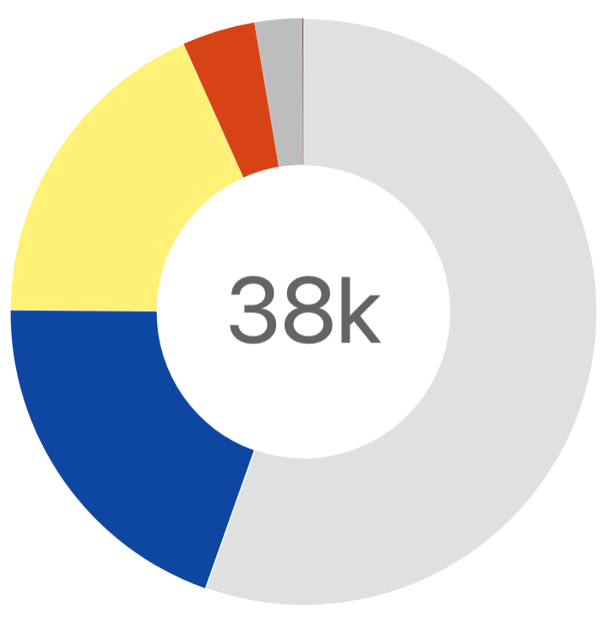
FedEx Hardware EoX Snapshot
EoX Overview – Parent Chassis in the US
Announced
1,082 (3%)
LDoS
1,538 (4%)
40.1k
4%
Of Devices Past Last Day of Support
39.3K
Total Active Devices in the US
17%
Of Devices End of Software Maintenance
EoSWM
6,998 (17%)
40.1k
Devices LDoS 2025-2029
6,622
EoSale
8,244 (20%)
Unannounced
23,085 (56%)
5,775
3,555
371

Slide 6
FedEx Hardware EoX Snapshot
Past Last Day of Support
Last Day of Support: The last date to receive support as entitled by active service contracts for covered Cisco hardware and software. After this date, support is no longer available.
Nexus 5000 Series Switches
Number Devices past LDoS per Product Family
1,538
Catalyst 4900 Series Switches
39.3K
(36%)
Catalyst 3560X Series Switches
Devices Past Last Day of Support
(25%)
2900 Series ISRs
(15%)
Catalyst 3560 Series Switches
89%
(6%)
Confirmed to be decommissioned with closure of the legacy data centers.
Other
(3%)
Of LDoS Devices in Legacy Data Centers
(15%)

Slide 7
FedEx Hardware EoX Snapshot
Currently End of Software Maintenance
End of Software Maintenance: The last date that Cisco Engineering may release any final software maintenance releases or bug fixes.
Devices EoSWM per Product Family
6,998
39.3K
Nexus 9000 Switches
81 (1%)
Nexus 5000 Switches
226 (3%)
Other
259 (4%)
Total Active Devices in the US and Canada
Catalyst 3850 Switches
408 (6%)
Devices End of Software Maintenance
95%
39.3K
Catalyst 2960-X Switches
6,024 (86%)
Total Active Devices in the US and Canada
Of Devices Currently EoSWM and will reach LDoS in 2027

Slide 8
FedEx Hardware EoX Snapshot
EoX Milestones June 1, 2025 — May 31, 2026
2025
2026
Month | EoX Milestone
June | LDoS: IE 3000 (22)
July | EoSWM: IE 4000 (4)
August | EoSWM: ISR 4000 (5,529)
September | LDoS: Nexus 5000 (226)
October | EoSWM: VG300 (1,081) LDoS: Catalyst 4500X (49) Catalyst 6500 (66) Catalyst 6800 (6)
November | -
December | -
Month | EoX Milestone
January | -
February | -
March | -
April | EoSWM: Catalyst 3560 (1)
May | -
June | -
July | -

Slide 9
FedEx Hardware EoX Snapshot
Devices Reaching LDoS in 2025
Device Product Family and Location | Device Count
Cisco Nexus 5000 Series Switches | 226
Cisco Catalyst 6500 Series Switches | 66
Cisco Catalyst 4500-X Series Switches | 49
Cisco Industrial Ethernet 3000 Series Switches | 22
Cisco Catalyst 6800 Series Switches | 5
Cisco ASR 1000 Series Aggregation Services Routers | 2
371
39.3K
Total Active Devices in the US and Canada
Devices will reach Last Day of Support in 2025

Slide 10
FedEx Hardware EoX Snapshot
Devices Reaching LDoS in 2027
Nexus 9000 Series Switches
81 (1%)
6,622
ASR 1000 Series Routers
74 (1%)
39.3K
Catalyst 3850 Switches
408 (6%)
Total Active Devices in the US and Canada
Devices will reach Last Day of Support in 2027
6.6k
Of the 6,024 Catalyst 2960-X reaching LDoS in 2027, 13% (804) are in Memphis and the remaining are located across 1,006 field sites.
91%
39.3K
Total Active Devices in the US and Canada
Of Devices are Catalyst 2960-X Series Switches
Catalyst 2960-X Switches
6,024 (91%)

Slide 11
SFA Initial IB Update

