Slide 1

WWT EA+ Value – FedEx SFA
Accelerating business capabilities & speed to value
Minimizing risk – Reducing cost – Building efficiency
Laura Kuehner– Area Vice President
Amanda Sturgeon – Director
Donna Herr – Manager – Premier Accounts

Slide 2


Cisco SFA Management & Adoption
Delivering Software Lifecycle Outcomes
We take a lifecycle approach to software and maintenance alignment, management and value extraction
Advisory
(Software,
Services, etc.)
Field Sales (CM/BD)
Leasing
& Legal
OEM
Sales
Customer Success
OEM CX
Solutions
& Services
Pre-Signature
Onboarding
Smart Account Support
EA Readiness & Utilization
Consumption Monitoring
Renewal
Validate IB & SFA scope
Examine cost & payment terms
Evaluate cost analysis & ROI
Secure
legal docs
Define timelines & needs
Develop digital community
Coordinate Onboarding Kick-Off
Create success plan
Facilitate SFA license generation
Review account structure
Educate license admins
Provision
SFA licenses
Support
end-user inquiries
Review priorities & deliverables
Explore digital labs & technical capabilities
Examine adoption & deployment
Prepare
for True Forward activities
Inspect
consumption alerts
Monitor technology adoption
Review SFA orders
Evaluate SFA model & adoption
Develop
Value
Analysis

Slide 3

WWT Partner of Record Value Adds
transformational programs for UB
Initial Benefits
WWT is providing:
  Consolidation of Partners
    Per FedEx’s international goals, WWT assists with lowering partner usage to two per region with the primary partner being WWT.
  Improved Process Documentation and Execution
    WWT continues to work with FedEx to understand their processes and provide optimization opportunities utilizing our experience working with our large customer base.
  Procurement Simplification
    Through the purchase of the SFA and consolidation of partners, the FedEx procurement team reduced the number of purchase orders that need to be created in addition to having a consistent process regardless of location or partner.
  Addition of Global Business Review into Monthly Operation and Quarterly Business Reviews
    Visibility and review of FedEx’s IT global business purchasing through WWT and measurement of key KPI’s.
  Just-In-Time Delivery
    WWT manages ordering in a timely manner by understanding project timeline needs thereby eliminating the need for bulk orders and excess inventory sitting in warehouses.
Partnership
Since becoming partners in 1994, WWT has grown to be Cisco’s largest global and strategic partner. WWT has been recognized for our depth of expertise and delivery excellence service across Cisco’s extensive product portfolio, geographic regions and market segments. In addition to being a Cisco Gold Certified Partner, WWT has also achieved certification in many key areas.

Slide 4
WWT Asset Management & Supply Chain Program
transformational programs for UB
Program Summary
Business Goals
WWT will provide a Cisco-based Supply Chain & Asset Management solution aimed to deliver outcome-based objectives for the FedEx business:
  WWT will work with FedEx to outline project priorities, requirements & forecasting
  WWT will provide staging, configuration, integration, kitting & testing services
  WWT will perform Asset tagging services which will enhance data quality
  WWT will provide just-in-time delivery to FedEx project sites
  WWT will leverage Global Supply Chain capabilities to support projects around the world
  WWT will perform joint planning and governance sessions with FedEx to ensure quality
  WWT will provide oversight and governance, and FedEx will not lose access to Cisco resources
  WWT will coordinate, validate & procure Cisco-approved infrastructure (Phased approach)
FedEx: Accelerate time to market and significantly improve four key metrics:
  Reduce time from request to delivery
  Reduce overall integration costs
  Achieve best in class pricing
  Consolidate global sourcing
WWT: Provide a programmatic Supply Chain & Asset management service as alternative channel to existing process. Support critical projects by leveraging WWT’s Integration Centers, supply chain & asset management expertise with a focus of building an efficient, streamlined process.

Slide 5
WWT Partner of Record Value Adds
Future Benefits
transformational programs for UB
Experience
WWT can offer:
  Self Service Online Ordering Tool – WWT offers a secure tool where FedEx can:
    Create a FedEx custom catalog – locked down catalog to drive compliance with FedEx approved standards
    Request quotes for individual parts or configured items
    Digitally transfer quotes and PO’s between FedEx’s procurement system and WWT
  Modernized Request and Approval Processes
    WWT can create and automate operational process flows for various requests using FedEx’s Community Page. We have the experience creating different options and designing what is the best and most streamlined to assist FedEx.
Since becoming partners in 1994, WWT has grown to be
WWT recognized long ago the importance of investing in the resources and capabilities necessary to deliver end-to-end solutions that help customers solve challenges throughout the lifecycle of their technology investments. Our commitment to invest in lifecycle solutions includes creating a mature, accredited software and lifecycle practice, which has achieved Advanced CX Specialization status and been recognized as Cisco’s Customer Experience Partner of the Year

Slide 6

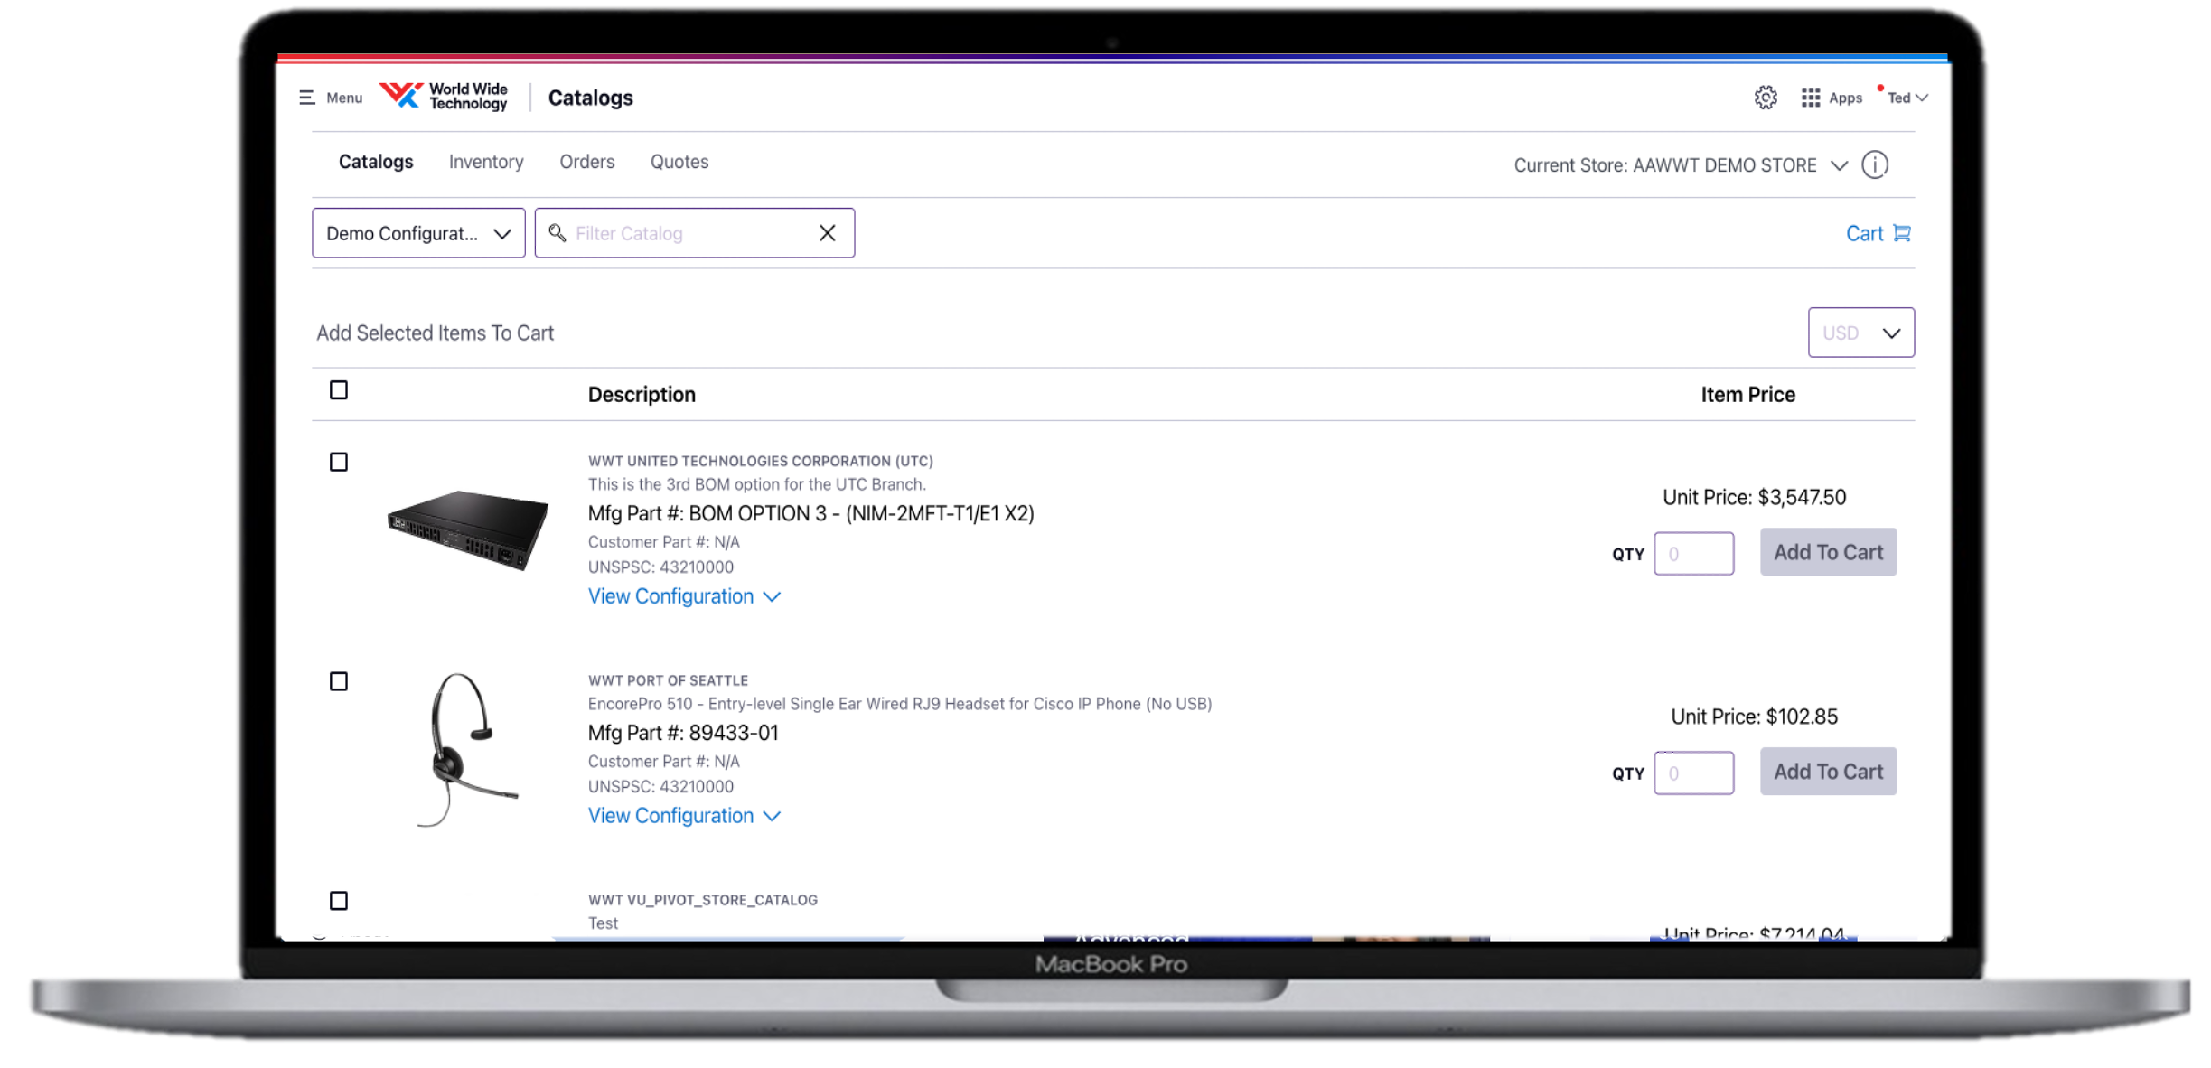

Catalogs
Shop from a customized catalog.
Provides product relevancy and buying standardization for the customer
24/7 access to shop and procure configured bills of material or stand-alone parts
Customer’s procurement system can be integrated with WWT’s product catalog via CXML or OCI
International pricing allows WWT to sell product in the customer’s desired local currency and buy product from vendors/OEMs in USD currency
Intelligent cart integration and checkout steps provide for a simple and prompt buying process
Eliminates dependency on WWT’s Inside Sales Representative to place an order

Slide 7

Opportunity to Delivery
WWT Team Alias: FedEx@wwt.com
QUOTING PHASE
PURCHASING & LOGISTICS
FEDEX EMAIL FEDEX@WWT.COM
CSE BOM VALIDATION
ISR REQUESTS
& RECIEVES PRICING
QUOTE SENT TO FEDEX
FEDEX CREATES OCF REQUEST
PO APPROVAL WORKFLOW
PURCHASING & LOGISTICS
ORDER SENT TO BUYER
EQUIPMENT DELIVERED TO INTEGRATION CENTER
INTEGRATION SERVICES
DELIVERY COORDINATED BY ORDER MANAGER
PRODUCT DELIVERED TO FEDEX FACILITY
CUSTOMER INVOICES INC. TAX AND IOR/CUSTOMS

Slide 8
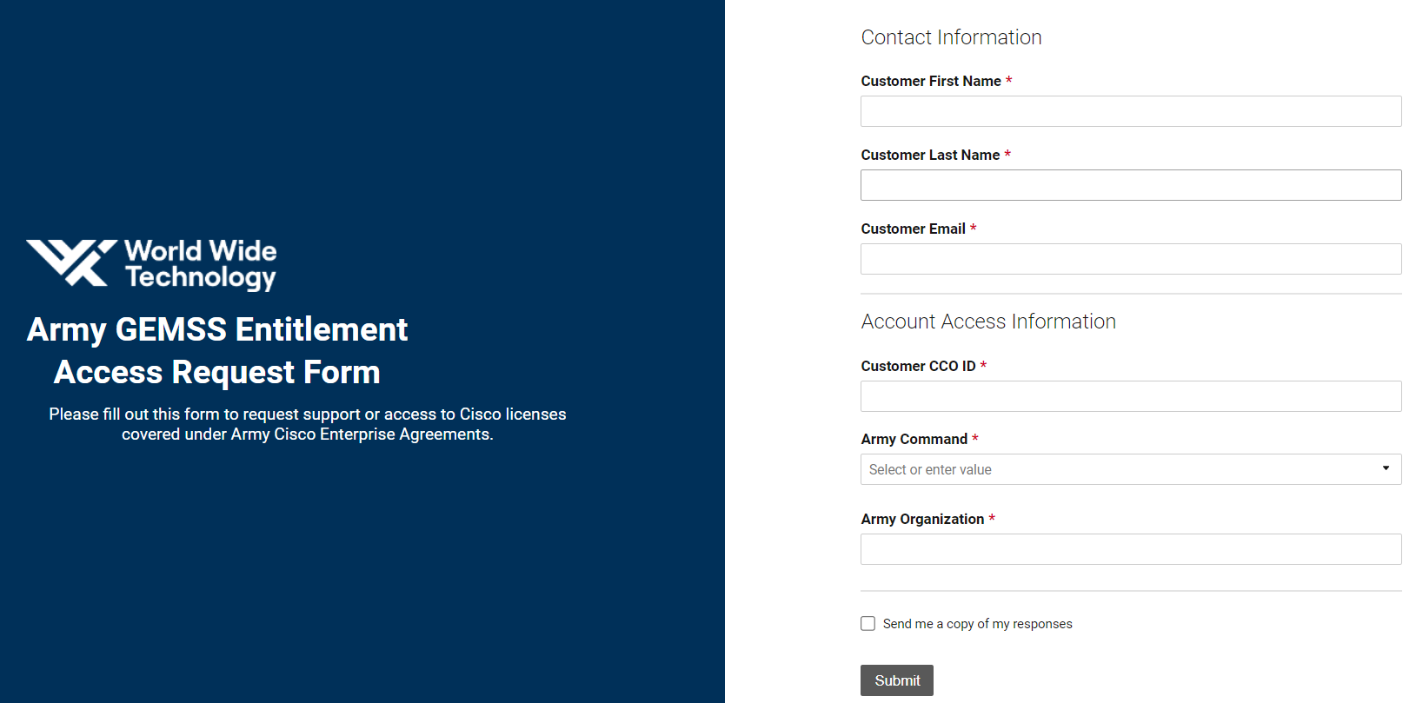
Notes:
11:00 – grab a plate (assuming food is ready and set up – Max is checking)
11:15 – Topic 1 – Introductions – Foundation Setting
11:30 – Topic 2 – Part 1: Operational Excellence – SFA Management Process
12:15 – break
12:25 – Topic 3 – Part 2: Operational Excellence – SFA Management Process
1:00 – Topic 4 – Global Sourcing & Supply Chain
1:20 – Q&A

Slide 9
