Slide 1





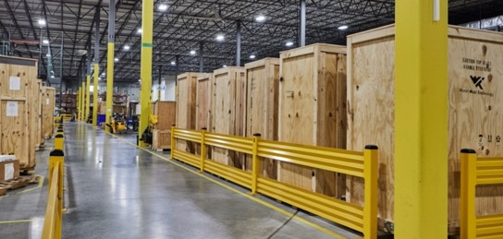

Maximizing Our Partnership
Three key WWT capabilities form the foundation of our SFA practice
WWT strives to be considered
an extension of your leadership
Expansive cross-utilization of WWT services
Identifiable, meaningful value brought to IT, sourcing and business units
The Right
Decisions Faster
Deployment at
Global Scale
Simplified
Transformation
Advanced Technology Center Labs
Global Supply Chain & Integration Centers
WWT Lifecyle Services
Business and technology outcomes are accelerated as a result
of the partnership with WWT.
Notes:
1) What is the WWT secret sauce?

Slide 2
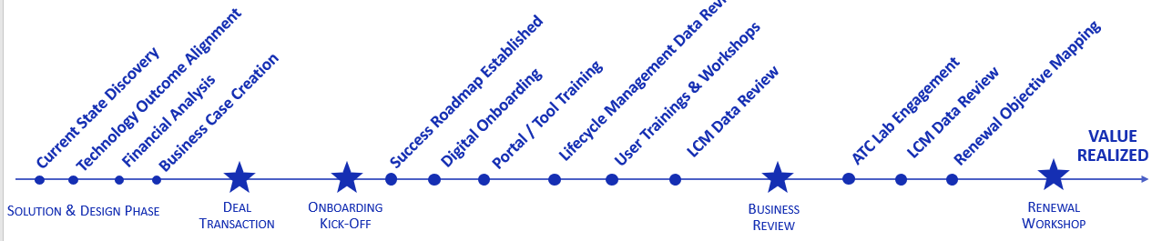
Value Overview
Drive ROI and accelerate value realization of Cisco SFA
SMART ACOUNT TRAINING
CONSUMPTION REVIEW
LAB ENGAGEMENT
RENEWAL EVALUATION
KICKOFF & REVIEWS
Kickoff & Scoping (first 60 days)
Operations Review
Vision Scoping Review
Operational Guide
Customer Success
Acceleration session
Portal & Tools
Monthly Reviews (Ongoing)
Operational Licensing Review
Roadmap/Project Review
Quarterly Success Reviews
SFA entitlement consumption tracking
Customer Success Roadmap progress
New objectives and re-prioritization
Lab & Adoption activities and outcomes
Cost Avoidance Reporting
LIFECYCLE MANAGEMENT
Customer Experience Executive (CXE)
FedEx, Cisco and WWT coordination
Single Point of Contact & escalation
Tracking, Reporting & Quarterly Reviews
Software Management
Entitlement consumption tracking and reporting
EOL/EOS Software Entitlement management
Cisco Smart Account Management
Maintenance Management
H/W and S/W maintenance tracking
EOL/EOS tracking & alignment
Tracking & Reporting of MACDs
LABS & ADOPTION
Pre-Built Labs
On-demand Labs
Schedulable Labs
Customized Labs
Sandbox Labs
Innovation Labs
Integration Labs
Adoption Services
Marketing & Content Creation
End-User Adoption
Technical Adoption

Slide 3

Contract Specialist Service + Partnership
Dedicated WWT Sr. Service Contract Specialists (SCS) working with the Cisco Asset Manager and HTOMs
Following booking of renewal, WWT SCS will conduct an initial Installed base (IB) reconciliation to establish agreed upon baseline and ensure all assets converted and entitled correctly
Establish with Cisco and communicate to FedEx an initial time period for updates to create accurate baseline IB
Cisco Asset Manager to produce baseline IB value (calculated off of annual service list price) with validation from WWT SCS
Effectively manage contracts by maintaining consistent contract numbers, monitoring and applying standards for coverage, updating install site addresses, discover and validate decommissions to offset growth value of IB
Communicate with appropriate FedEx POC's to ensure maintenance contract based on actual installed base and provide visibility into growth throughout year leading up to annual review and renewal date
  Identify FedEx source of truth for IB and POC to provide monthly to WWT SCS and Cisco Asset Manager
Work with Cisco Asset Management to ensure accuracy of devices added to contract throughout contract term and review growth calculation and detail
  Perform updates and corrections monthly for accurate reporting
Visibility into current and upcoming End of Support devices
Maintain country specific contracts and install sites where required by FedEx
Track Asset decommission against growth for accurate install base value calculation
Monitor and report on cost savings for maintenance to capture financial value of SFA

Slide 4
ALIGNMENT OF PEOPLE, PROCESS, & TOOLS
FedEx Resources
Goals for Service Management
Processes for Consumption
Contract
Reporting
Understanding Data
Who will the WWT SCS being aligning with at FedEx to maintain accurate IB list and contract details?
Who has final say on process, standards, exceptions, access, etc.?
Review current processes
  How are MACDs tracked w/Cisco
What software/ systems are used to identify a device in the network? Are there improvements needed?
How are refreshes planned and data captured?
How are purchases made? What location allowed to purchase or is it consolidated?
What is the source of truth from FedEx? Who can provide and how often?
What reporting details is FedEx getting from Cisco currently? What gaps are there in the data?
Show reporting examples and discuss what FedEx wants to see and when.
What initiatives does FedEx have around asset management and maintenance costs under the SFA?
Is FedEx trying to reduce spend, reduce IB, improve capture of decommissions, improve asset visibility?
  What are FedEx’s standards for coverage & site identifiers
    Need to understand standards for coverage by device/install site criteria and identify critical site locations
    Discuss identifiers in IB reports and create keys for reconciliation

Slide 5
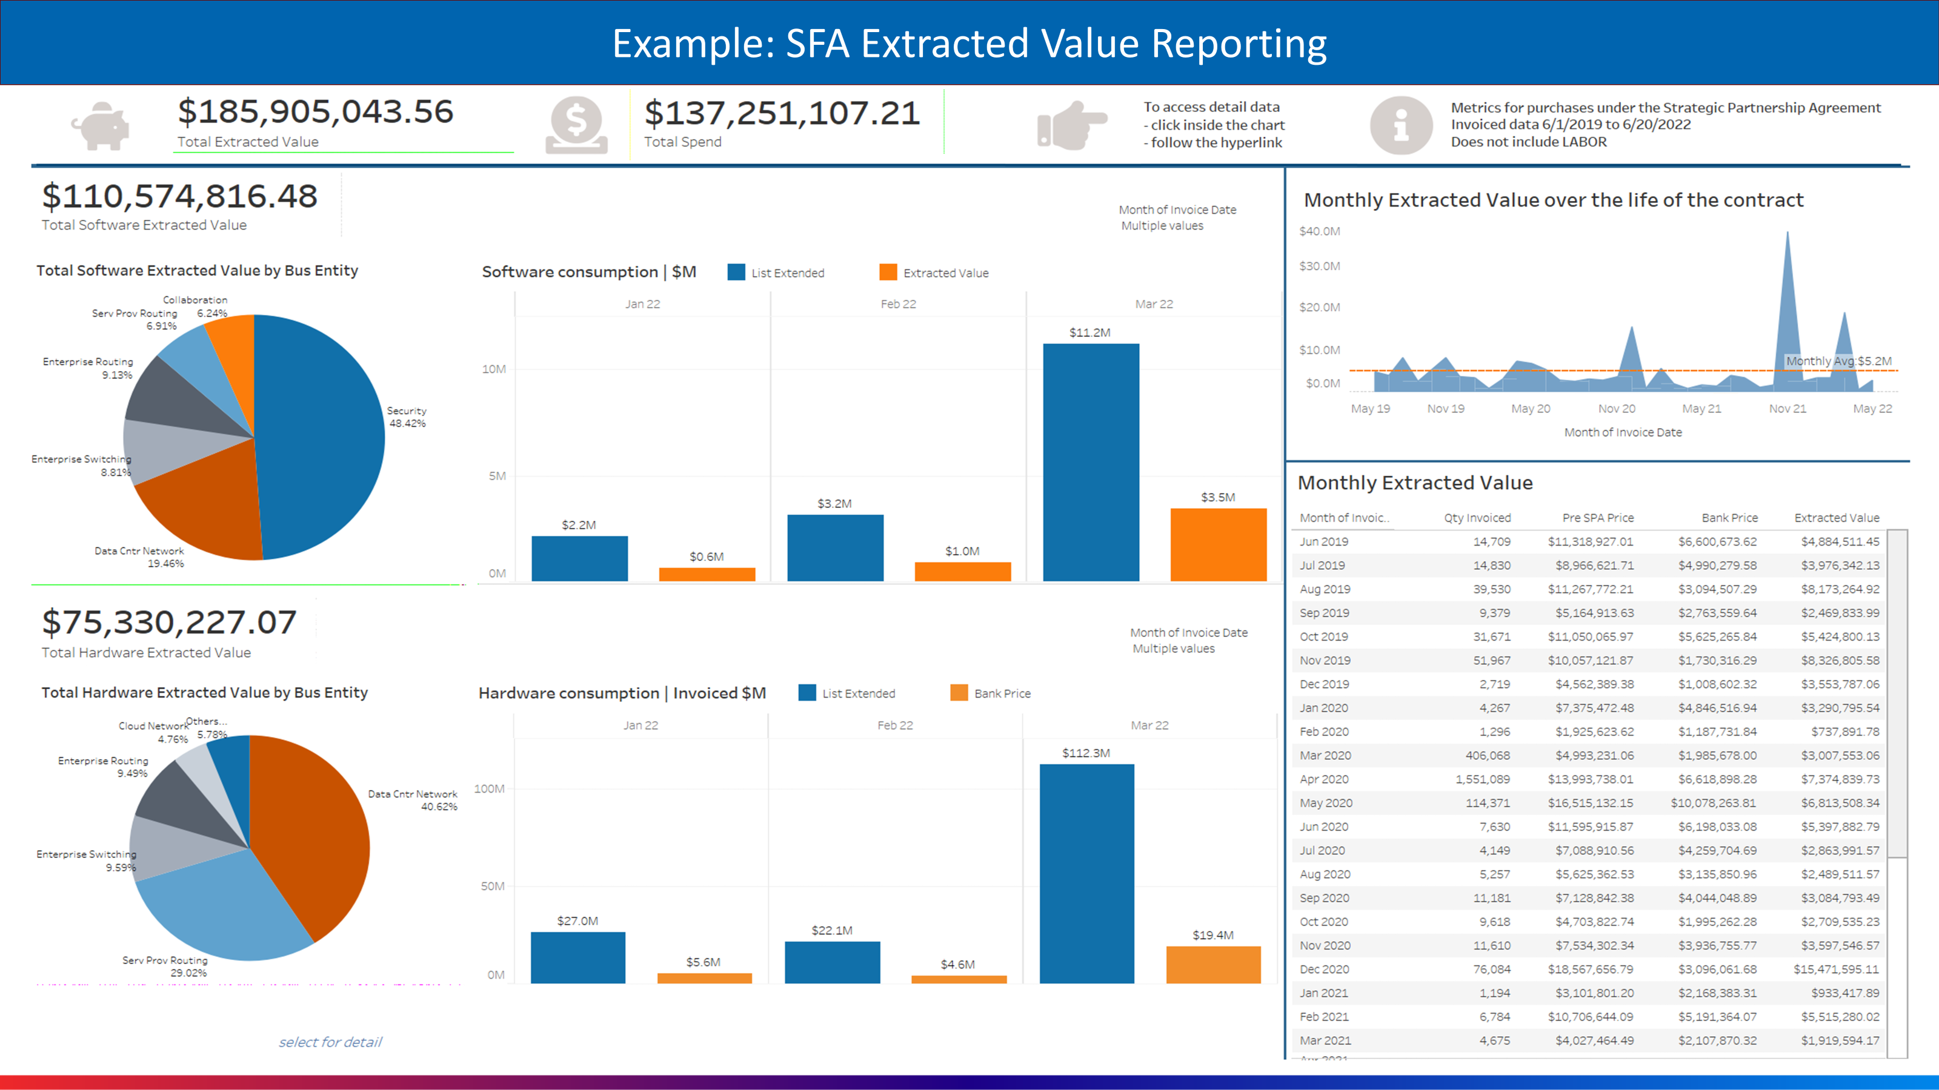

Slide 6
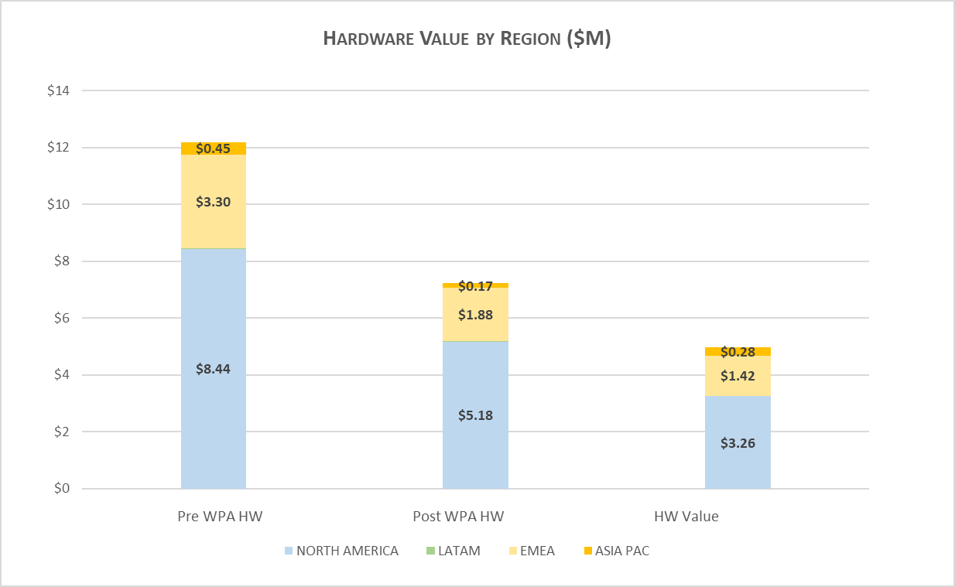
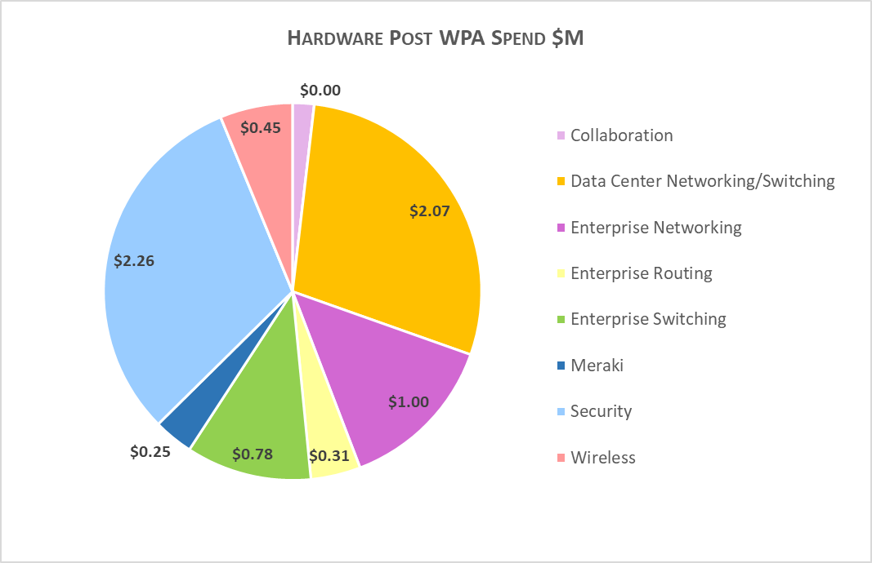
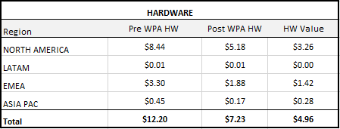
Sample Hardware Value
Year 1: April 2021 through March 2022
*All numbers based on WWT invoiced orders*

Slide 7
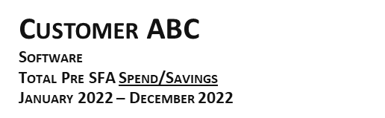
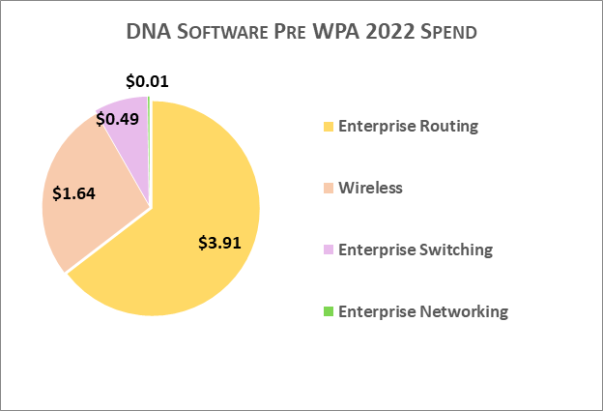
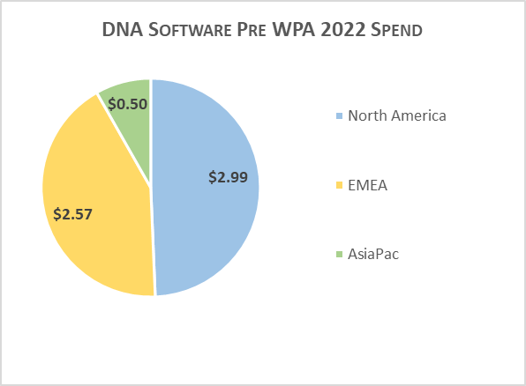
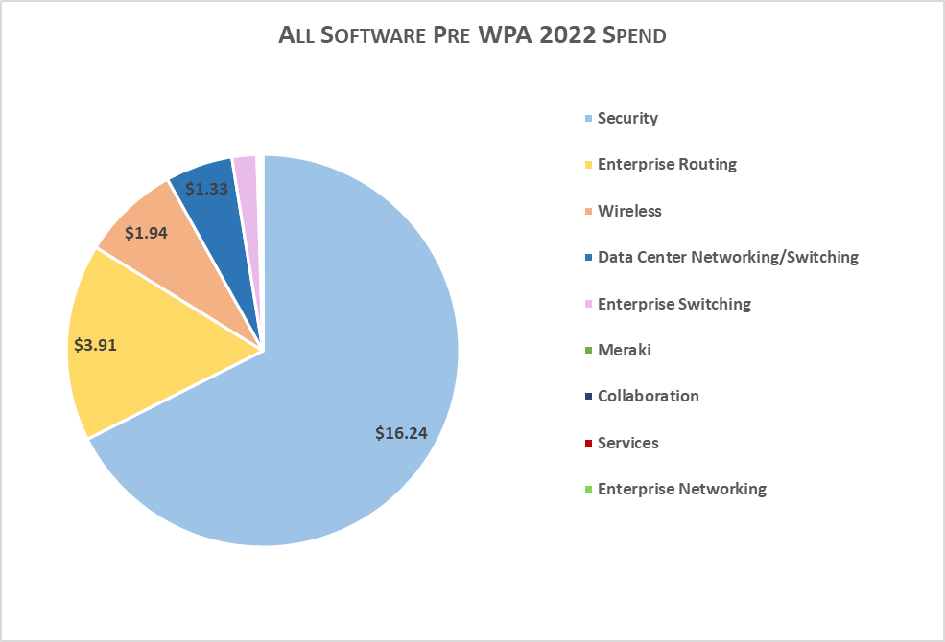
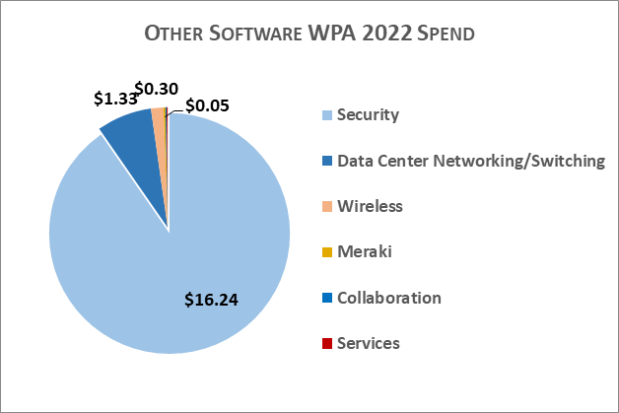
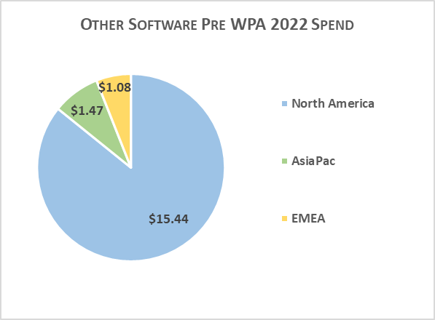

*All numbers based on WWT invoiced orders*
WWT Proprietary & Confidential
Notes:
This is showing the Pre WPA HW SPEND / SPEND WITHOUT WPA = $24.04
Or you say, this is SAVINGS, as SPEND with WPA is $0

Slide 8
SPA Return on Investment
Asset Management Deliverables (Monthly)
Management Deliverables (Monthly)
SFA ROI - Cumulative
$448M
$362M
$350M
$300M
$274M
$250M
$200M SFA…
$200M
$200M
$160M
$186M
$150M
$120M
$100M
$88M
$48M
$80M
$50M
$40M
$M
Yr 1
Yr 2
Yr 3
Yr 4
Yr 5
Non-SFA Cost
Cumulative SFA Payments
Breakeven
Projection (Based on Yr 1 continuation)
WPA ROI | Yr 1 | Yr 2 | Yr 3 | Yr 4 | Yr 5
Breakeven | $240M | $240M | $240M | $240M | $240M
Cumulative SFA Payments | $40M | $80M | $120M | $160M | $200M
Addl HW Cost (Pre-SFA) | $41M | $23M | $41M | $41M | $41M
Software Licenses | $25M | $63M | $25M | $25M | $25M
New Maint. Attach | $3M | $6M | $3M | $3M | $3M
Services (Maint./BCS/SVS) | $18M | $14M | $18M | $18M | $18M
Cumulative Savings | $48M | $106M | $154M | $202M | $248M
* If trend continues, breakeven would occur during Year 3 and would continue with total expected savings of $248M over the 5 years

Slide 9

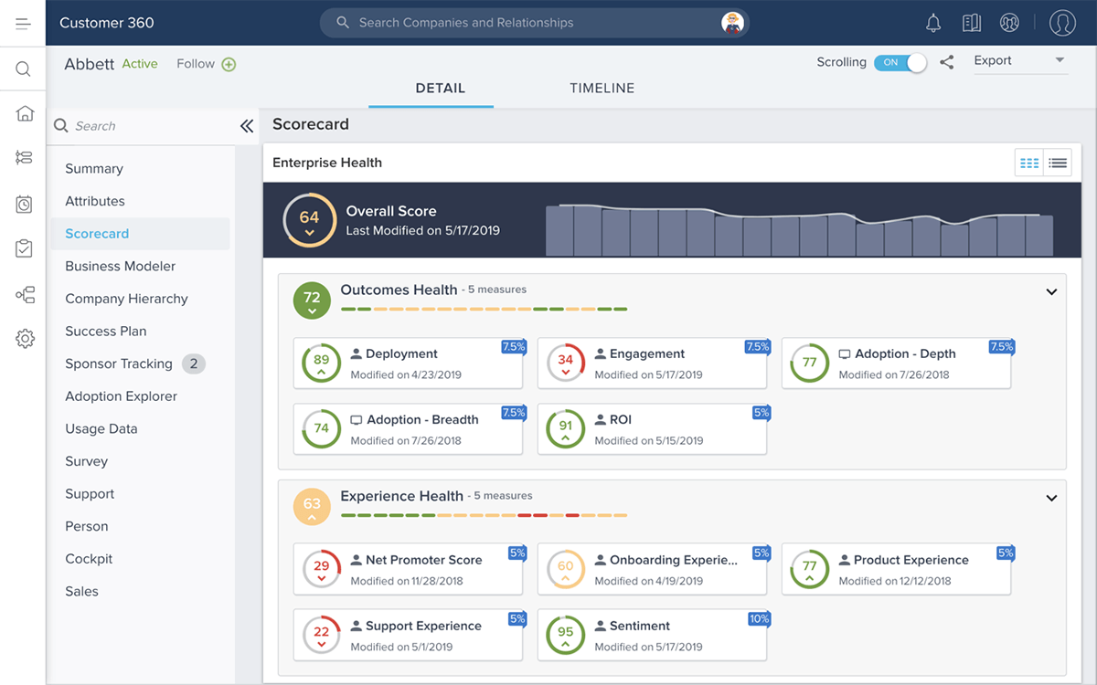
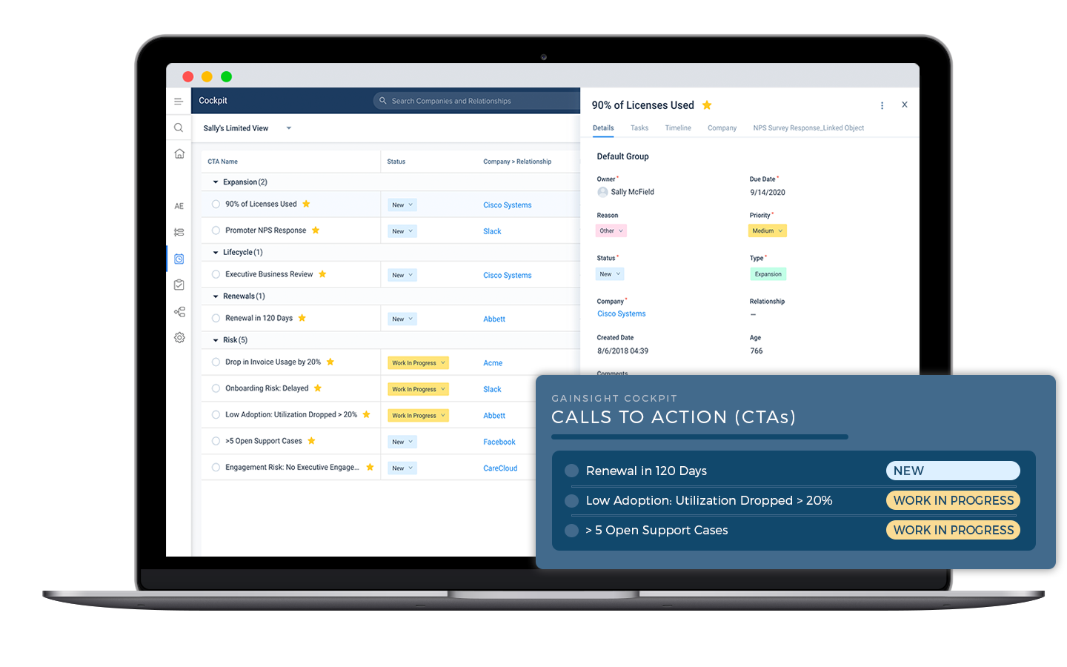
•Scale and Efficiency
•Establish trends/best practices and predict behavior
•Proactive vs Reactive
•Contract Health Scoring
•Real time visibility
•Expansion & Retention

Slide 10
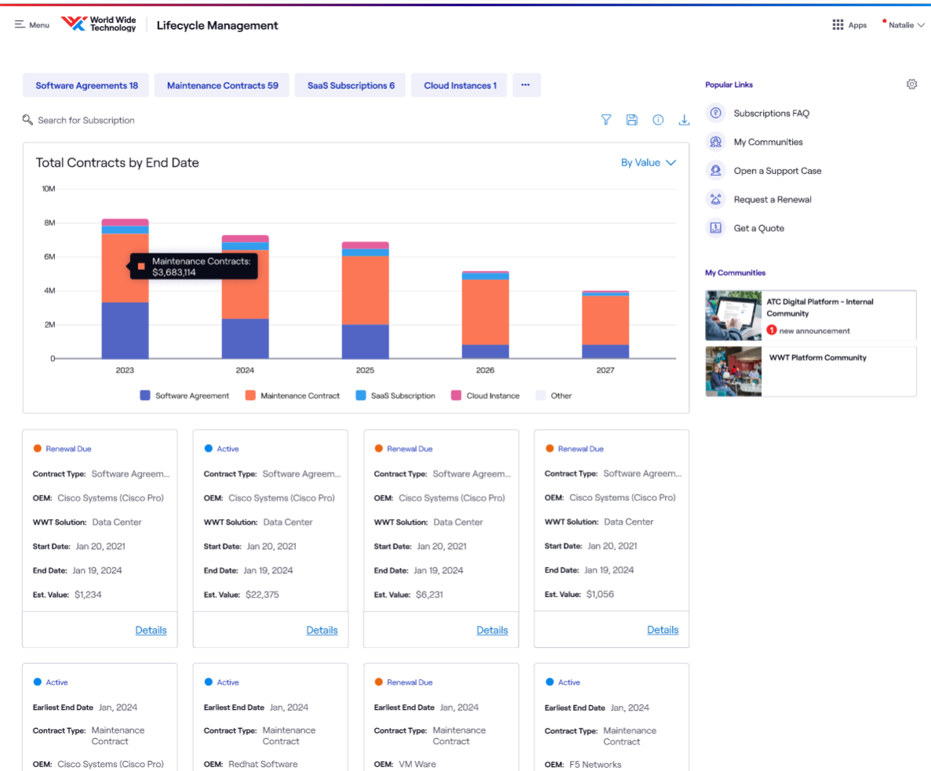
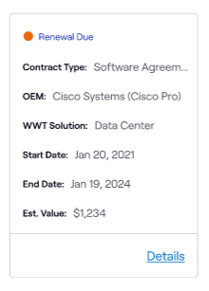
Summary view of term-based entitlements
Filter by Product Type
  SaaS/Subscription Products
  Enterprise Agreements
  Maintenance/Service Contracts
  HaaS and more…
Renewal Timeline Overview
High level card view with term dates associated
  Flagging of “Renewal Due” if end date is within 1 year
  Contract Status
  OEM and Product Type
  Estimated Contract Value ($)

Slide 11
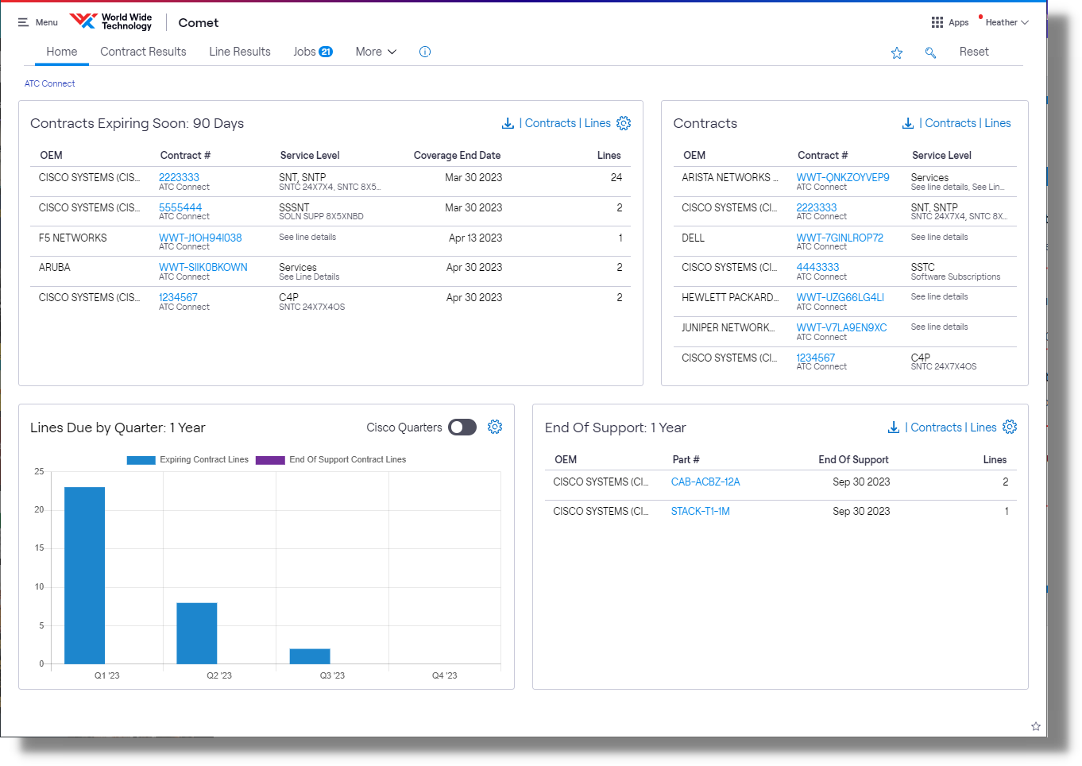




COMET PORTAL
Contracts Expiring Soon
Contracts expiring in 30, 60, 90 days
Lines Due by Quarter
Number of lines ending by calendar quarter or Cisco quarter
Contracts
Snapshot of renewal contracts
End of Support
Quick view of Cisco end-of-support devices

Slide 12
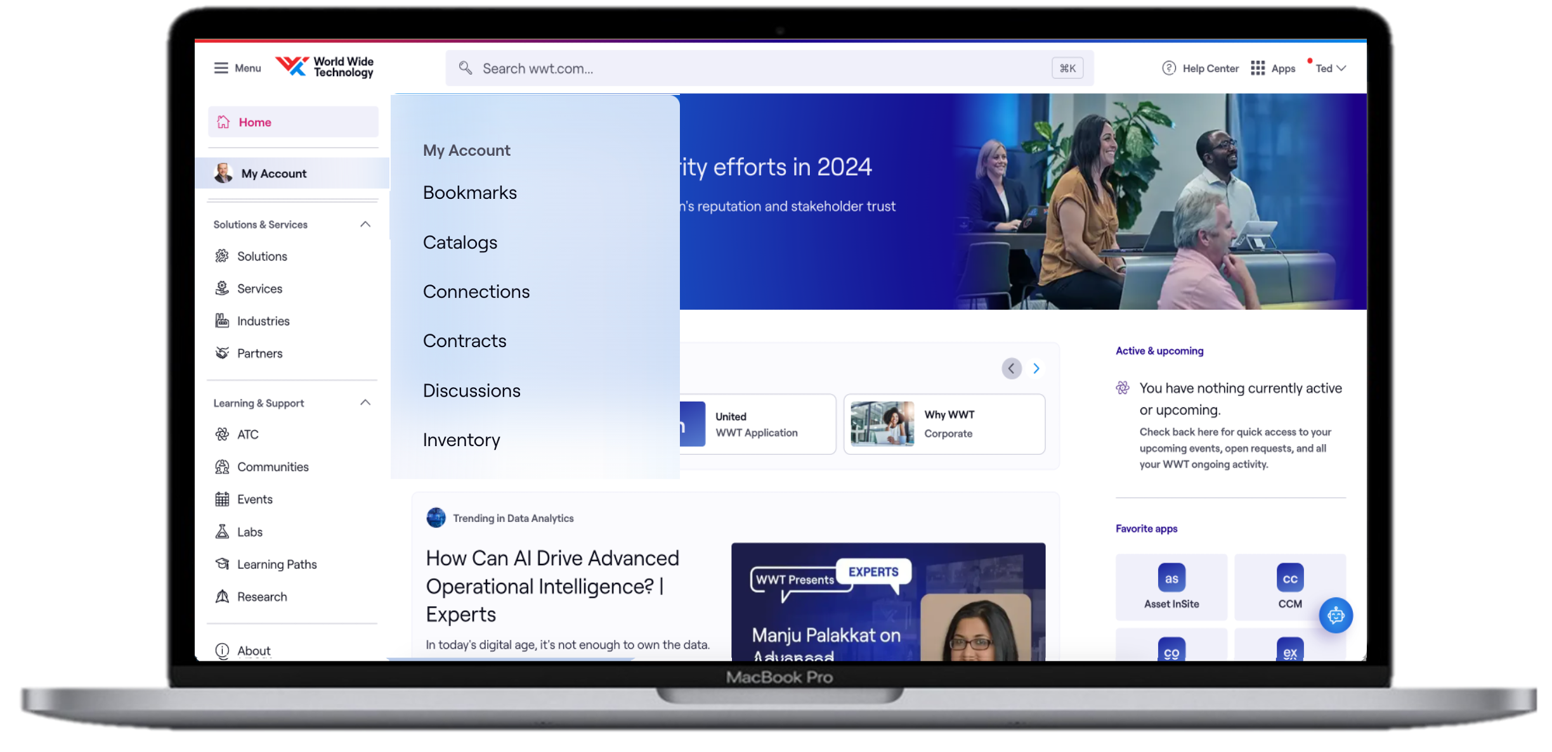


Value
Customers utilize our digital self-service
and eCommerce tools to evaluate, quote,
procure, assign, and track product.
These capabilities provide simple ways
to transact while reducing our customer’s dependency on WWT’s internal teams.
Real-time Access
& Availability
Streamlined
Ordering
Elimination of
Manual Errors
Integrated &
Non-Integrated Checkout
Frictionless
Customer Experience

Slide 13
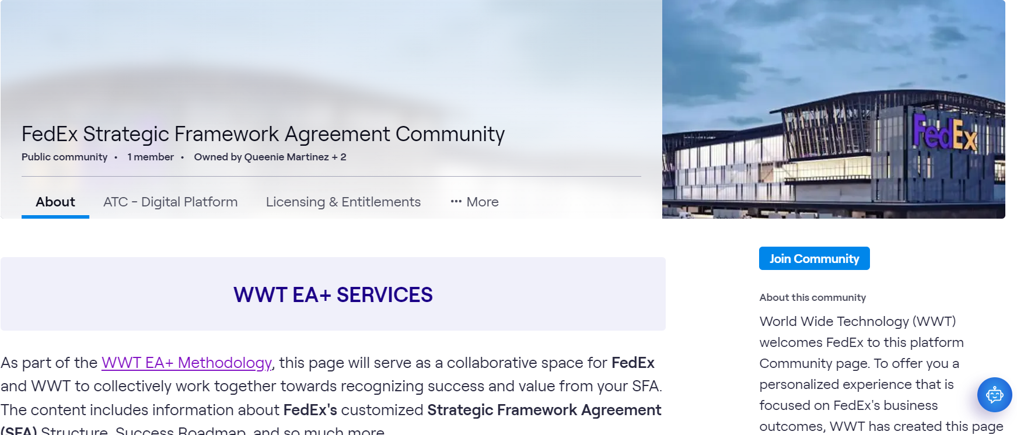
Digital Communities
https://admin.apps.wwt.chttps://admin.apps.wwt.com/pages/371716
om/pages/371716
Single one-stop-shop for all SFA information and utilization needs
“Living” content that can be easily updated to meet the needs of the customer
Consolidated view of all events – both WWT and Cisco, allowing customers to engage with technology experts as well as expand training skills
Time sensitive announcements that are pushed to Community members
One click engagement with Team Experts

Slide 14
