Slide 1
WWT Framework – Cisco SFA August 27, 2024
Accelerating business capabilities & speed to value
Minimizing risk – Reducing cost – Building efficiency
Brian Hoover – Client Executive
Max Blake – Systems Engineer
https://www.wwt.com/video/culture-of-innovation

Slide 2
The WWT Team
Account Leads:
Brian Hoover – Client Executive
Max Blake – Systems Engineer
Customer Experience & Operations Team:
Donna Herr – Manager, Customer Experience
Brendan Loughman – Sales Operations
Molly Stratman – Area Director, Sales Operations
Katie Frye – Business Relations Manager – IT Production
Pat Moriarty – Sales Operations
Jeff Nagus – Sales Operations
Karen Witzofsky – Sales Operations
Isaiah Vasquez – Asset Manager
Wender Bernosky – Director, Asset Management
Ashlyn Stephens – IT Production

Slide 3
AGENDA
August 27: 2:00 – 5:00 (Breaks as needed)
2:00 – Define & Collaborate on Success Metrics (best practices + customization as needed)
2:30 – Opportunity to PO Process
Overview of WWT Ordering Tool
Demo – Self Service Tool
Demo – My LCM (Subscriptions – Serial #'s – Assets)
Demo – COMET
Demo FedEx Community Page
Discuss & Align on Integration Requirements
4:45 – Final Demo and Next Steps
Cadence Schedule
SOW Progress
Notes:
11:00 – grab a plate (assuming food is ready and set up – Max is checking)
11:15 – Topic 1 – Introductions – Foundation Setting
11:30 – Topic 2 – Part 1: Operational Excellence – SFA Management Process
12:15 – break
12:25 – Topic 3 – Part 2: Operational Excellence – SFA Management Process
1:00 – Topic 4 – Global Sourcing & Supply Chain
1:20 – Q&A

Slide 4
WWT SFA Framework – Summary:
Part 1: SFA Standards
Standard Services
SFA Governance, reporting, validation, and contract management.
Access to WWT expertise across networking, automation, AIOps, Cloud, Security, etc.
SmartNet - WWT will provide automation advantages through a custom portal for Cisco licensing and SmartNet support. WWT will track assets in the Cisco portal, at no cost to FedEx.
Smart Account – WWT will lead and assist with governance and structuring.
Skilled Resources
Experienced team of resources, throughout the term of this Agreement.
A flex resource model, which can burst to additional team members, will allow us to leverage WWT SME and practice leaders. For Global objectives, we will have in-country alignment.
WWT Engineering Support
FedEx will have unlimited access to WWT OnDemand labs, WWT Research and other FedEx related content – through a customized, FedEx Community Page portal.
WWT will provide, at minimum, four (4) custom innovation acceleration sessions per year.

Slide 5
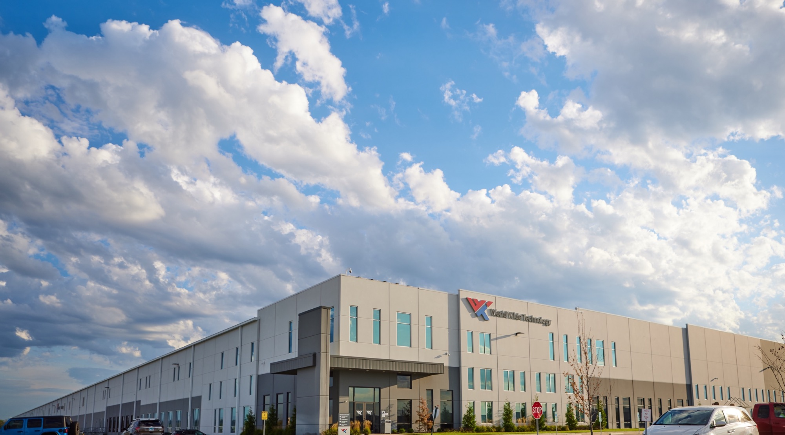
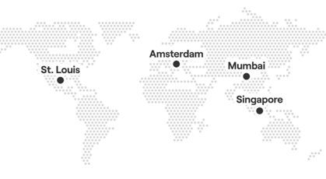
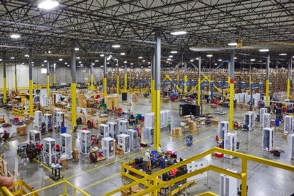
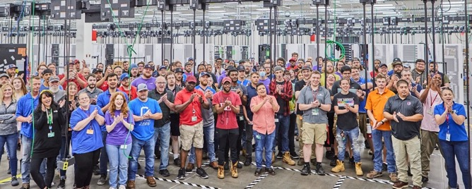
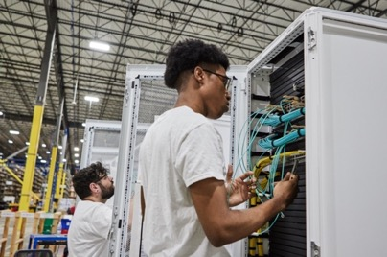
Part 2: Global Supply Chain
100,000+ orders processed each year with 99.4% accuracy
4 million
Square feet
on 3 continents
325
Concurrent rack
build stations
800,000+
Integrated systems shipped annually
Integration Centers
Staging and Integration • Material Planning • Order Management • Just-in-time Delivery
Notes:
Our solutions don’t stop in the lab. We simplify the complicated supply chain as a single point of contact to procure hardware and software, design, build, test and deploy fully integrated systems globally, on time and on budget. Our team of 600+ professionals span three continents and deliver on more than 100,000 orders annually with a 99.4% accuracy rate while minimizing environmental impact. Our ESG efforts have been recognized with a 2023 Sustainability Impact Award, and we are charting our path—as well as the path for many of our customers—toward NetZero.

Slide 6
Success Metrics – from Good to GREAT
Financial (Savings – ROI – ETC)
Procurement Simplicity
Greater Visibility, Governance & Reporting
Simplification of OEM ecosystem
Improved process documentation and execution
What else is important to FedEx that needs to be measured?
??
??
??

Slide 7
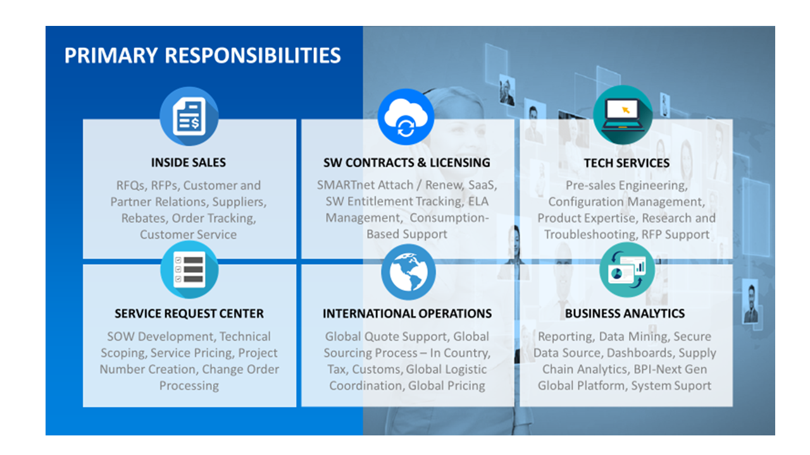
WWT Sales Operations
Notes:
11:00 – grab a plate (assuming food is ready and set up – Max is checking)
11:15 – Topic 1 – Introductions – Foundation Setting
11:30 – Topic 2 – Part 1: Operational Excellence – SFA Management Process
12:15 – break
12:25 – Topic 3 – Part 2: Operational Excellence – SFA Management Process
1:00 – Topic 4 – Global Sourcing & Supply Chain
1:20 – Q&A

Slide 8
Opportunity to Delivery
WWT Team Alias: FedEx@wwt.com
QUOTING PHASE
PURCHASING & LOGISTICS
FEDEX EMAIL FEDEX@WWT.COM
CSE BOM VALIDATION
ISR REQUESTS
& RECIEVES PRICING
QUOTE SENT TO FEDEX
FEDEX CREATES OCF REQUEST
PO APPROVAL WORKFLOW
PURCHASING & LOGISTICS
ORDER SENT TO BUYER
EQUIPMENT DELIVERED TO INTEGRATION CENTER
INTEGRATION SERVICES
DELIVERY COORDINATED BY ORDER MANAGER
PRODUCT DELIVERED TO FEDEX FACILITY
CUSTOMER INVOICES INC. TAX AND IOR/CUSTOMS
Notes:
11:00 – grab a plate (assuming food is ready and set up – Max is checking)
11:15 – Topic 1 – Introductions – Foundation Setting
11:30 – Topic 2 – Part 1: Operational Excellence – SFA Management Process
12:15 – break
12:25 – Topic 3 – Part 2: Operational Excellence – SFA Management Process
1:00 – Topic 4 – Global Sourcing & Supply Chain
1:20 – Q&A

