Slide 1
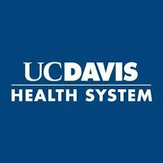
Introduction to
World Wide Technology
Make a new world happen
Notes:
Slide Purpose: Introduce discussion about WWT and the impact our solutions can have on the client’s business and technology objectives
Key Topics:
Thank you for the opportunity to learn more about your organization and share info on WWT, our capabilities and key differentiators
Alternate slide(s): N/A

Slide 2
Agenda
Voice of UC Davis Health
WWT Overview
WWT in Healthcare
WWT / Cisco
WWT / UC’s, UC Davis Health

Slide 3

Voice of the UC Davis Health
Technical debt
Compliance
and regulatory pressures
Growth expectations
Software Asset Management
Clinical leadership
Cost to serve and
ROI validation
AI and automation
Accelerated schedules
Cyber and data privacy
Legacy systems and processes
Business justification
Resource optimization
Data management and analytics
Tech innovation
Cloud complexity and management
Talent shortage and skills gap
Quality of service
Sustainability
Digital transformation
Vendor and industry consolidation
Remote and distributed teams
Culture
Notes:
Every business is a tech business
Slide Purpose: Show our understanding of the challenges those in IT leadership roles face; we know your job is challenging
Key Topics:
Virtually every industry has been disrupted by digital transformation in the last decade, including a whole host of challenges
Ask audience if any of these resonate with them
Alternate slide(s): 45 (message is more C-suite / board level-focused)

Slide 4
WWT Overview

Slide 5






WWT is a global IT solution provider, solving the business and technology challenges of enterprises for more than 30 years.
$20 billion
Annual revenue,
$6.6b International, $1.1b Services
Privately held
12,000+
Team members globally
82%
Of the Fortune 100 enlist
WWT as a solution provider
Across industries
Financial Services, Healthcare, Life Sciences, Energy & Utilities, Manufacturing, Retail, Web Scalers, Global Service Providers and Public Sector
#1 partner to
And many more
200+
Partner network
130 countries
Leveraging WWT solutions
14 years running
Fortune “100 Best
Companies to Work For”
Sustainable
growth
Deep industry
expertise
Global partner
ecosystem
Recognized culture
of innovation
Notes:
Slide Purpose: Provide a brief overview of WWT
Key Topics:
WWT is a growing company
Industry expertise leveraged by the Fortune 100 across large vertical industries
Global capabilities and aligned with more than 200 OEM partners
Committed to a culture of innovation that allows us to solve client challenges
Alternate slide(s): 20, 41, 42, 43

Slide 6
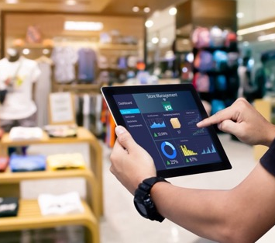




Transformational Solutions
Delivering our most in-demand technology solutions to accelerate key client outcomes
Customer & Employee Experience
Application Development & Data Platforms
AI Studio
AI Foundry
AI Factory
Cyber Resiliency
Cyber Risk & Regulatory Response
Zero Trust Architecture
Network Modernization
Cloud &
Data Center Modernization
Software Asset Management
Microsoft Solutions
ADVISORY & CONSULTING • IMPLEMENTATION • SUPPORT
Digital
AI
Cyber
Cloud + Infrastructure
Software
Advanced Technology Center
WWT Research
Labs and Learning
Cyber Range
AI Proving Ground
Proofs of Concept
Lab Hosting
Notes:
Slide Purpose: Showcase our Transformational Solutions portfolio
Key Topics:
Transformational Solutions typically involve complex projects that are in high demand around our 5 Focus Areas
These are common ways clients choose to engage WWT
We have proven success in these areas
Alternate slide(s): 11

Slide 7








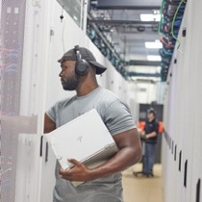




WWT’s Advanced Technology Center (ATC)
Learn more
A physical and virtual environment, accessible from anywhere in the world, to help you make the right technology decisions faster
…and many more!
$1B+
Infrastructure
investment
20,000+
Virtual machines
in the cloud
200+
OEM partner
ecosystem
500+
Rack
capacity
6,000+
Customer
engagements
WWT Research
Labs and Learning
Cyber Range
AI Proving Ground
Proofs of Concept
Lab Hosting
ATC PRODUCTS
On-demand research papers, webinars, blogs, expert insights
Hands-on, interactive access to technology labs and curated learning material
Train your teams to defend against emerging security threats through hands-on experiences
Explore, design, test, and select your
next-gen AI architecture
Bake-offs, performance validation, functionality, upgrades/migrations
Let us create your own ATC: secure, available, and online
Notes:
Slide Purpose: Convey the value and capabilities of the Advanced Technology Center (ATC)
Key Topics:
A configurable lab environment where you can integrate technologies into architectures that become solutions
Leverages our deep alignment with more than 200 OEM partners to deliver multi-vendor, real-world environments.
Helps you make the right decisions faster and de-risk deployments while upskilling your team
Ability to conduct Proofs of Concept; access hands-on labs, learning paths, a wealth of thought leadership and research; and connect with our experts
Alternate slides: 47, 48

Slide 8
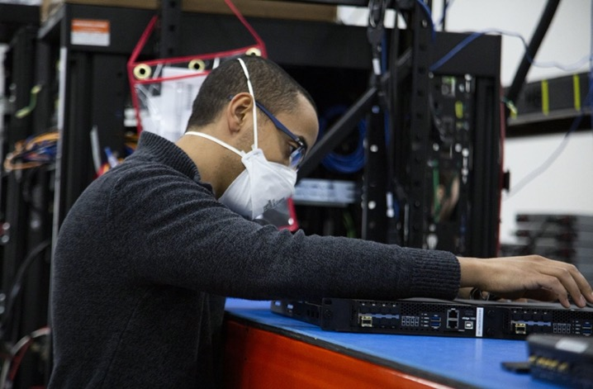
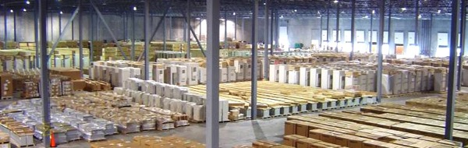
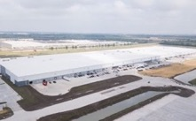
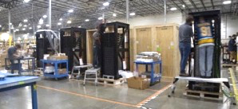
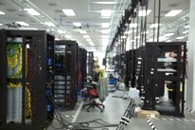
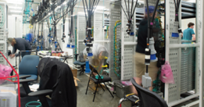
WWT’s Integration Centers - Deployment at Scale
4 million sq. ft. on 3 continents • 100,000+ orders processed each year
325 concurrent rack build stations • 800,000+ integrated systems shipped annually
St. Louis • Amsterdam
Singapore • Mumbai
Staging and Integration • Material Planning • Order Management • Just-in-time Delivery
Notes:
… just as our Global Supply Chain Services do. Deploying at scale with a global supply chain is very complex, especially right now. Our integration centers span 4 million square feet, across three continents, supporting $14.5B of business annually. Our teams can simplify the supply chain by acting as your single point of contact to procure hardware and software and design, build, test, and deploy fully integrated systems on time and on budget.

Slide 9
WWT In Healthcare

Slide 10

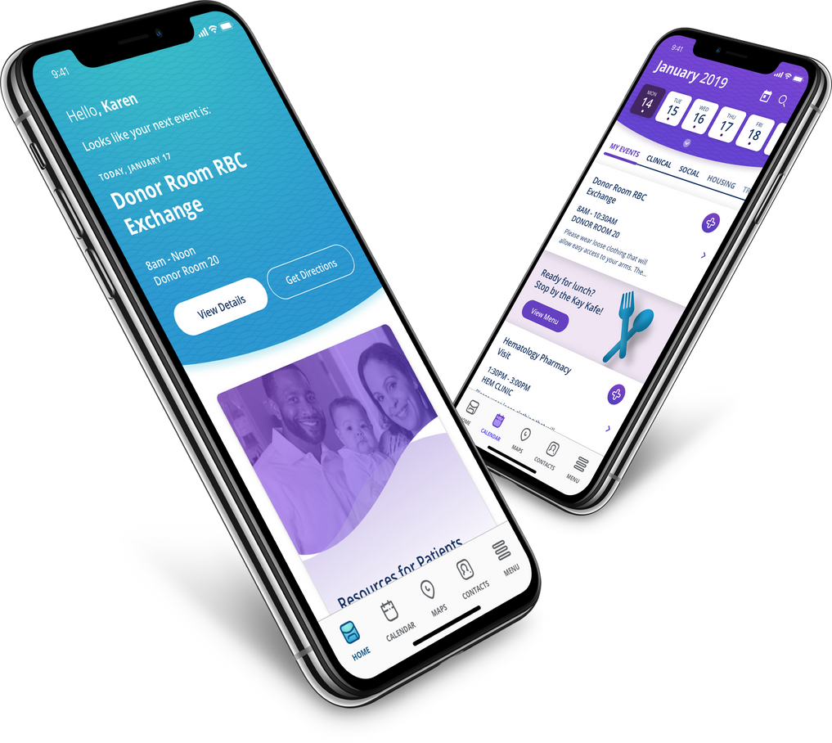

CASE STUDY
ST. JUDE HOSPITAL
CHALLENGE
St. Jude Children's Research Hospital sought to create an
end-to-end, digital experience for the patient journey
WWT BUILT AN AWARD WINNING, PATIENT-FACING APPLICATION REQUIRING INTEGRATION OF NUMEROUS APPLICATIONS RESIDING INSIDE AND OUTSIDE OF THE HOSPITAL WALLS INCLUDING:
SOLUTION
  EHR & PRACTICE MANAGEMENT APPLICATIONS
  HOSPITALITY, RETAIL, AND TRAVEL APPLICATIONS
  CALENDAR SYSTEMS
  TELEMEDICINE PLATFORMS
  PHARMACY APPLICATIONS
2020 Webby Award Winner

Slide 11


CASE STUDY
CALL CENTER TRANSFORMATION
CHALLENGE
Large academic children's health system caring for 1M patients/year. Scheduling call center fields 5,000 calls/wk, with average patient time through IVR of 2 min.
GOALS
  Capture an estimated $1M of appt opportunity per day
  Use AI to transform the patient scheduling experience
  Improve patient experience and reduce leakage
  Improve patient outcomes with timely appt access
WHAT WE DID
DEVELOPED PATIENT-CENTRIC PATHWAYS ON GOOGLE'S CCAI.
  HUMAN-CENTERED DESIGN OF CUSTOM CONVERSATIONAL PATHWAYS
  Workshops with clinical teams to map USER JOURNEYS
  IMPLEMENTED CLINICAL AND OPERATIONAL BEST PRACTICE PROTOCOLS LEVERAGING CUSTOMER'S KNOWLEDGE ENVIRONMENTS

Slide 12
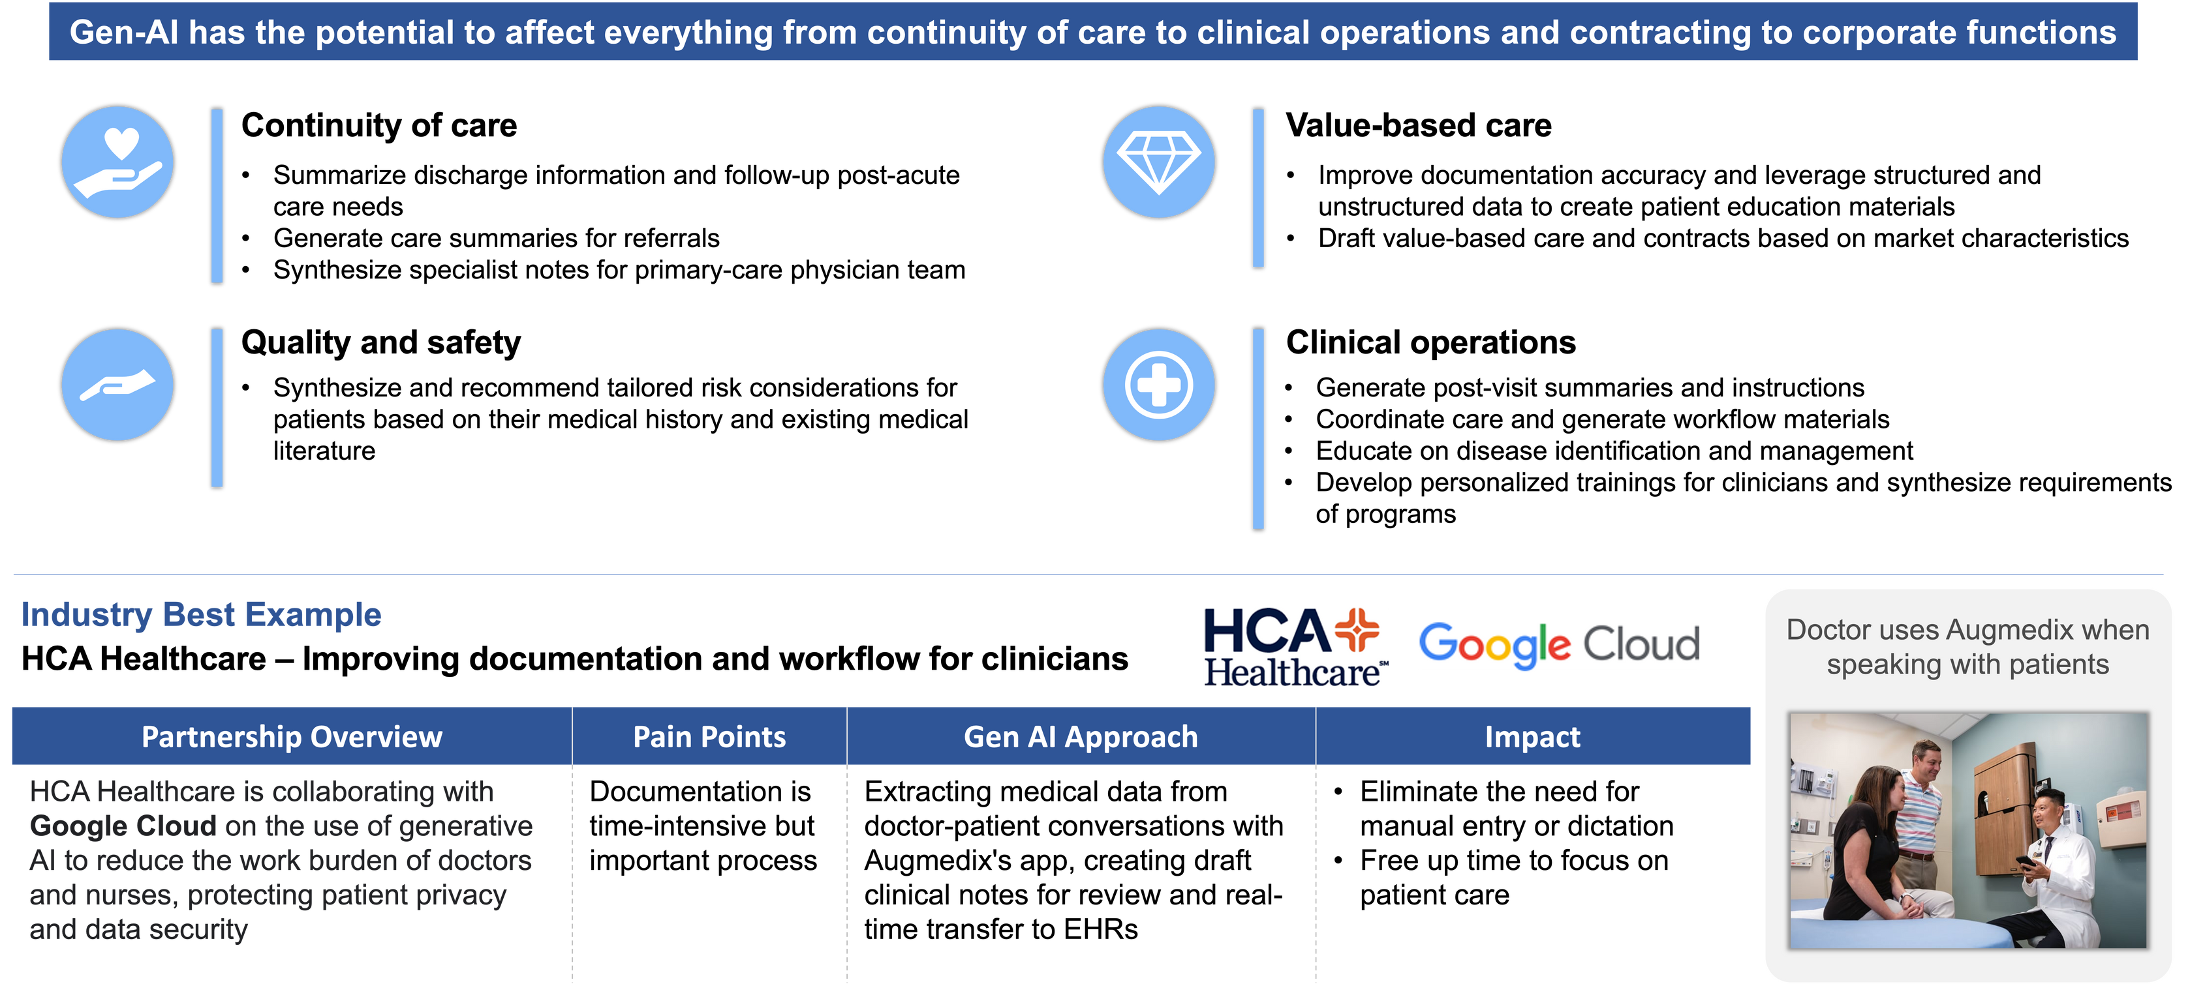

GenAI for Clinician Experience
CLIENT SPOTLIGHT:

Slide 13


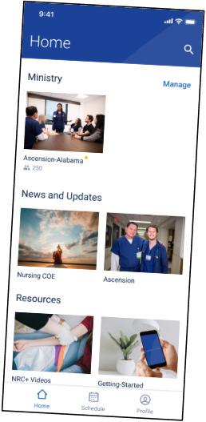

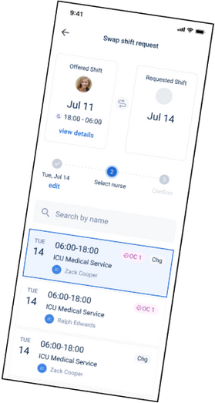
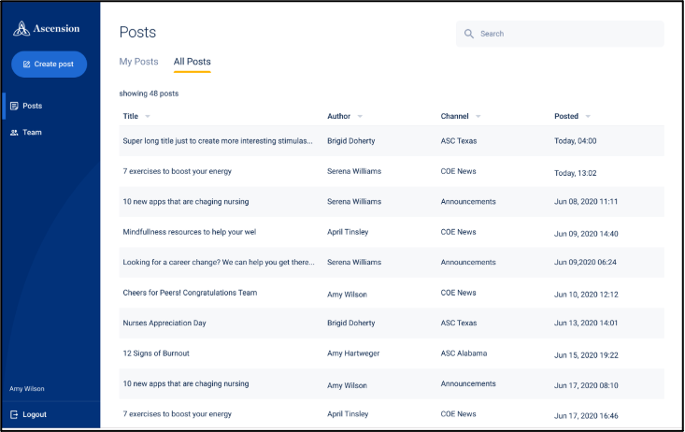
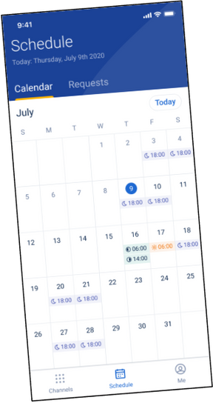


Welcome!
We want you to thrive professionally and personally while keeping you abreast of important news and updates in your community.
Login
Privacy Policy
CASE STUDY
NURSE EXPERIENCE
WHAT WE BUILT
WEB, IOS, AND ANDROID APPLICATION INTEGRATING WITH SEVERAL THIRD PARTY APPLICATIONS TO PROVIDE:
  Dynamic shift scheduling, backfilling, and swapping
  Market-specific collaboration and news dissemination
  Professional development training, CME, licensure
  Medical content and collateral
Large, national nonprofit health system
CHALLENGE
To improve satisfaction and retention of their 65,000+ nurses with a digital solution that serves their administrative, collaborative, and professional development needs.

Slide 14
WWT / Cisco

Slide 15
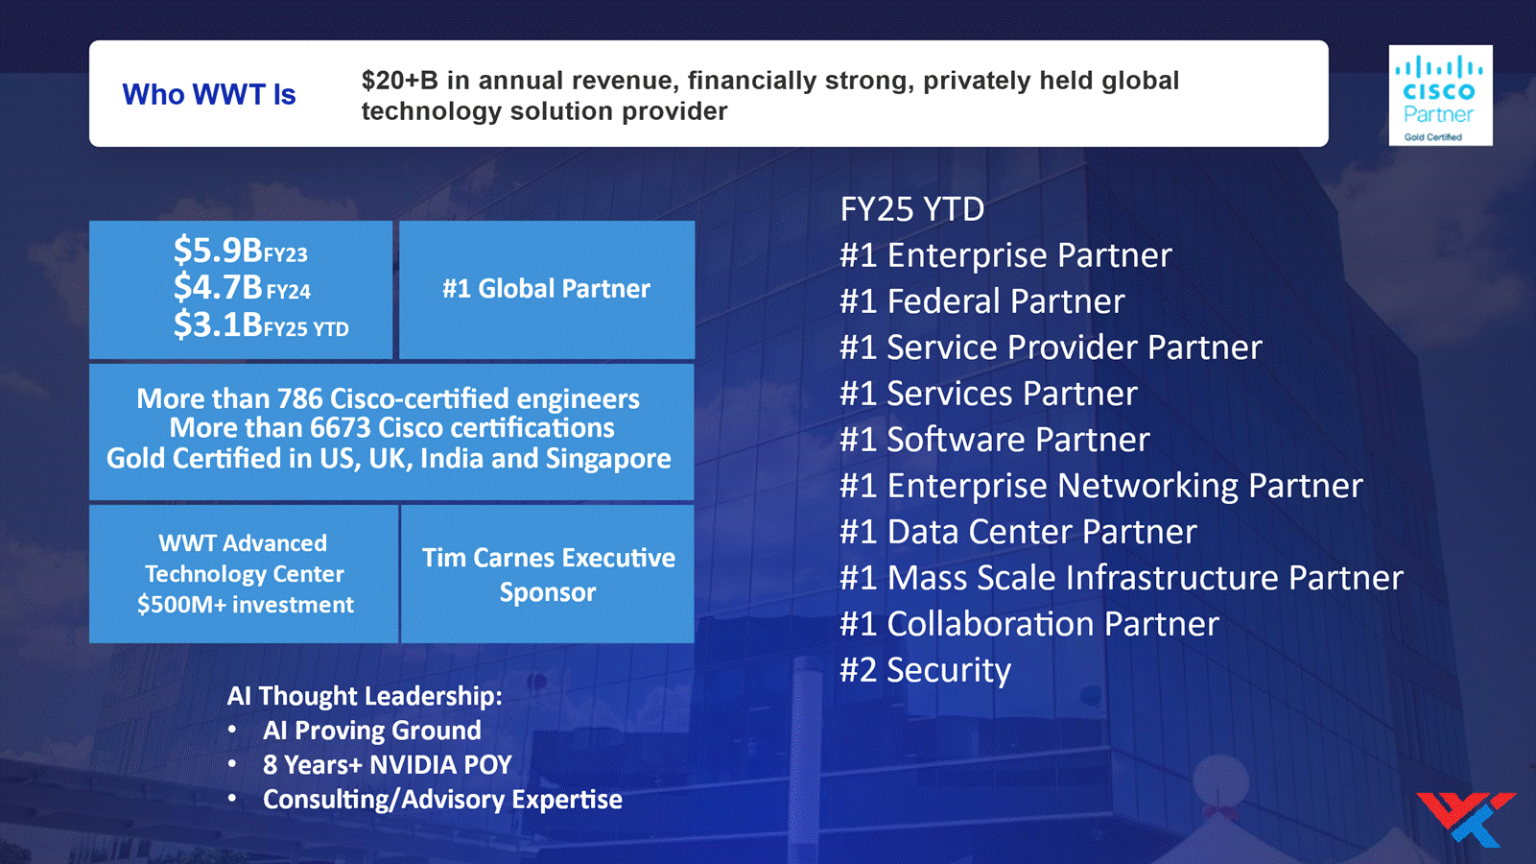

Slide 16








Aligning With WWT’s Strategy to Solve Customer Problems
“
“
“
“
“
“
“
I need to engage
my customers
I need to ensure worker productivity
I need to securely connect my workers
I need to run, optimize, & protect workloads
I need to manage, protect, & leverage my data
I need to automate everything I can
I need to improve my visibility and threat prevention
Customer Experience
Workforce Experience
Connected Workforce
Cloud
Platforms
Data
Strategy
Automate Everything
Cyber
Security
Webex Connect
Webex Contact Center
Contact Center Enterprise (UCCE)
ThousandEyes
Secure Hybrid Work
Webex Suite
Webex Devices
Cisco Spaces
Secure Client
Umbrella
ThousandEyes
Meraki Systems Manager
Catalyst & Meraki Switching & Wireless
Viptela & Meraki SD-WAN
Meraki Z
ISE
Duo
Secure Client
ThousandEyes
Intersight Workload Optimizer
ACI
Nexus Cloud/Dashboard
Cloud OnRamp for Multicloud
Secure Firewall Cloud Native
Secure Cloud Analytics
Secure Cloud Insights
App Dynamics
Hyperflex
Converged Infrastructure
Secure App
Secure Workload
IoT Connectivity & Security
App Dynamics
ThousandEyes
Intersight Workload Optimizer
ACI
DNA Center
Webex Connect
NSO
DevNet & APIs
SecureX
Secure Firewall
Umbrella
SecureX
Secure Endpoint
ISE
Duo
CyberVision

Slide 17


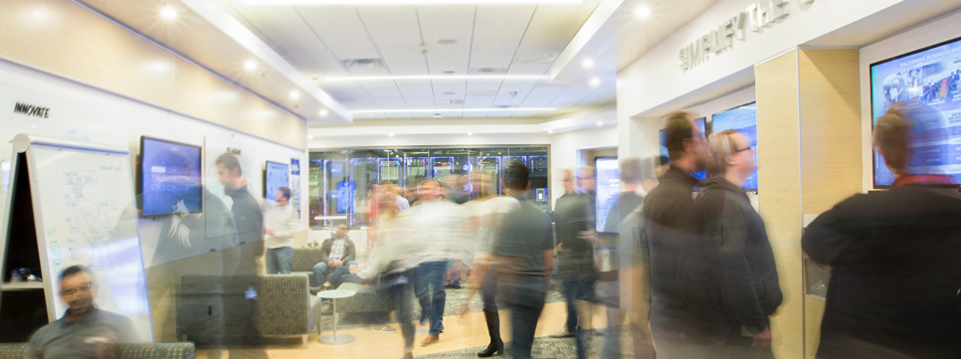
WWT Advanced Technology Center (ATC)
Hyperscale Innovation Labs
ATC Offerings
WWT Research
In-depth analysis of the latest industry trends, solution comparisons and expert guidance for maturing your organization's capabilities.
WWT Labs &
Learning Paths
Helping customers build skills and understanding of complex technologies through hands-on lab environments and educational resources across Security, Infrastructure, Automation, Cloud and Digital.
20,000+
VMs in the ATC cloud
$900M+
Infrastructure investment
200+
OEMs
500+
Rack capacity
600+
Pre-built capabilities
6,000+
Customer engagements
WWT Cyber
Range
Combining real-world, hands-on learning with entertaining gameplay on a scalable platform that can facilitate any type of force-on-force simulation to sharpen skills and evaluate emerging tech.
Proofs of concept
Proofs of concept leverage our existing (and expanding) data center infrastructure, equipment from our strategic partners and OEMs, and our solution experts and test automation capabilities to quickly simulate a solution or implementation.
87 Cisco Labs
69 Cisco Learning Paths
Cisco’s Investment in the
WWT AI Proving Ground exceeds 3M
Updates and
migrations
Product
comparisons
Architecture
validations
Performance and
functionality
Outcomes
Hands-on, on-demand experience
Real-world insights and research
Practical and actionable guidance
Compare, contrast and validate
Strategy, expertise and training
Lab as a Service
Drive down costs and time to market with dedicated, on-demand access to lab data center space that is built to suit in an isolated and secure data center environment.
Notes:
As described earlier, underpinning many of our solutions is our Advanced Technology Center, the ATC. This $500M state-of-the-art lab consisting of hardware, software and a team of technologists accelerates and de-risks architectural solutions well before deployment by providing product testing and comparisons as well as design validation and proofs of concept. It saves many of our customers time, money and headaches ...

Slide 18
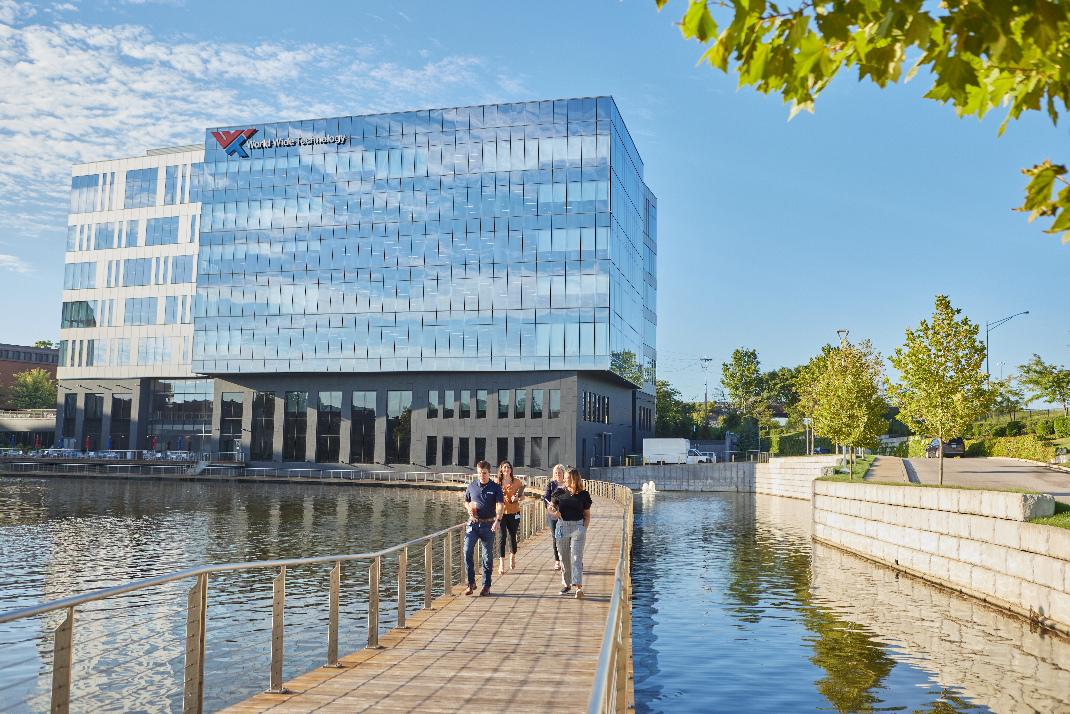
WWT’s EA+ includes customizing a solution that meets customer’s technology requirements, business needs, long term goals and allocated budget plus remains engaged post signature to drive adoption and maximize ROI.
26.7%
95%
90%
SOFTWARE UTILIZATION
When viewing the overall impact of our EA+ Customer Success and Adoption Services, we see an average increase of 26.7% in utilization of software entitlements.
TCO SAVINGS
When structuring a like-for-like renewal agreement, WWT’s Software Advisors are able to negotiate top-tier discounts that drive savings for our customers over 95% of the time.
RENEWAL RATE
WWT drives a greater than 90% renewal rate across our entire portfolio of 550+ Enterprise Agreements, that is consistently growing by over 30% each year.

Slide 19
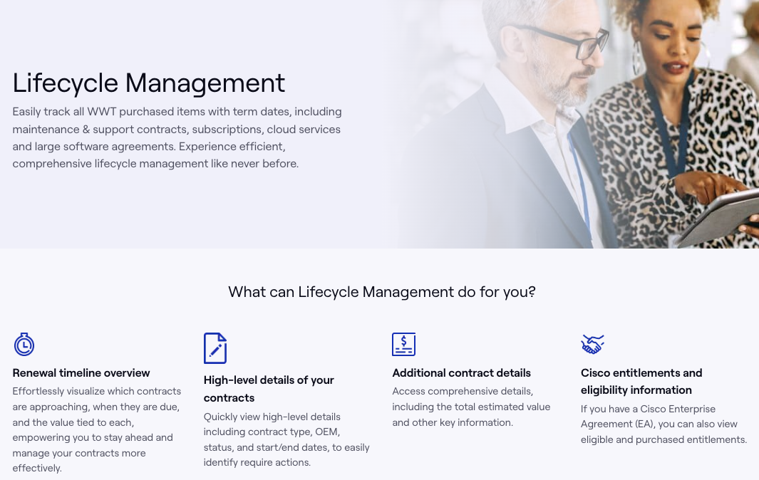

Slide 20
WWT / UC Davis Health

Slide 21



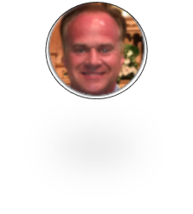

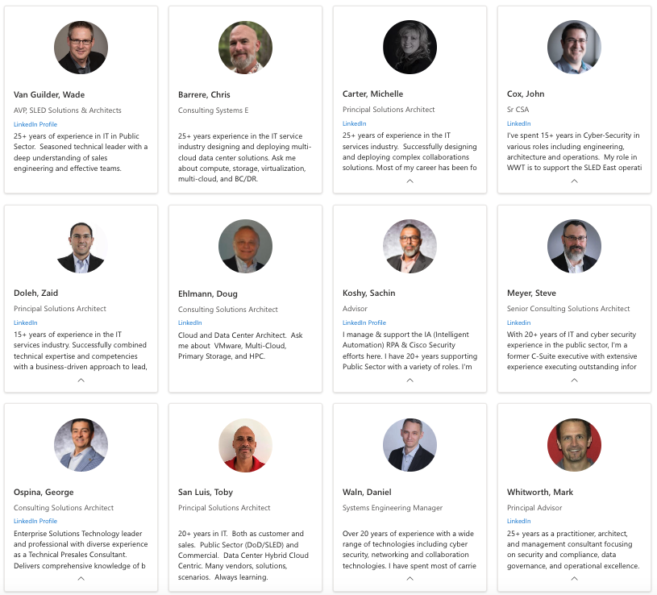





University of California - Sales Organization Chart
Brian Capporici
CSE –DC and Storage
Eric Koontz
CSE DC and Networking
Arshad Jones
Sr Systems Engineering Mgr
Sarah Senftle
SLED Alliance Manager
Mike Horner
Partner Director
Colin Martin
CSE – Cisco and Networks
Colin Marks
SLED Aliance Manager
Adam Petrovsky
California SLED Director
Hollie Anderson
Sr Global Alliance Manager
Dannielle Hill
Inside Sales
Jerry Tonies
UC System Client Executive
Hani Shouga
Director, SLED Services
Dedicated UC Service Team
Wade Van Guilder
VP, SLED Solutions & Architects

Slide 22






Example Cisco Engagement
EA+/ Comet Training
Inventory, Order Status
Customer Liaison
Quarterly Review
Place Order
Presales
Eric, Jerry, Jessica,
WWT License Consulting Team
Online, Traditional Quoting
WWT Portal
EA+, Smartnet Customer Liasson
UCOP OEM Contracts
Online Quoting Example
Inventory Example
Contract Example
WWT / UCOP Master Services Agreement

Slide 24















Empowering leading organizations across the most demanding industries
82 of the Fortune 100 rely on WWT
12 of the 15 largest U.S. financial services organizations
11,000 hospitals and treatment centers
100+ of the world’s largest manufacturers
30% of the
top quick serve restaurants (QSRs)
FINANCIAL SERVICES
HEALTHCARE & LIFE SCIENCES
MANUFACTURING
RETAIL / QUICK SERVE RESTAURANTS (QSRs)
5 of the top U.S. Electric & Gas Utilities
The 3 largest web hyperscalers, largest Tier 1 telcos and cable operators
All Federal departments and branches of the Military
70% of our nation’s people impacted by WWT solutions
UTILITIES & ENERGY
TECH / WEB SCALERS / SPs
FEDERAL GOVERNMENT
STATE & LOCAL GOVERNMENT, EDUCATION
Notes:
Slide Purpose: Show WWT’s deep engagement in primary industry verticals
Key Topics:
Our technology expertise is complemented by deep industry insights that have been gathered over the last 30+ years
Alternate slide(s): N/A

Slide 25


Higher Education
Across 21 states and running
These 68 institutions have
the following breakdown:
68 Institutions
49 universities
18 community colleges
1 institute
By The Numbers
52 public schools
16 private schools
(11 private not for profit, 5 private)
16
land grant
universities
32
space grant
universities
24 Hispanic serving
institutions (HSI)
and
16
sea grant
universities
2
sun grant
universities
5 Historically black
colleges and universities (HBCU)
Notes:
These 49 institutions have the following breakdown:
40 public schools, 13 private schools (10 private not for profit, 3 private)
13 land grant universities, 26 space grant univeristies,13 sea grant universities, 2 sun grant universities,
20 Hispanic serving institutions (HSI)
2 Historically black colleges and universities (HBCU)
1 university administrations, 2 community college administrations

Slide 26

Higher Education Research
26
R1 research institutions
5
R2 research institutions
4
Doctoral research institutions
1
special focus
research institution

Slide 27









Leading Innovation with Our Partners
Fair and accurate depictions of how these technologies work
#1
#1
#1
#1
#1
GOLD PARTNER
TITANIUM BLACK PARTNER
ELITE PARTNER
PLATINUM PARTNER
STAR PARTNER
#1
#1
#1
#1
PRINCIPAL PARTNER
PLATINUM PARTNER
DIAMOND INNOVATOR PARTNER
TITANIUM PARTNER
and many more…
Notes:
Slide Purpose: Provide a brief overview of WWT’s OEM alliances
Key Topics:
Our partner network includes more than 200 OEMs
Alternate slide(s): 2, 20, 41, 42

Slide 28

WWT Splunk Services
• Splunk Health Check
• Splunk Optimization
• Workload pricing reduction
• Splunk Architecture Design and Review
• Data Source Assessment
• Enablement
• Capacity Planning
• App Development
• Custom Dashboards
• Application integration
• App installation
• Consulting
• Splunk Deployment Engineering
• Turn-Key Solutions
Data onboarding

Slide 29
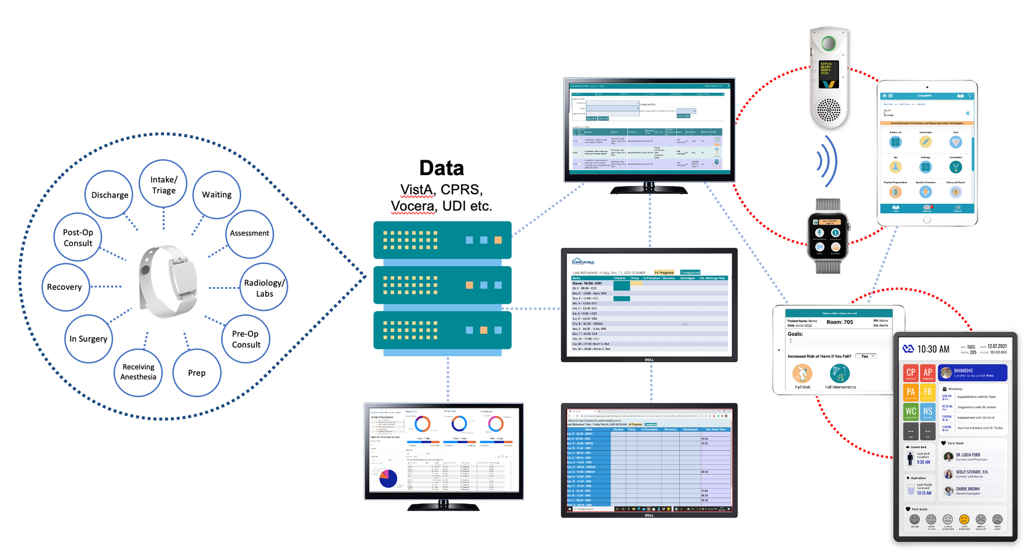
CASE STUDY
INTEGRATED CLINICIAN EXPERIENCE
CUSTOMER:
Government healthcare system serving 22 counties.
VOICE-DRIVEN DOCUMENTATION ON VOCERA
CHALLENGE
Integrate a myriad of disparate applications and datasets across the care continuum to create an integrated experience for clinicians and staff.
PATIENT DATA SOURCES
(EHR, UDI, CPRS)
CLINICAL DASHBOARD
SOLUTION
Integrated platform with consolidated EHR instances, aggregation, normalization, and interpretation of disparate data sources, actionable analytics and insights, visual optimization, and workflow automation using AI and IoT devices.
NURSING SIGNAGE
DYNAMIC PATIENT TRACKING
IN-ROOM
DIGITAL WHITEBOARDS
REPORTING & ANALYTICS DASHBOARD
WAITING ROOM SIGNAGE

Slide 30
WWT Splunk Business Development (Presales)
• Splunk Workshops
• Consulting
• POC (Proofs of Concepts)
• Technology integrations
• Business Value Assessments (BVA)
• Total Cost of Ownership (TCO)
• Return on Investment (ROI)
• Business Process integration
• Design and Architecture
• Reference Architectures
• Integrated Value Assessme
WWT Splunk Business Development (Presales)
• Splunk.Observability Workshops
• Consulting
• POC (Proofs of Concepts)
• Technology integrations
• Business Value Assessments (BVA)
• Total Cost of Ownership (TCO)
• Return on Investment (ROI)
• Business Process integration
• Design and Architecture
• Reference Architectures
• Integrated Value Assessment (IVA)
• Security Maturity Model

Slide 31
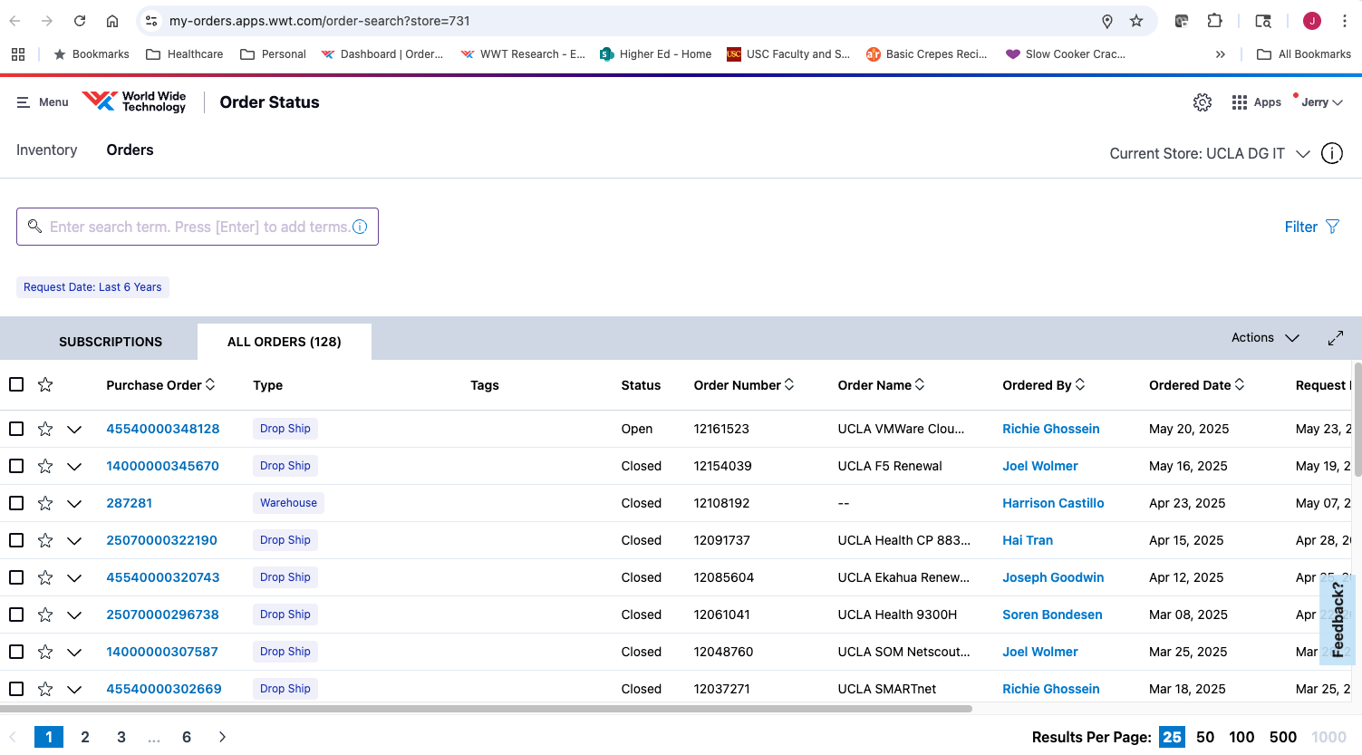

Slide 32
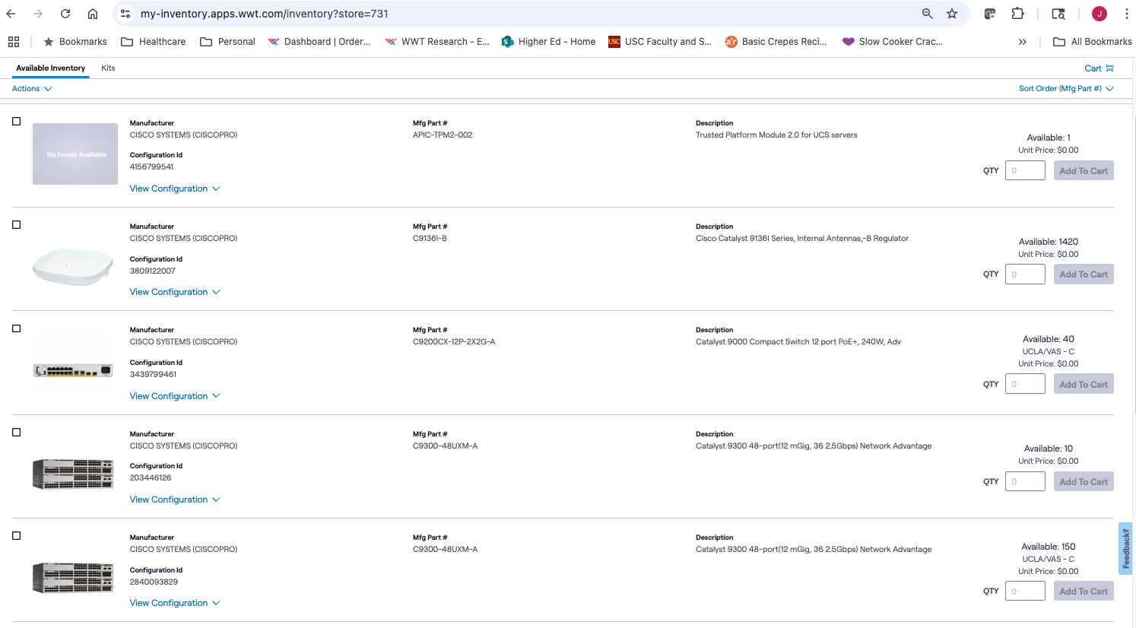

Slide 33
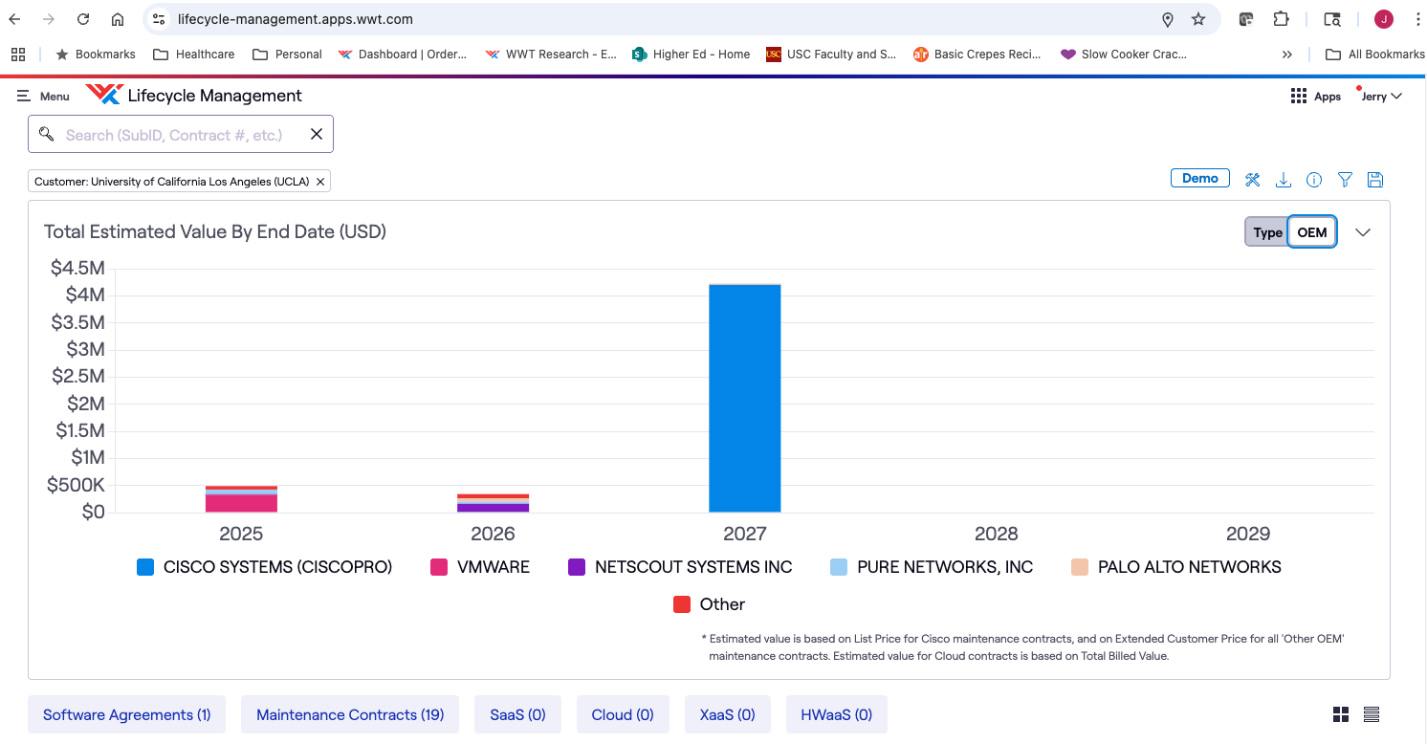

Slide 34
