Slide 1
Cisco License Central
Navigation and How-To
For GEMSS Accounts
July 10, 2025

Slide 2
CLC How-To Sections
CCOID and User Permissions
Login and Landing
Virtual Account Selection
Overview Summary
Filtering
Selecting Devices
Exporting
Tagging
As part of Cisco’s commitment to simplify the licensing experience, we are excited to announce the migration from My Cisco Entitlements (MCE) to Cisco License Central (CLC) — a more streamlined, efficient, and intuitive platform to manage licenses and assets. Participate in a “My Cisco Entitlements to Cisco License Central” training webinar, starting June 18th. Click here to view date options and register today. My Cisco Entitlements will be decommissioned August 31, 2025.

Slide 3
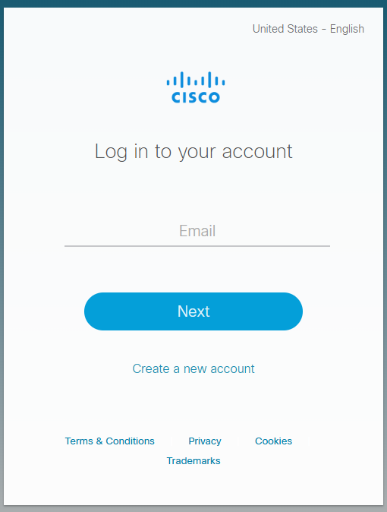
Cisco Connection Online ID (CCOID)
To view a Smart Account, one must have a valid Cisco Account/Profile:
TO CREATE CCO ID/ Cisco Profile - INSTRUCTIONS FOR CUSTOMER - https://www.cisco.com/c/dam/en_us/training-events/training/cx-cco-id-registration.pdf
1. In a web browser, navigate to www.cisco.com
2. Click on Create an Account at the right of the screen
3. Enter the required information. You are required to provide organization contact information.
4. Click on the Submit button at the bottom of screen.
5. The Complete Registration screen displays. Be sure to choose input your Navy Command in the “Organization/Company Name” Field. Please do not use “SELF” or “US Navy”
6. You will be directed to your email account to activate your registration.
7. Check the email account for email with subject “Cisco.com Registration: Action Required.”
8. Click on the cisco.com activation link in the email (or copy and paste into a browser window).
9. The Successful Registration screen displays.
10. You will receive a follow up email confirming your registration with your Email/Cisco User ID.
11. Add Access/Associate to Your Contract Number - Cisco 204215489 Send an email from your .mil account to donhtom@cisco.com to complete contract association.
Must have .mil email address

Slide 4
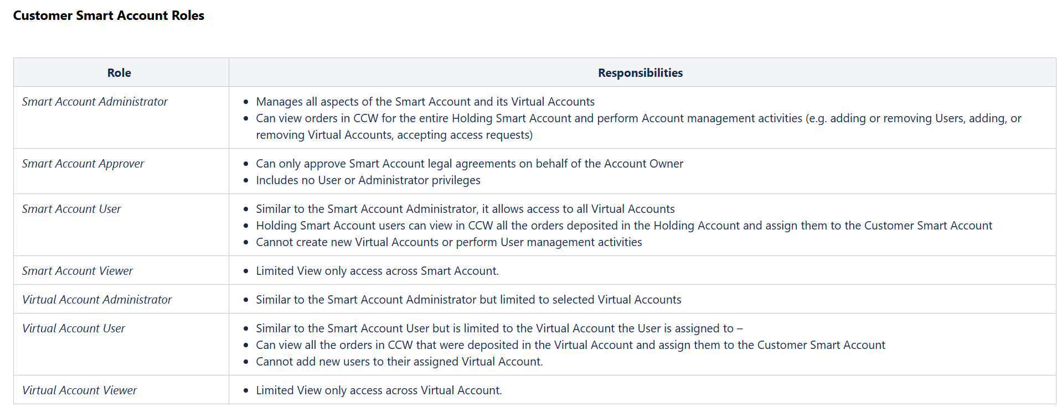
Smart Account Roles/Permissions

Slide 5
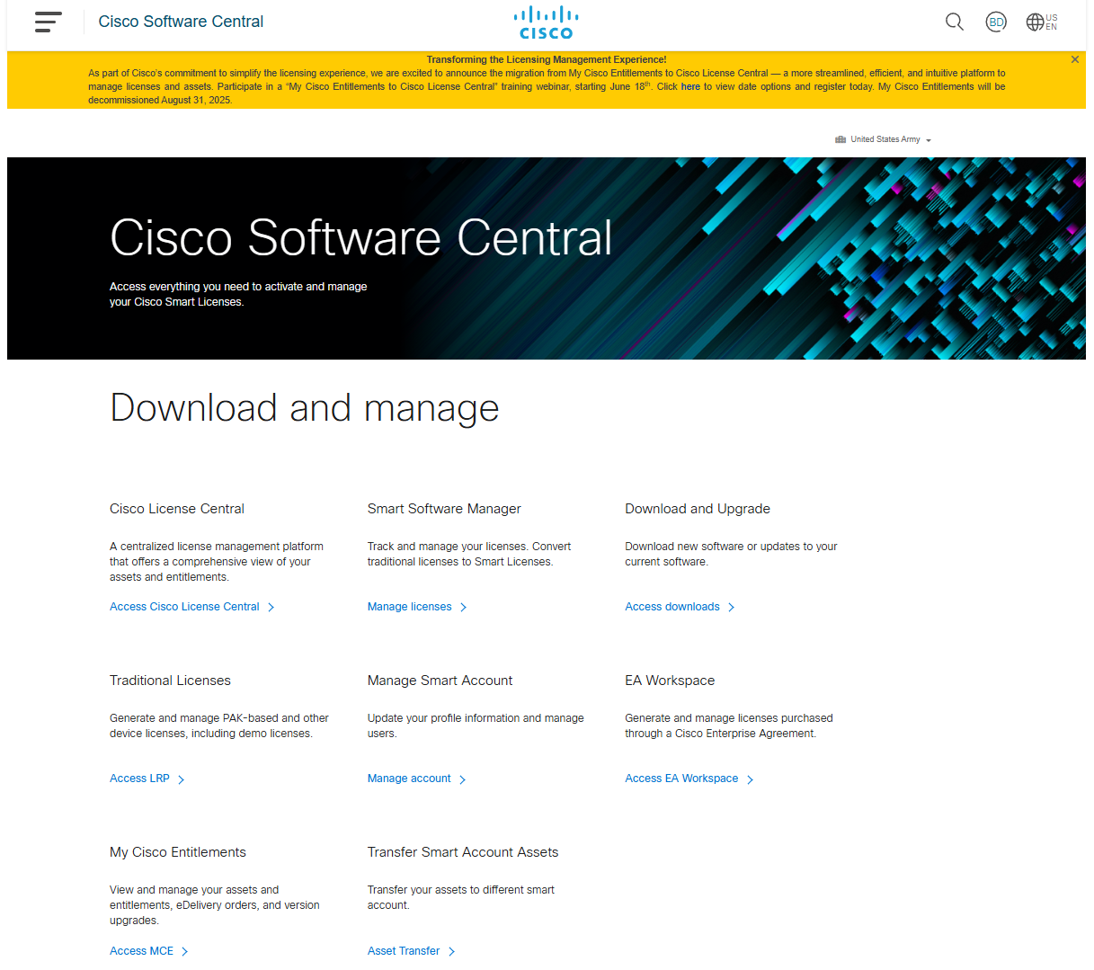
Login and Landing
Click link below to access Cisco Licensing Central.
Login as you would on any Cisco Tool.
You will land on the Overview page.
Cisco Software Central
Cisco License Central (DIRECT LINK)

Slide 6
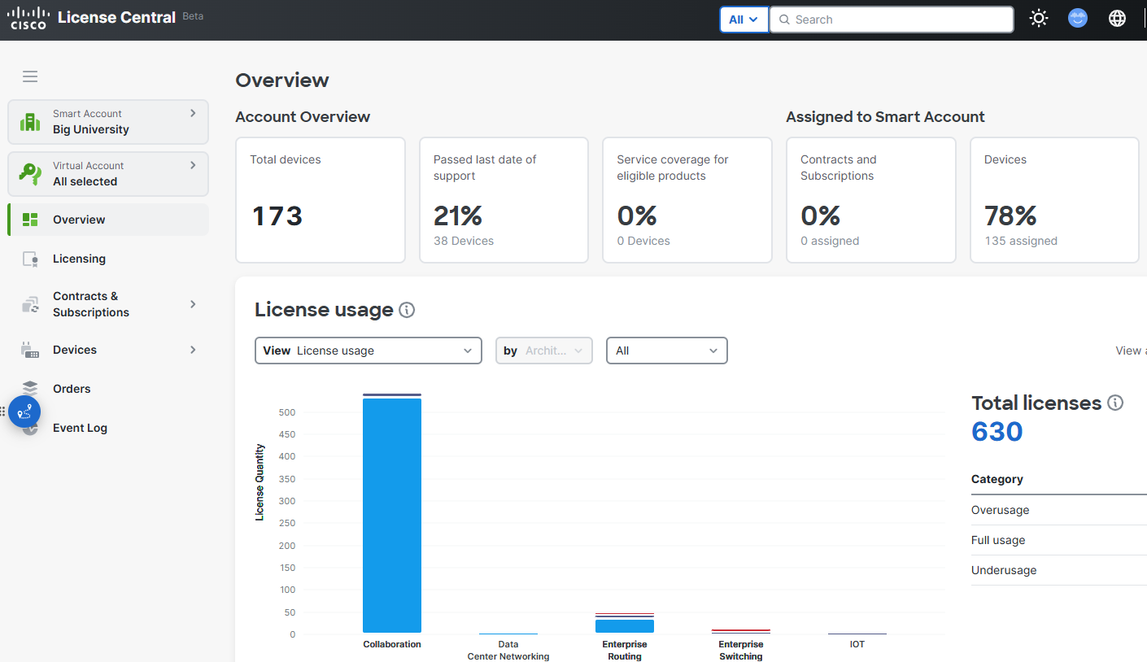
Cisco Licensing Central (CLC)

Slide 7
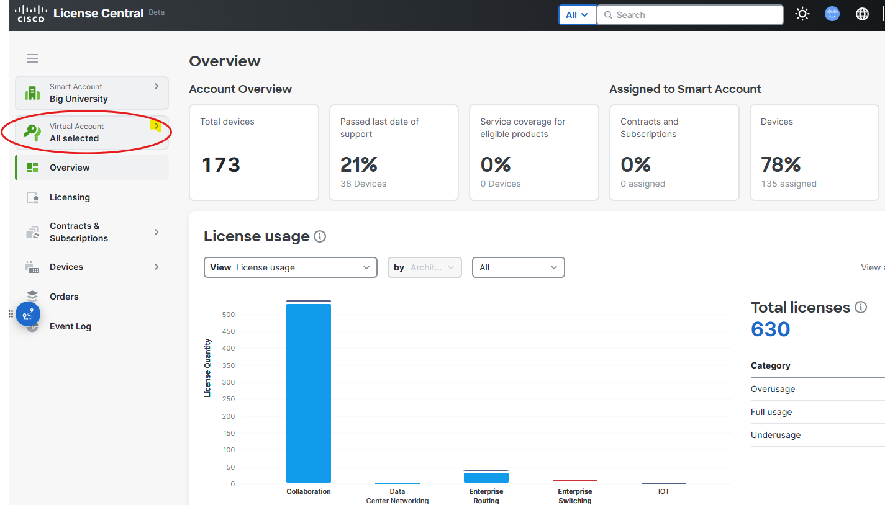
Select Smart Account
& Virtual Account(s)
Hover over the Smart Account tile and search for desired Smart Account and click on your selection. It should be pre-selected according to your access.
Once Smart Account is chosen, hover over Virtual Account and repeat to select desired Virtual Account(s)

Slide 8
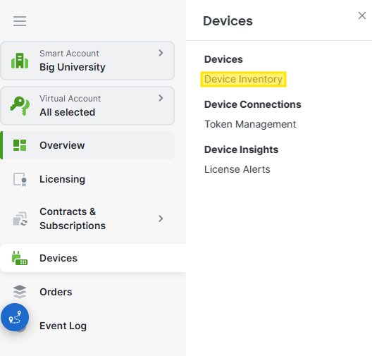
Accessing Device Overview
Hover over Devices on the main menu on the left and select “Device Inventory”
You will see four categories pertaining to your selected account(s). You can filter this data by selecting “Covered”, “Not Covered”, “Approaching LDOS”, “Past LDOS”, etc.

Slide 9
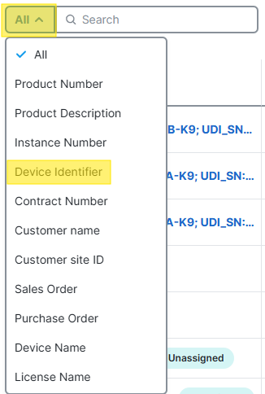
Selecting Inventory
Click on the “All” button below the Summary categories and choose the parameter you wish to search… Device Identifier (Which is the Serial Number), Sales Order number, etc.
You can search up to 100 with comma separated entries.

Slide 10
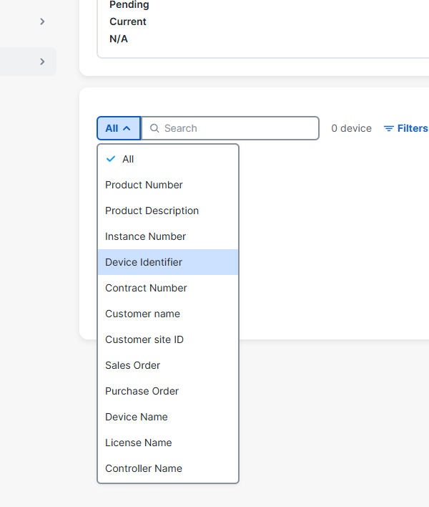
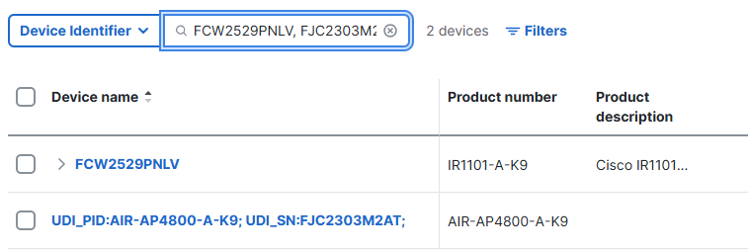
SEARCH BY CATEGORY

Slide 11
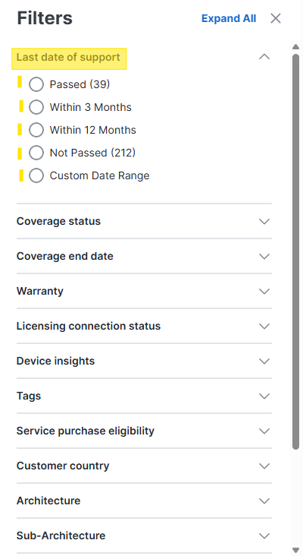
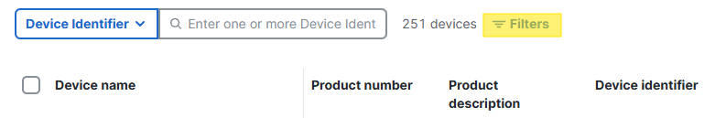
Filtering Search Results
Results can be filtered by multiple parameters.
Click on “Filters” to the right of the Search Dialog box and select or modify any of the available parameters.

Slide 12
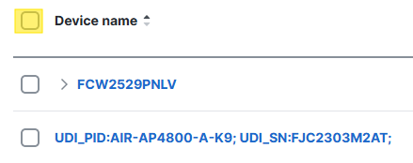
Selecting Items for Export
Selecting In Bulk
Items can be selected individually or in bulk.
The number of results on the screen can be adjusted up to 100.
If results are more than 100, All can still be selected as shown.

Slide 13
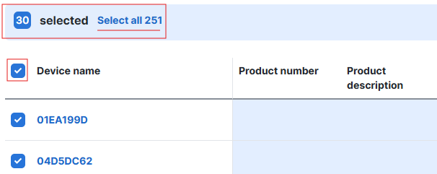
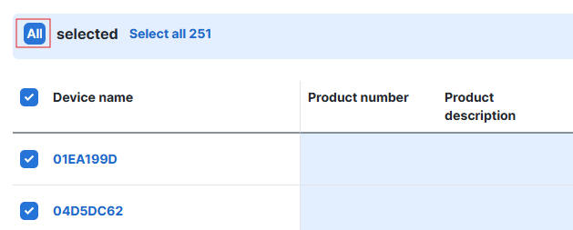
Selecting All
Click on “Select All”

Slide 14
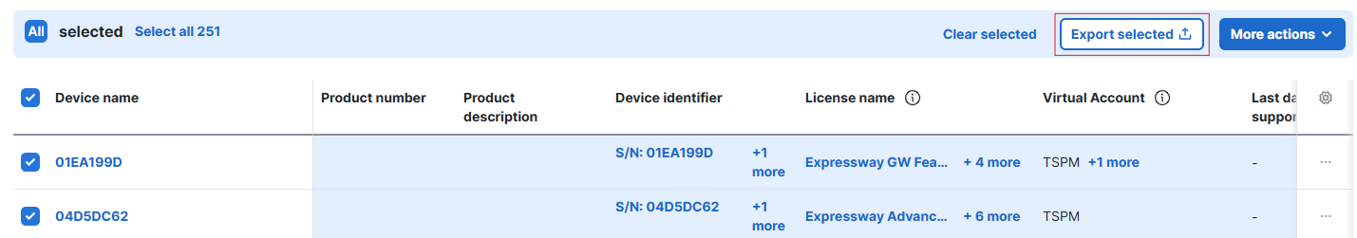
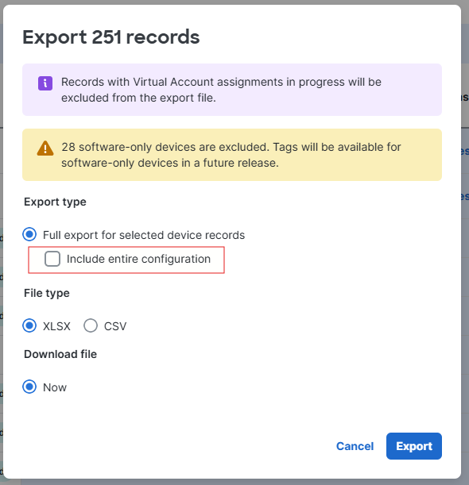
Exporting From CLC
Select Devices to Export and click “Export Selected”.
There may be warnings to alert you to items for which export is delayed or incompatible.
Options include exporting minors and file type.

Slide 15
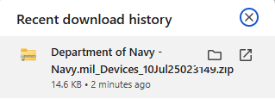
Once you click “Export”, you will be prompted to download through your browser.

Slide 16
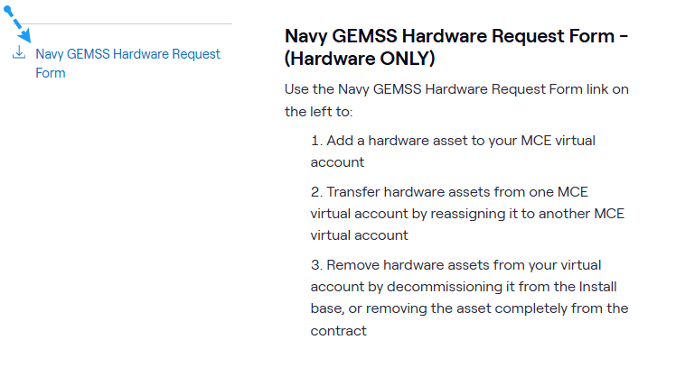
INSTALL BASE (IB) MANAGEMENT
Please utilize the tool and reports to audit your Cisco Install Base.
If you identify any changes to be made, please fill out the Navy GEMSS Hardware Request Form and send to Cisco Asset Management Team: nvassetmgr@cisco.com
Navy GEMSS Hardware Request Form

Slide 17
Cisco

