Slide 1
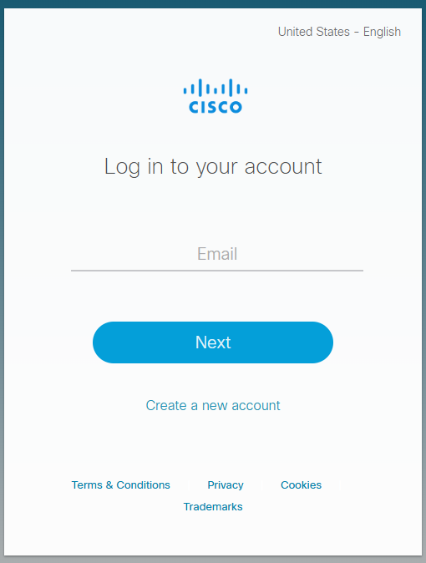
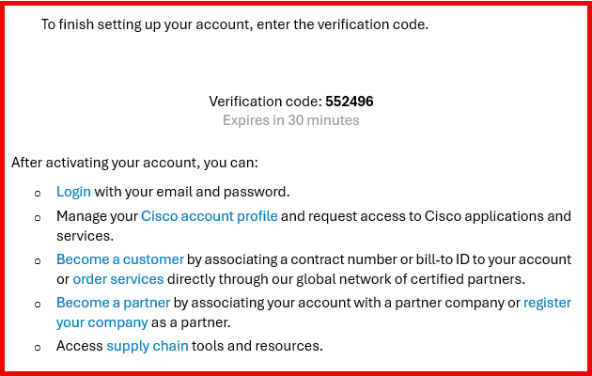
Custodian Form
Creating a Cisco Account/ CCOID
To view assets associated to your command, one must have a valid Cisco Account/Profile:
TO CREATE CCO ID/ Cisco Profile - INSTRUCTIONS FOR CUSTOMER - https://www.cisco.com/c/dam/en_us/training-events/training/cx-cco-id-registration.pdf
In a web browser, navigate to www.cisco.com
Click on Create an Account and enter the required information. Click the Submit button at the bottom of screen.
A Verification code will be delivered to your email address, enter the verification code received to validate the email address (Please see example highlighted in Red).
The Complete Registration screen displays. Be sure to input your Navy Command in the “name, company, address, email ” field. Please do not use “SELF” or “US Navy”.
Select the Access Management tab, and click on Smart Accounts, Request Access to an Existing Smart Account. (Account Domain Identifier: “Navy.mil”) and click Submit.
Reason For Request: Please provide the following - BSO: XX, Virtual Account Name: NXXXXX, Role: User; click Select Request.
Send an email to donhtom@cisco.com, to associate Cisco profile to Navy GEMSS contract – 204215489.
EXAMPLE
Must have .mil email address

